Slide 1
Shared Education
Orritor Primary School and St. Mary’s Primary School
Primary 6 2018/19

Slide 2
Case IV Peace Project
The Case IV Peace Project aims to promote and provide the opportunity for children to access shared education.
Involvement in the Shared Education Peace IV Programme has enabled our schools to foster positive relationships, share and utilise expertise and resources, develop skills and encourage and raise awareness of wellbeing for all.

Slide 3
What Have we Done?
7 days contact
- Maths trail at Parkanaur (Speedwell Trust)
STEM activities at Further Education College, Dungannon
Maths trails and problem solving activities in Orritor Primary School and St. Mary’s Primary School.

Slide 4
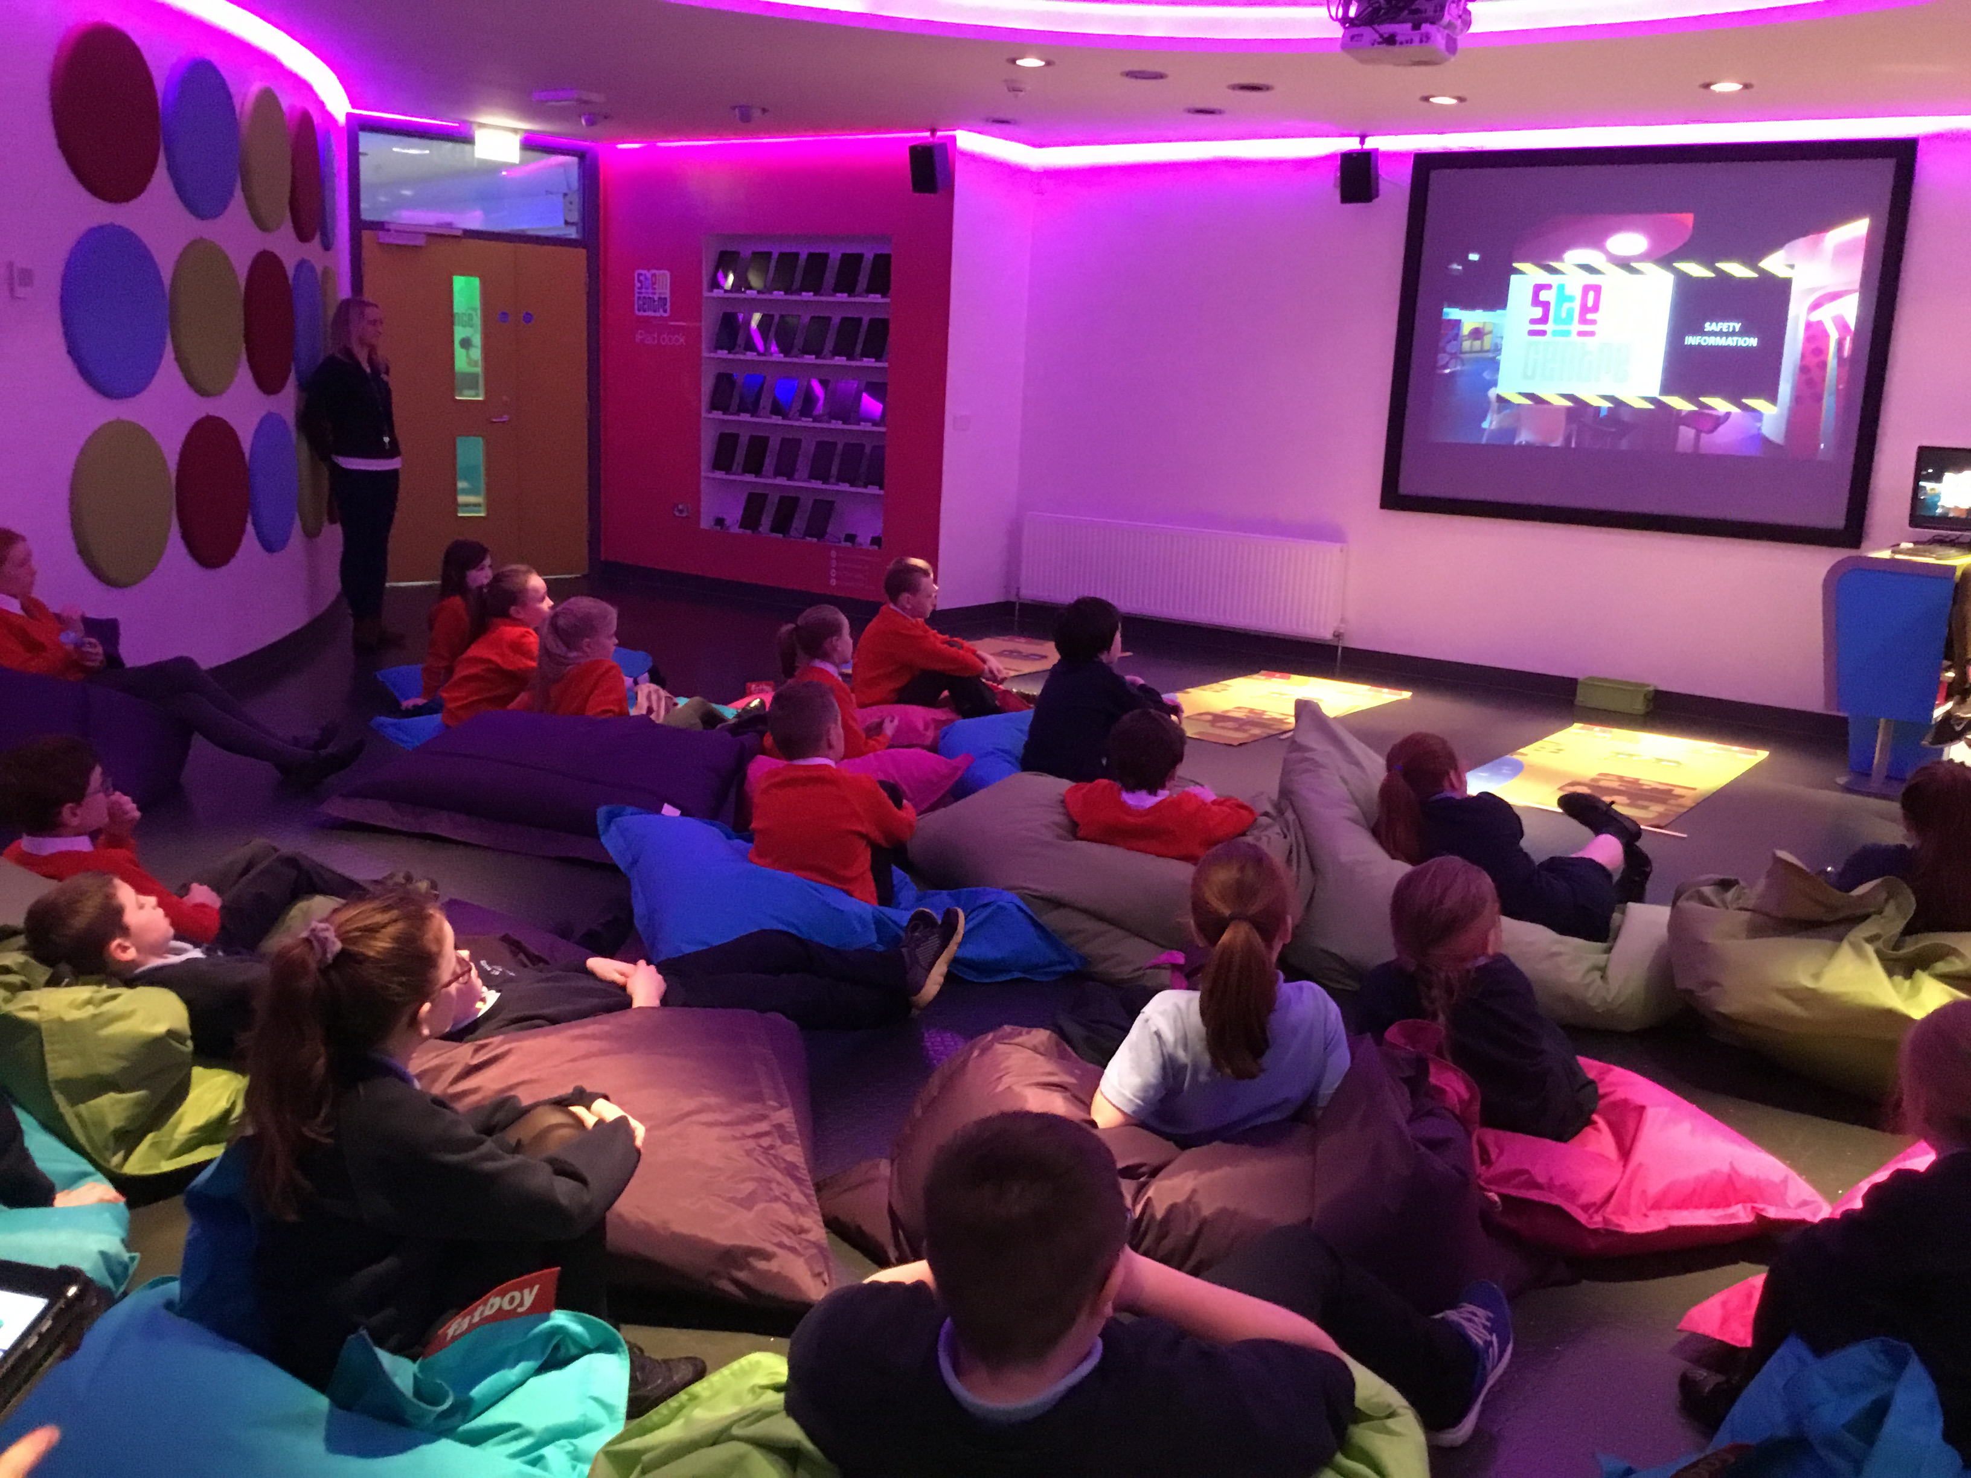
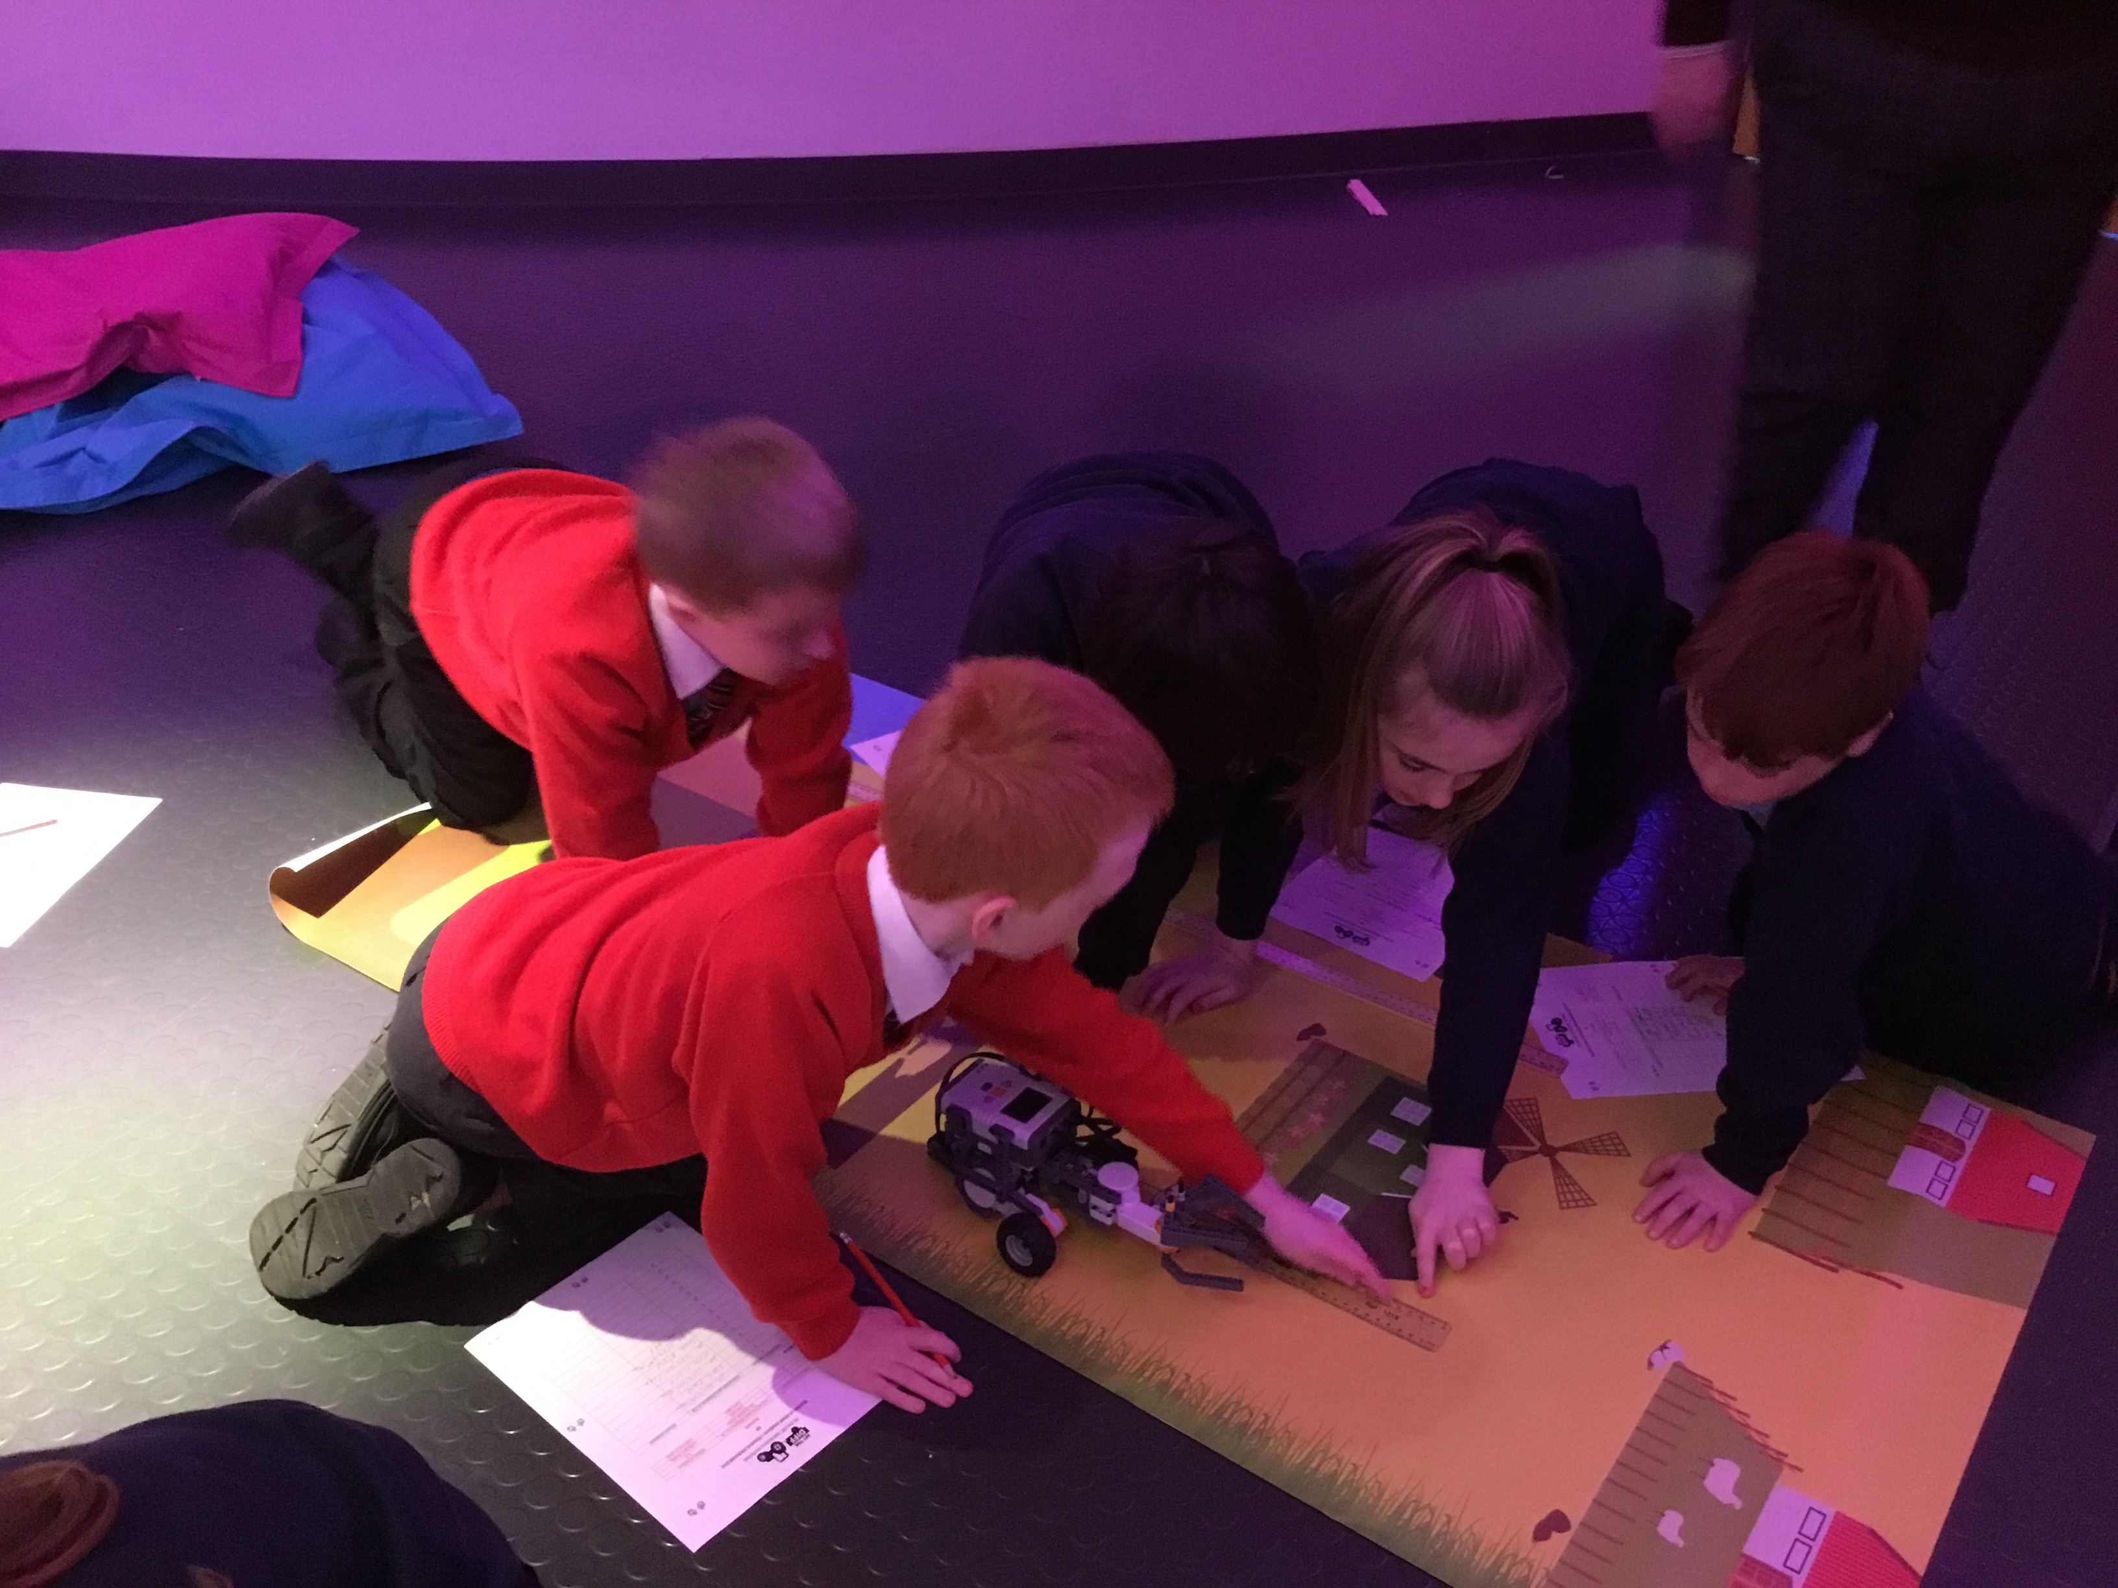
STEM Centre Dungannon

Slide 5
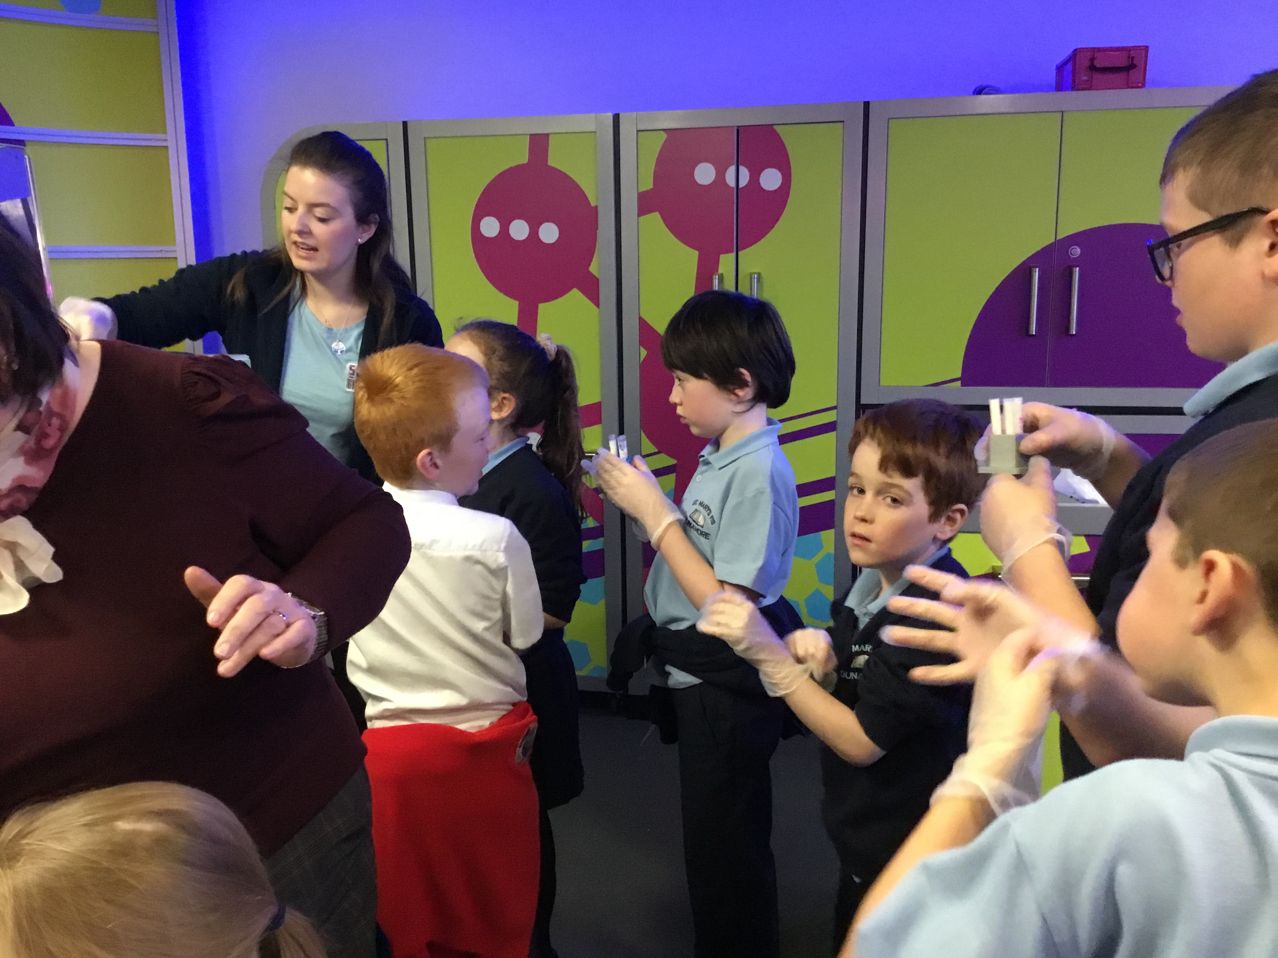
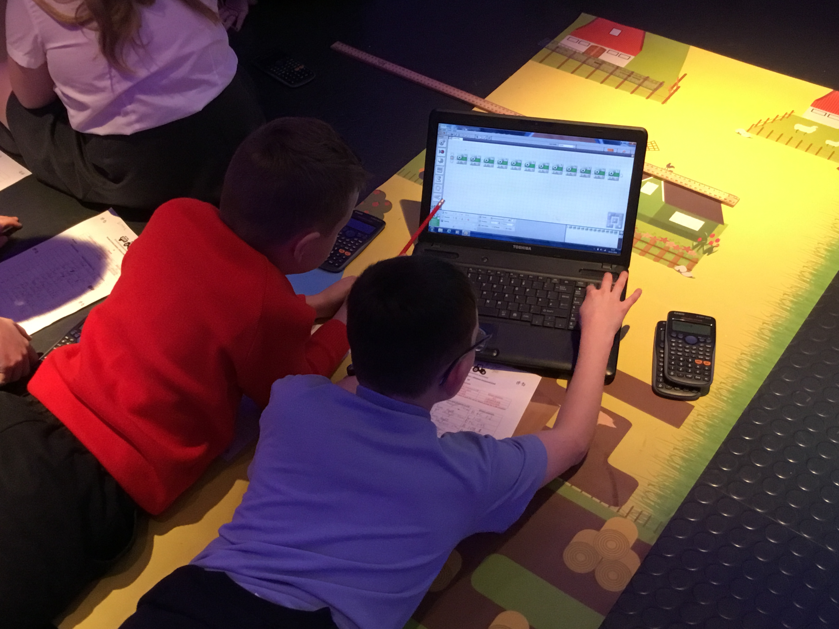

Slide 6
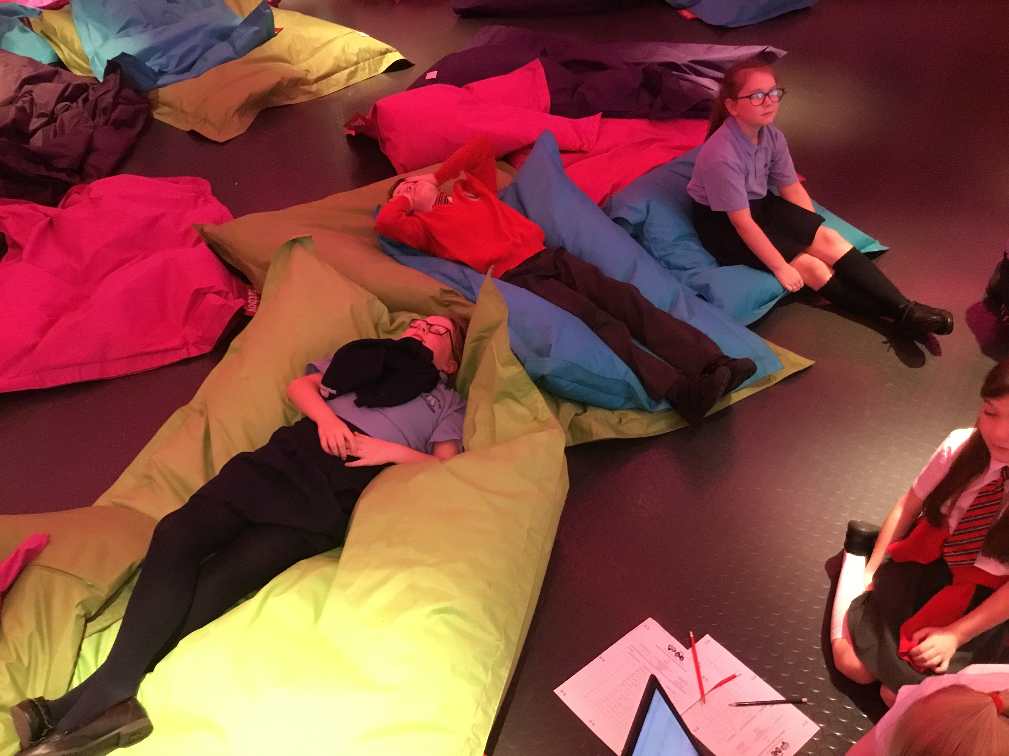
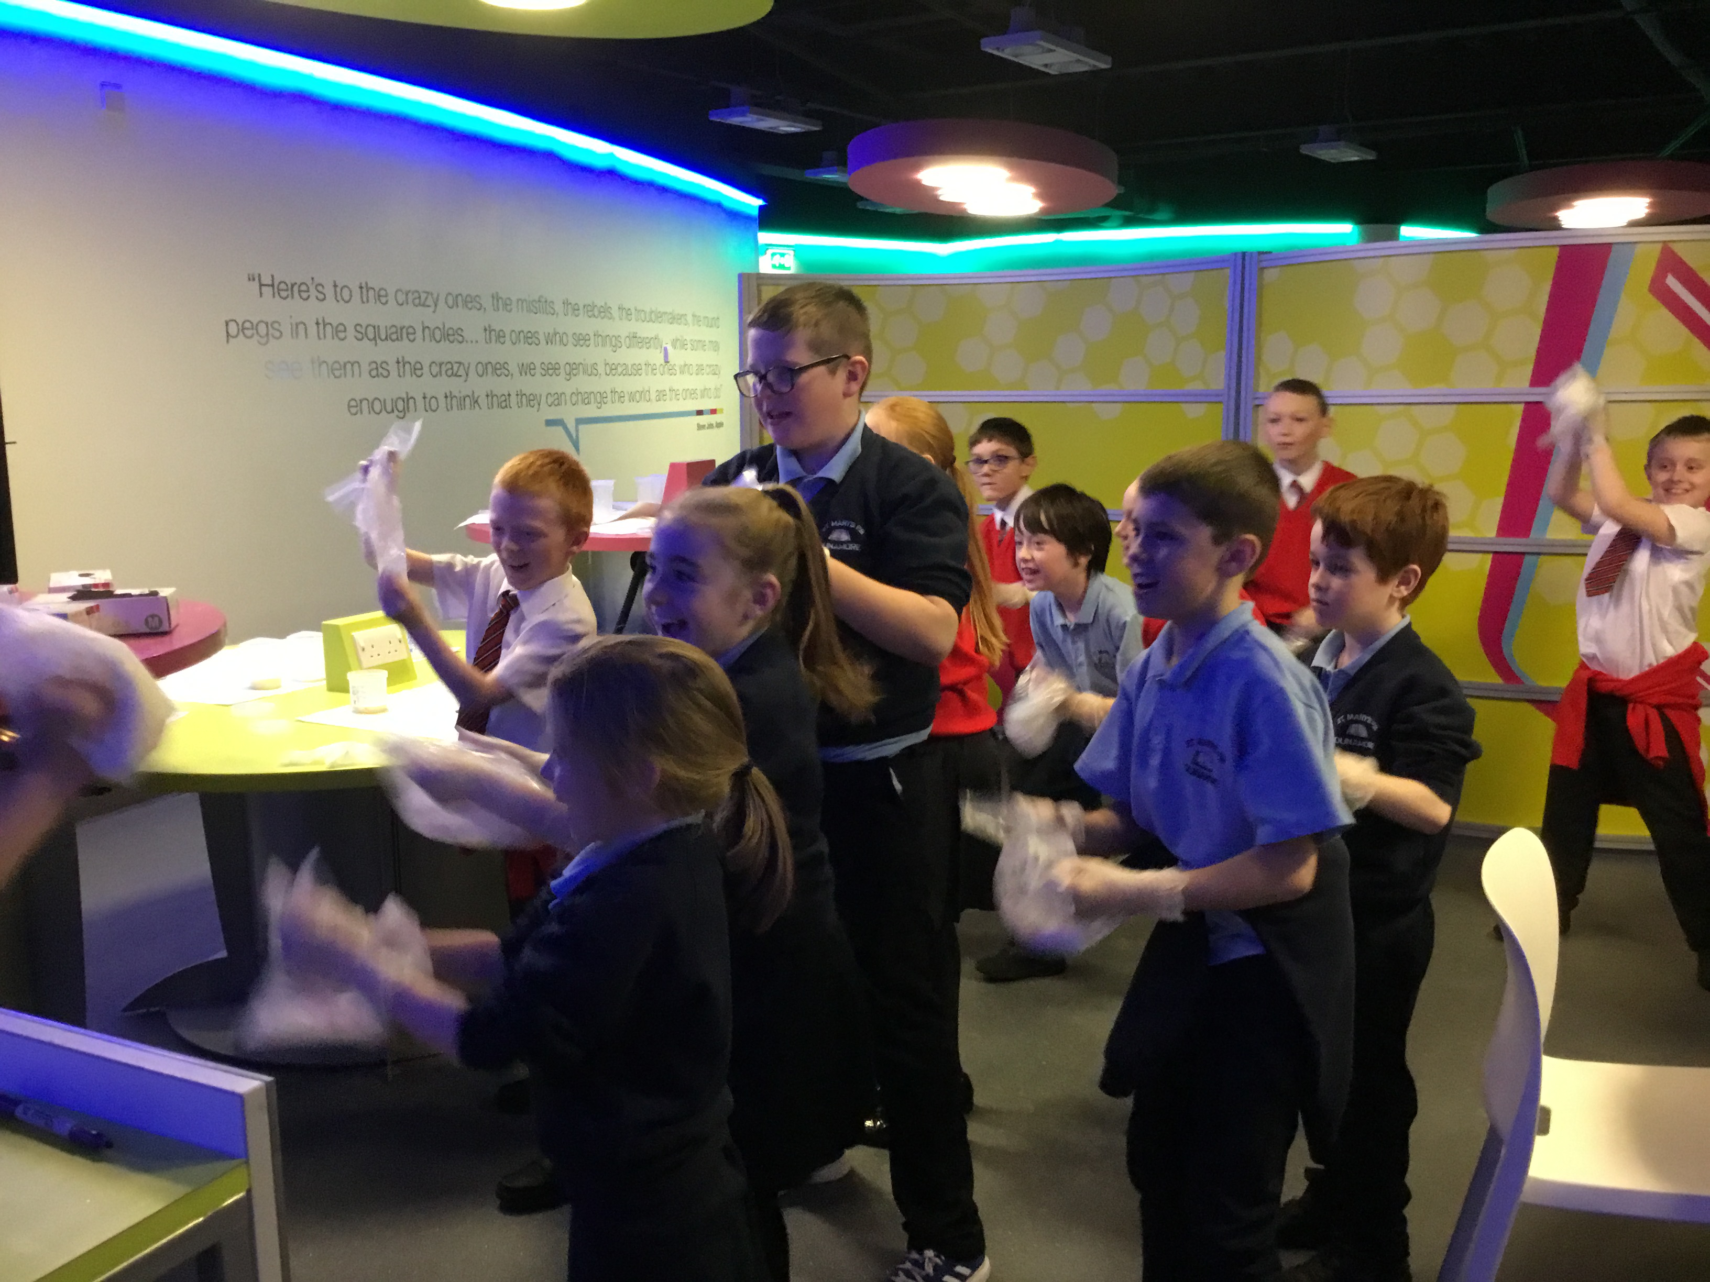

Slide 7
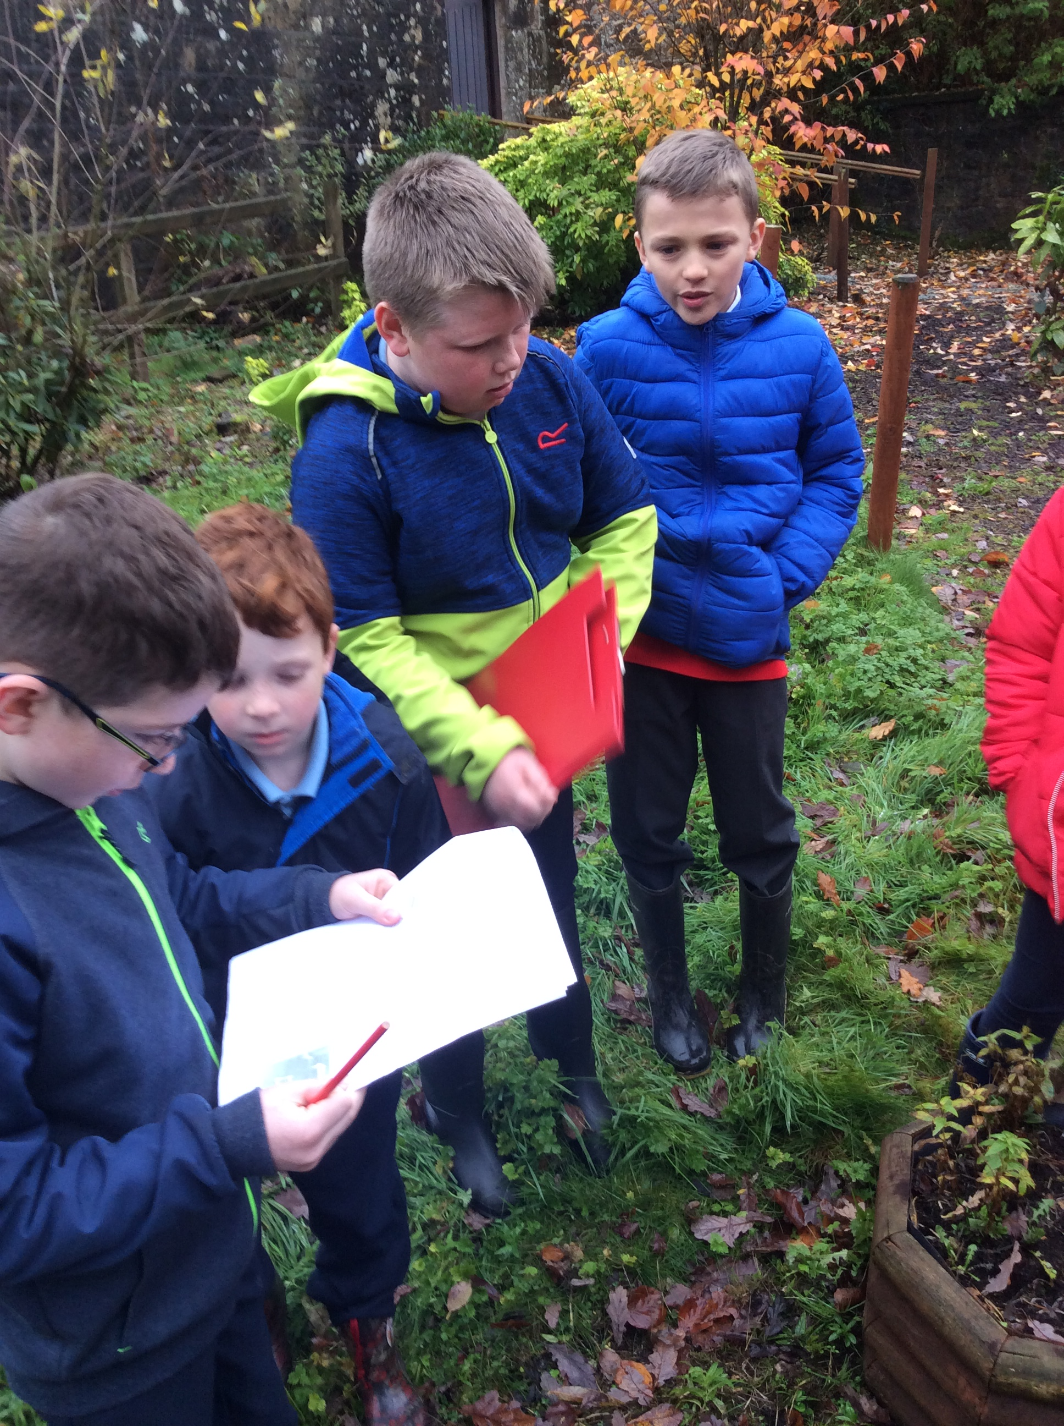
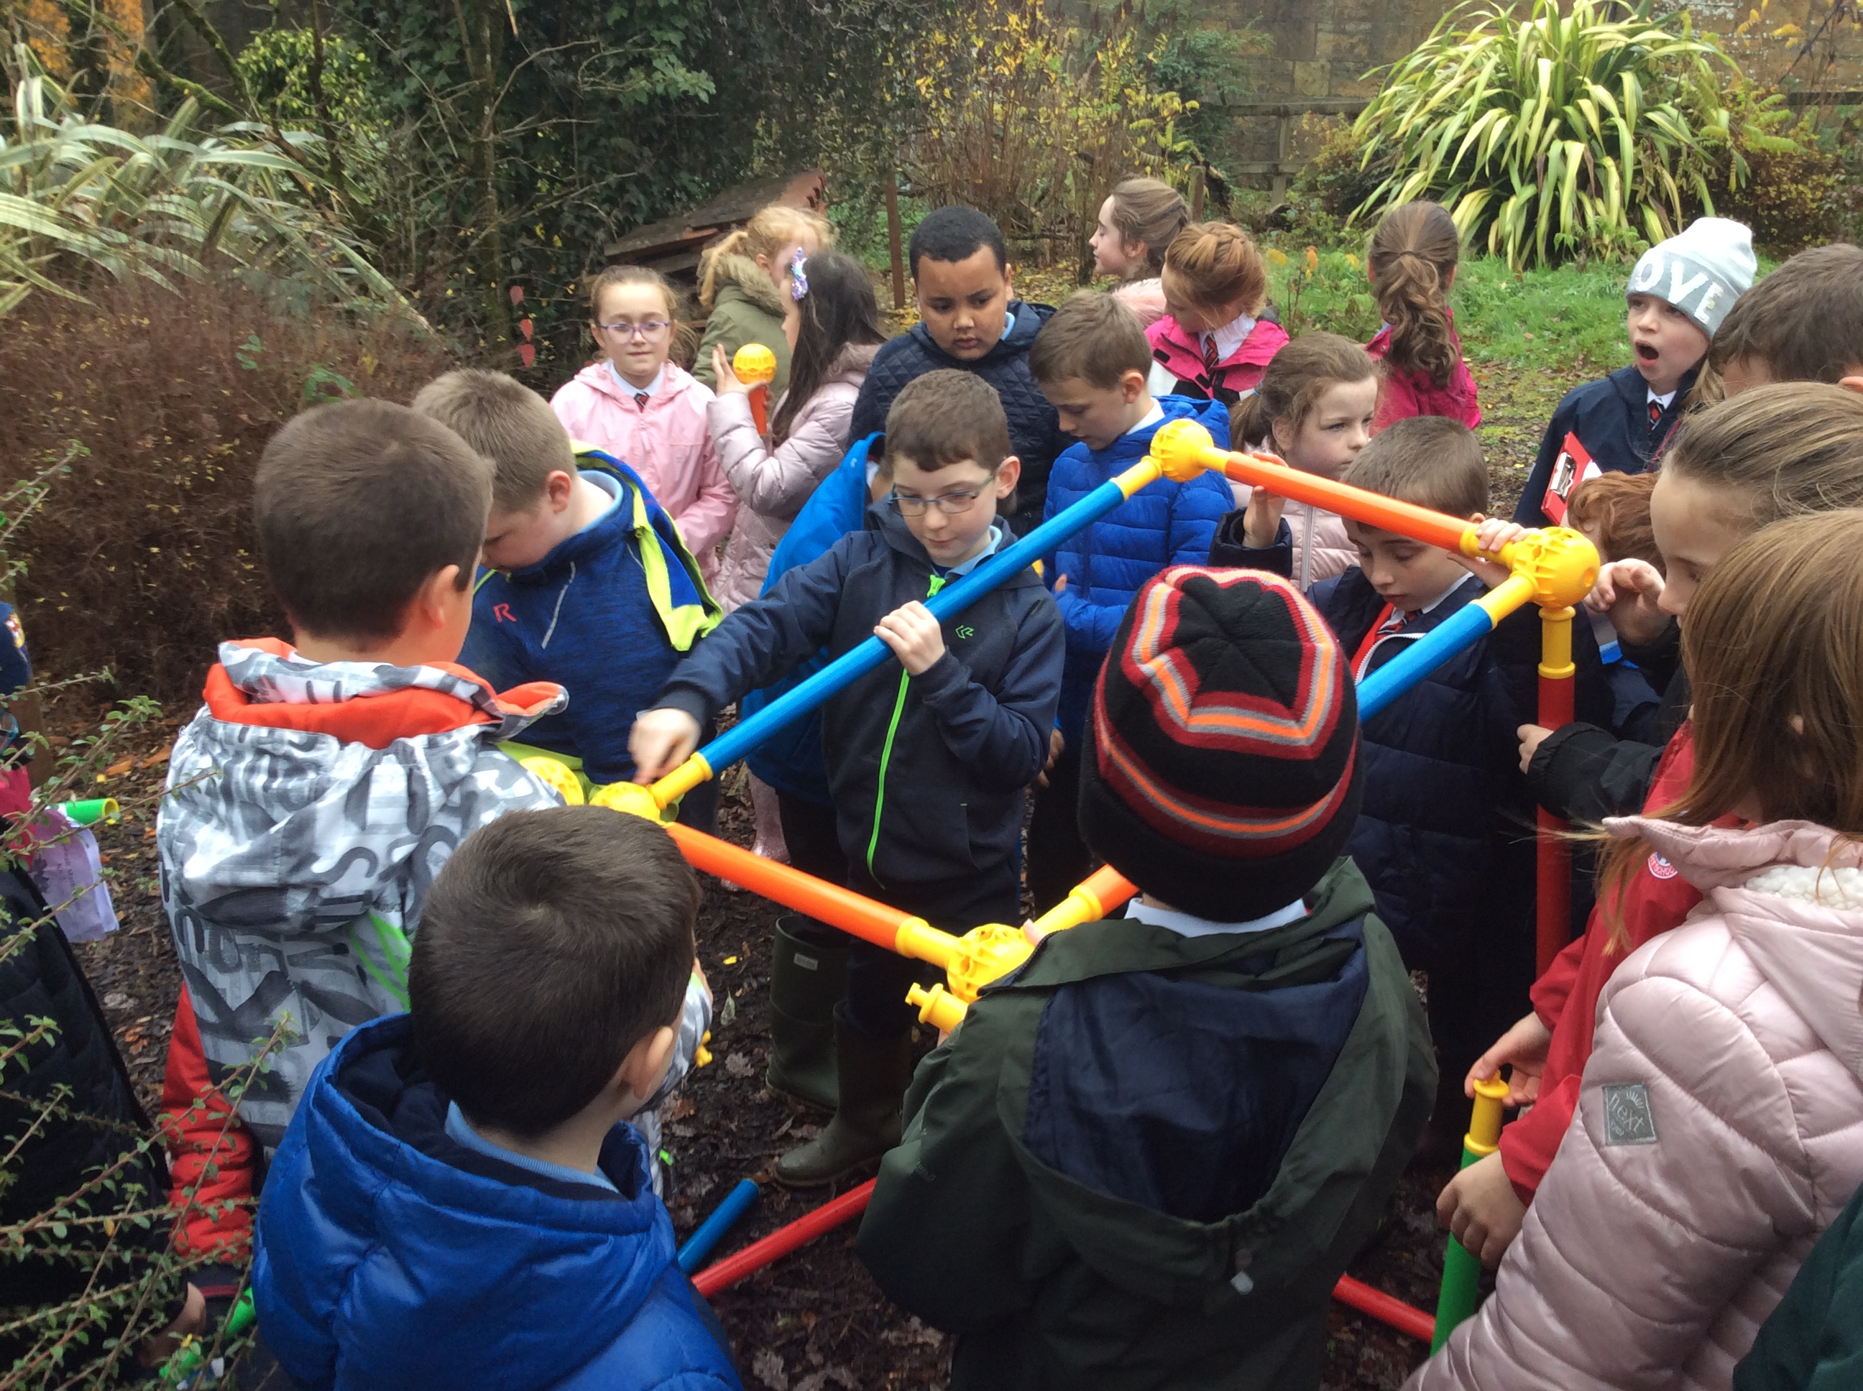
Speedwell Trust at Parkanaur Forest Park

Slide 8
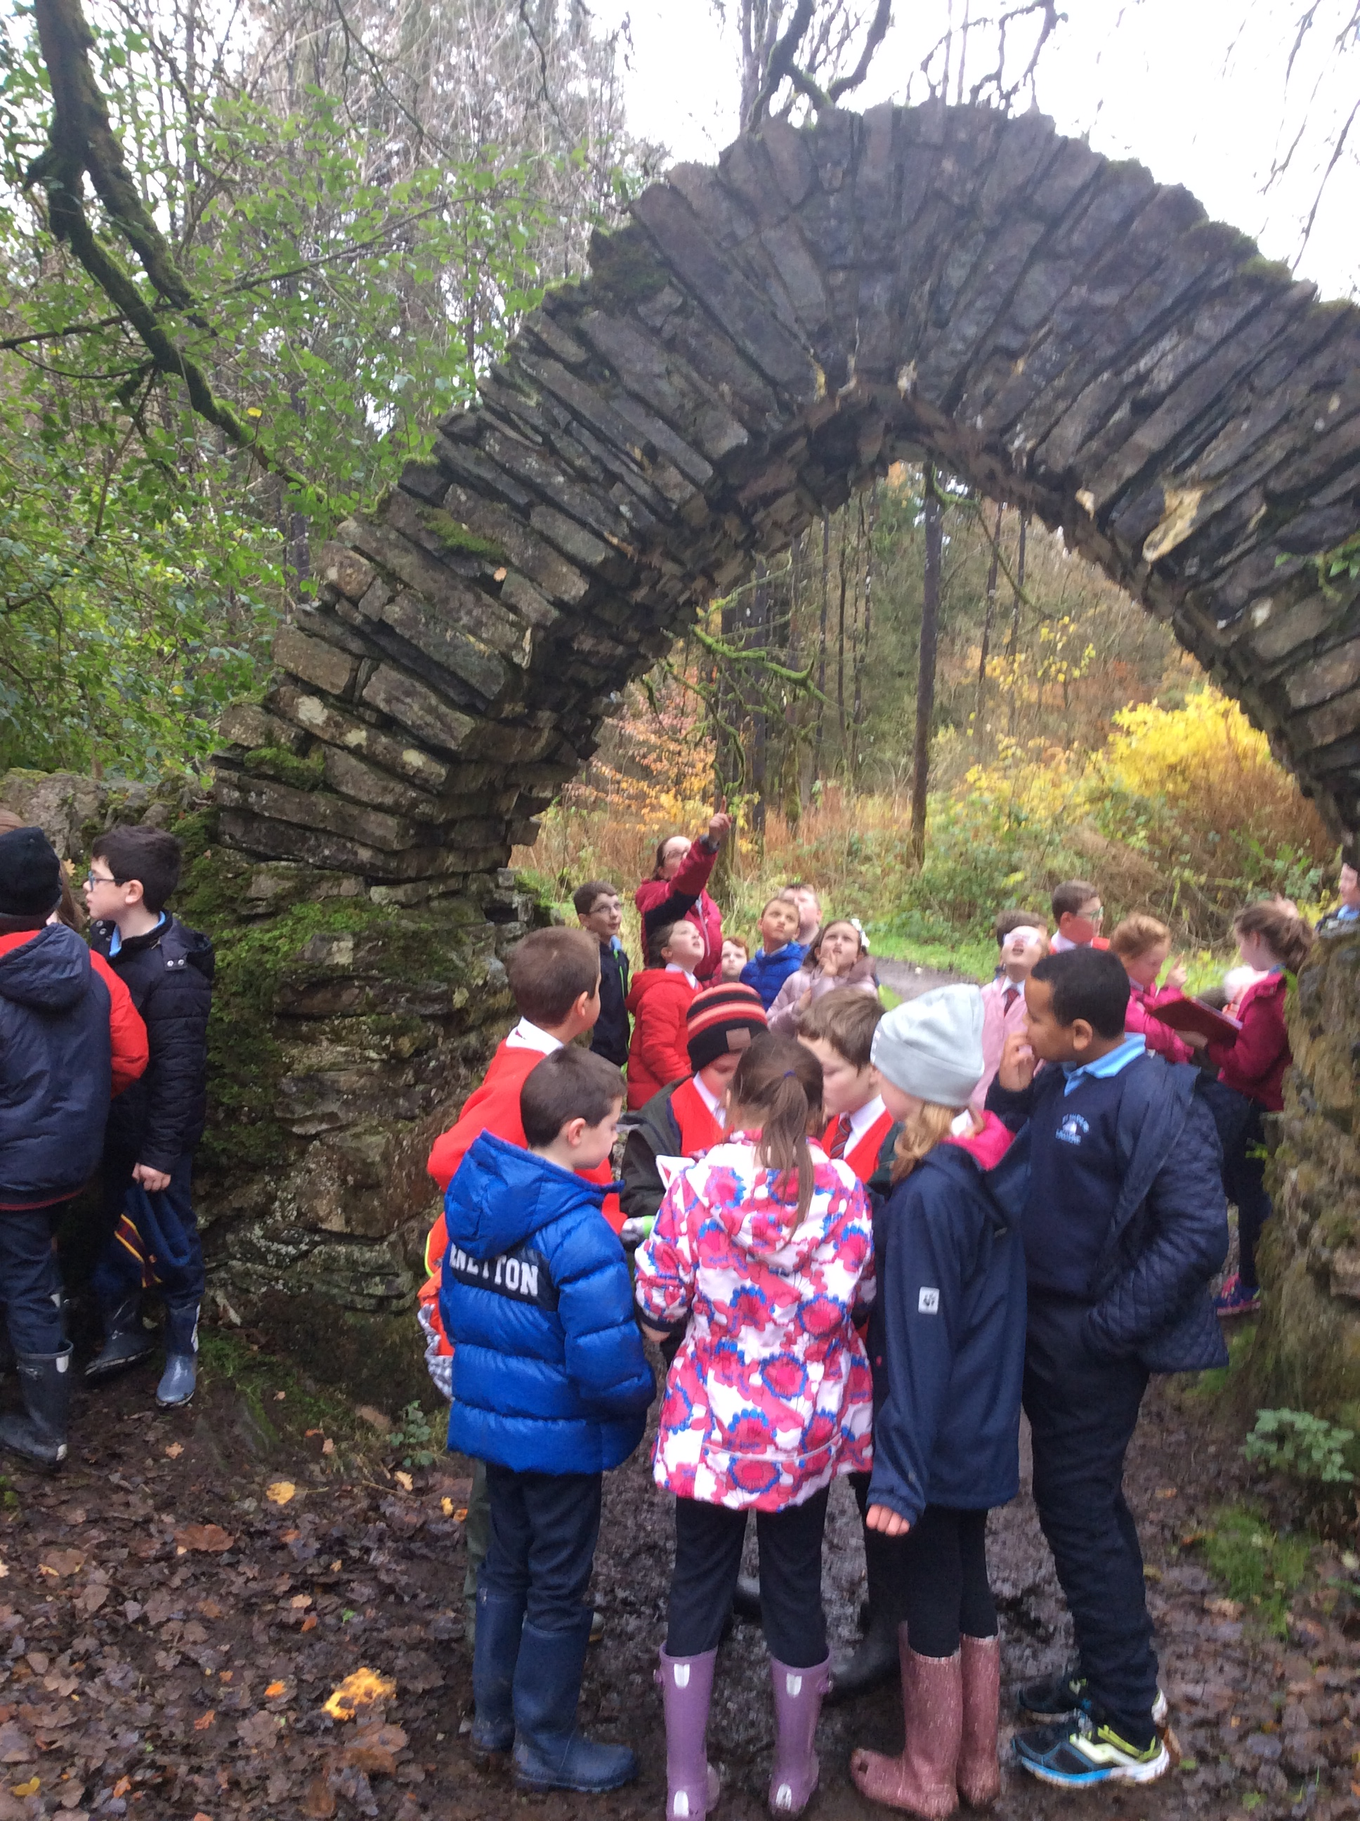
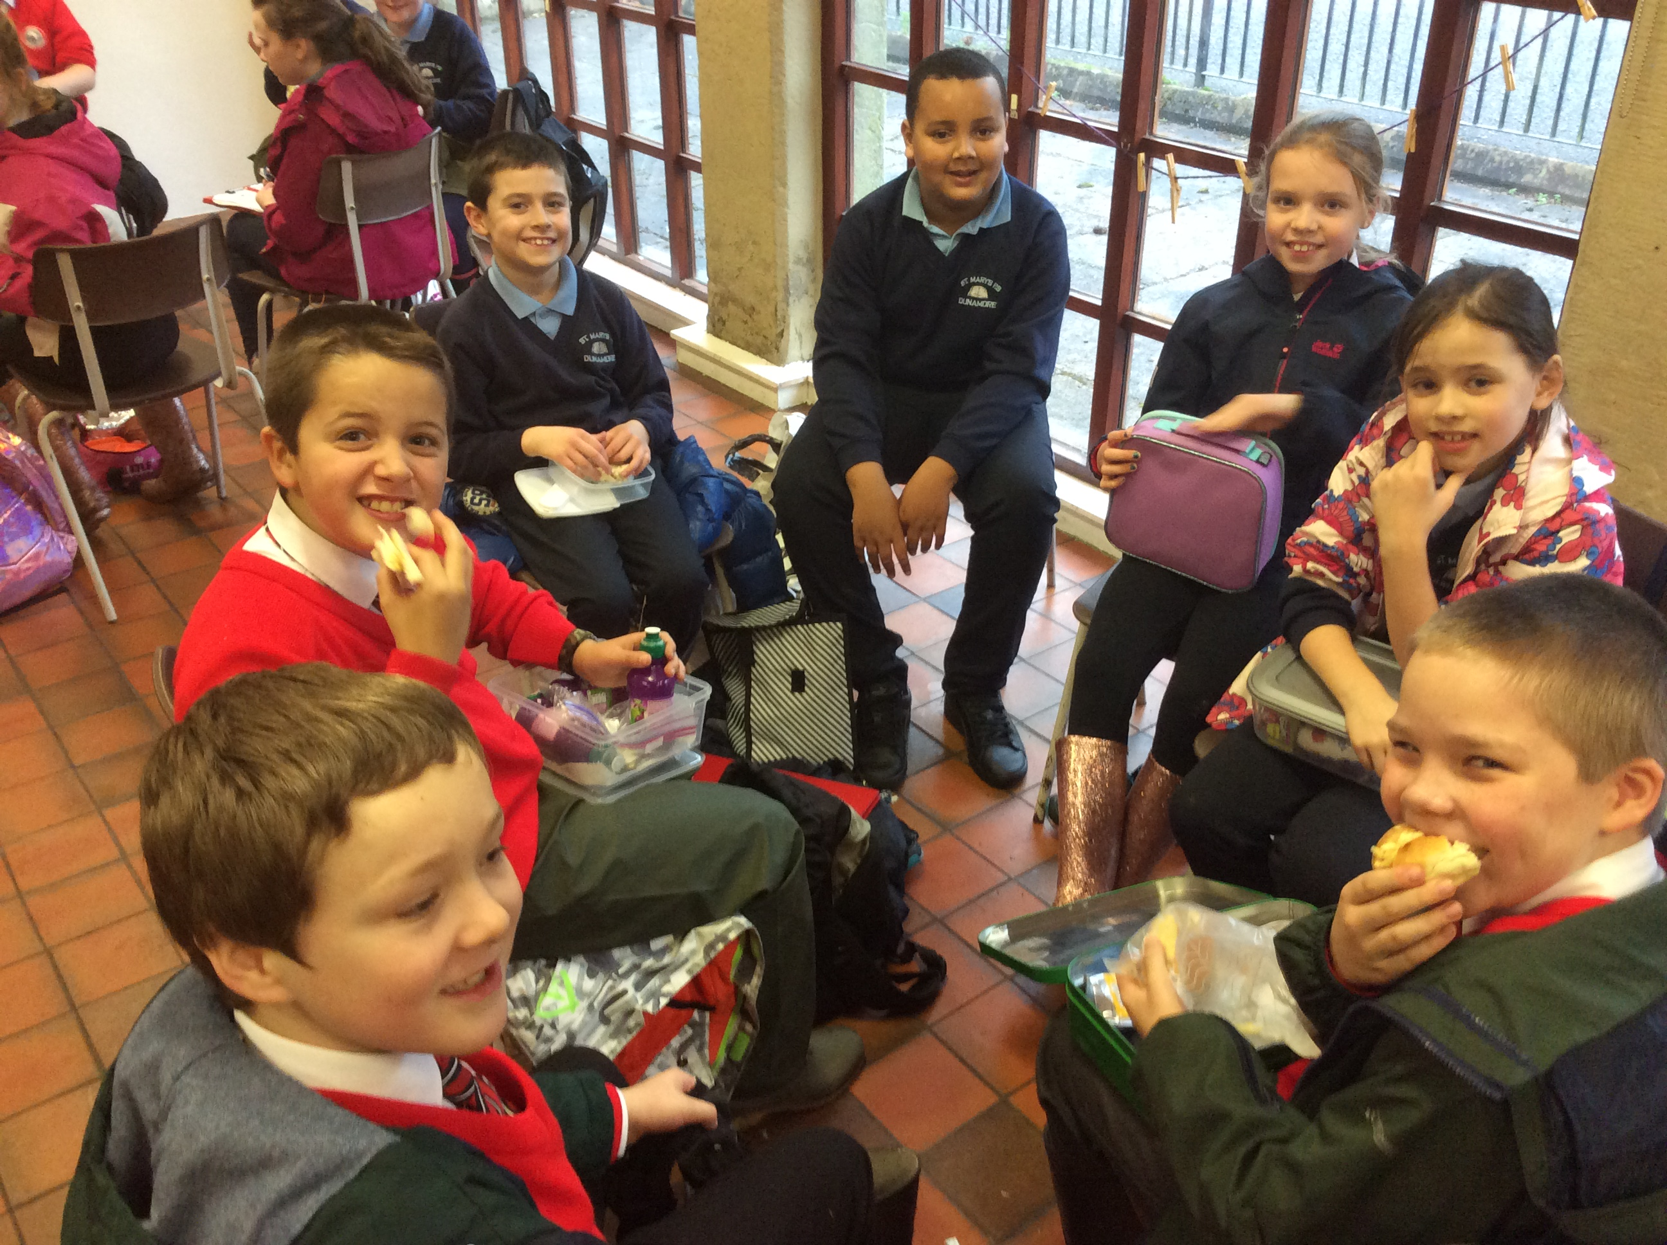

Slide 9
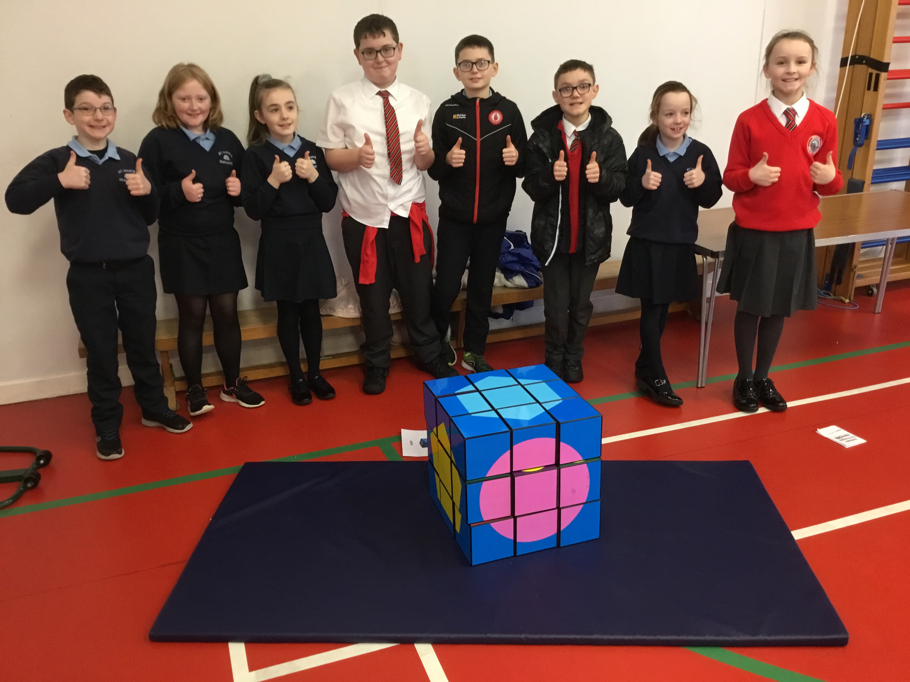
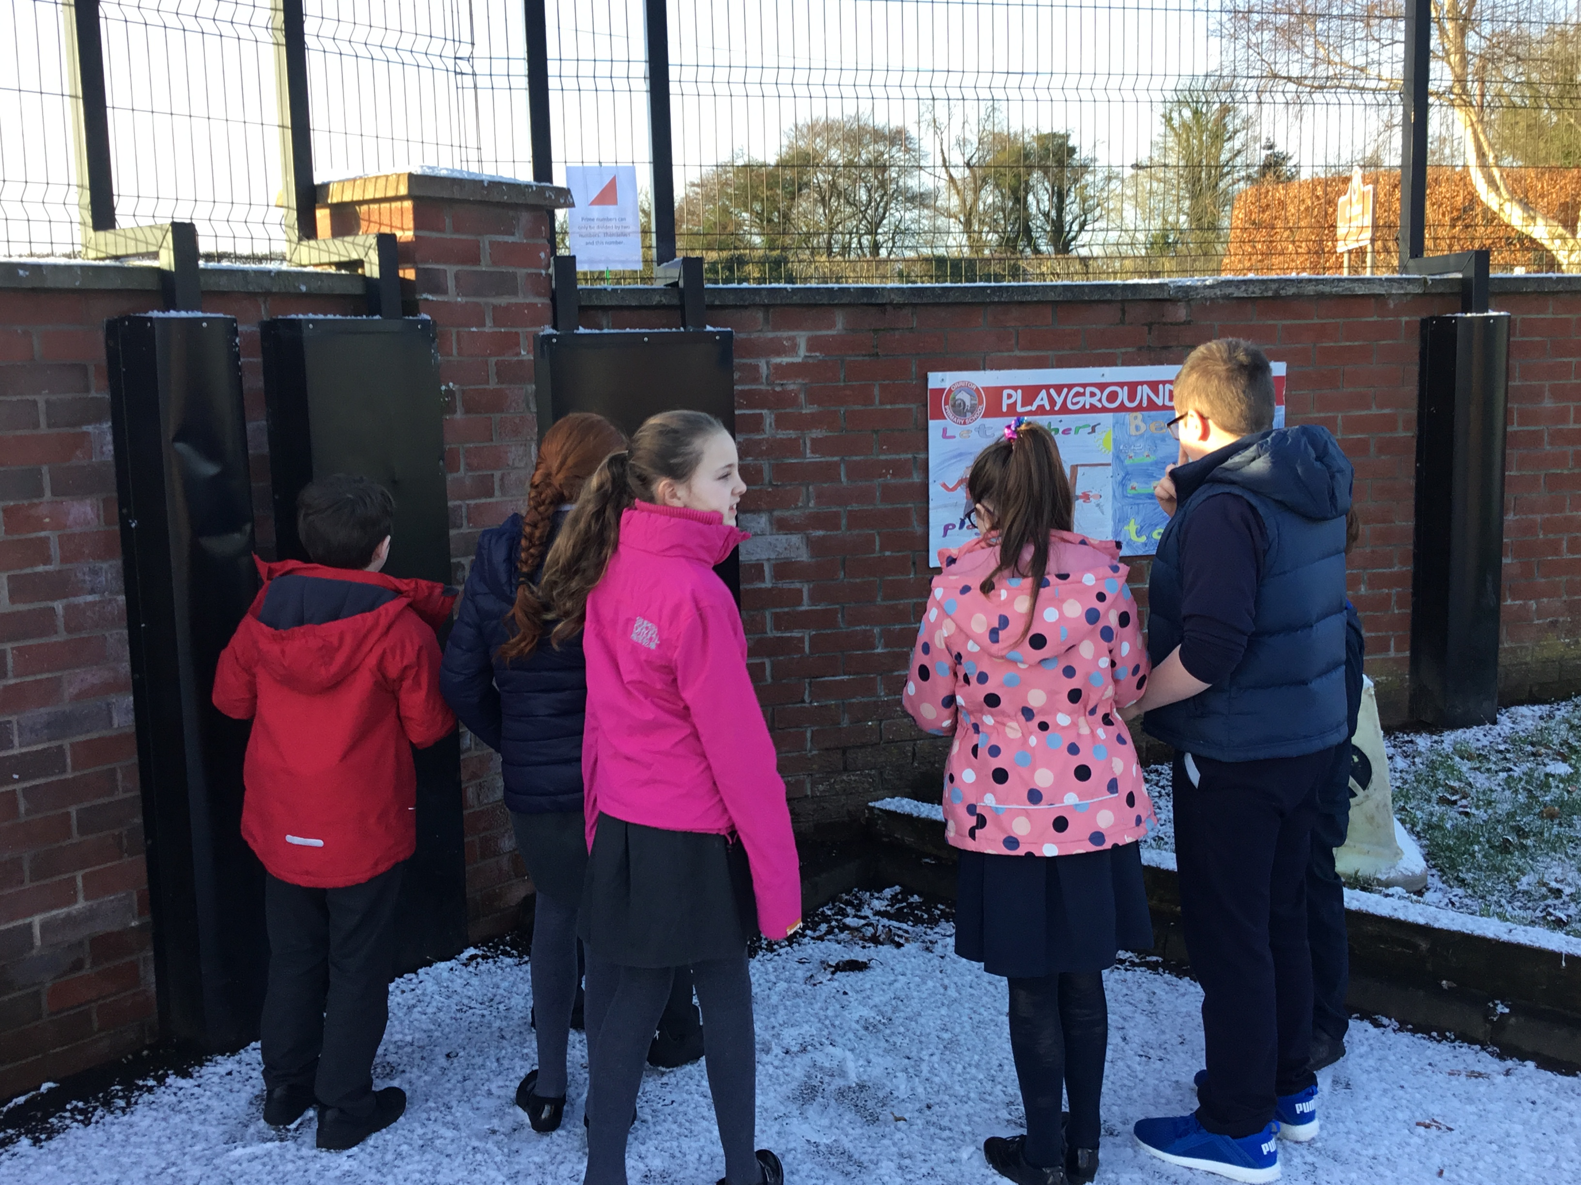
Maths Tasks at Orritor Primary School.

Slide 10
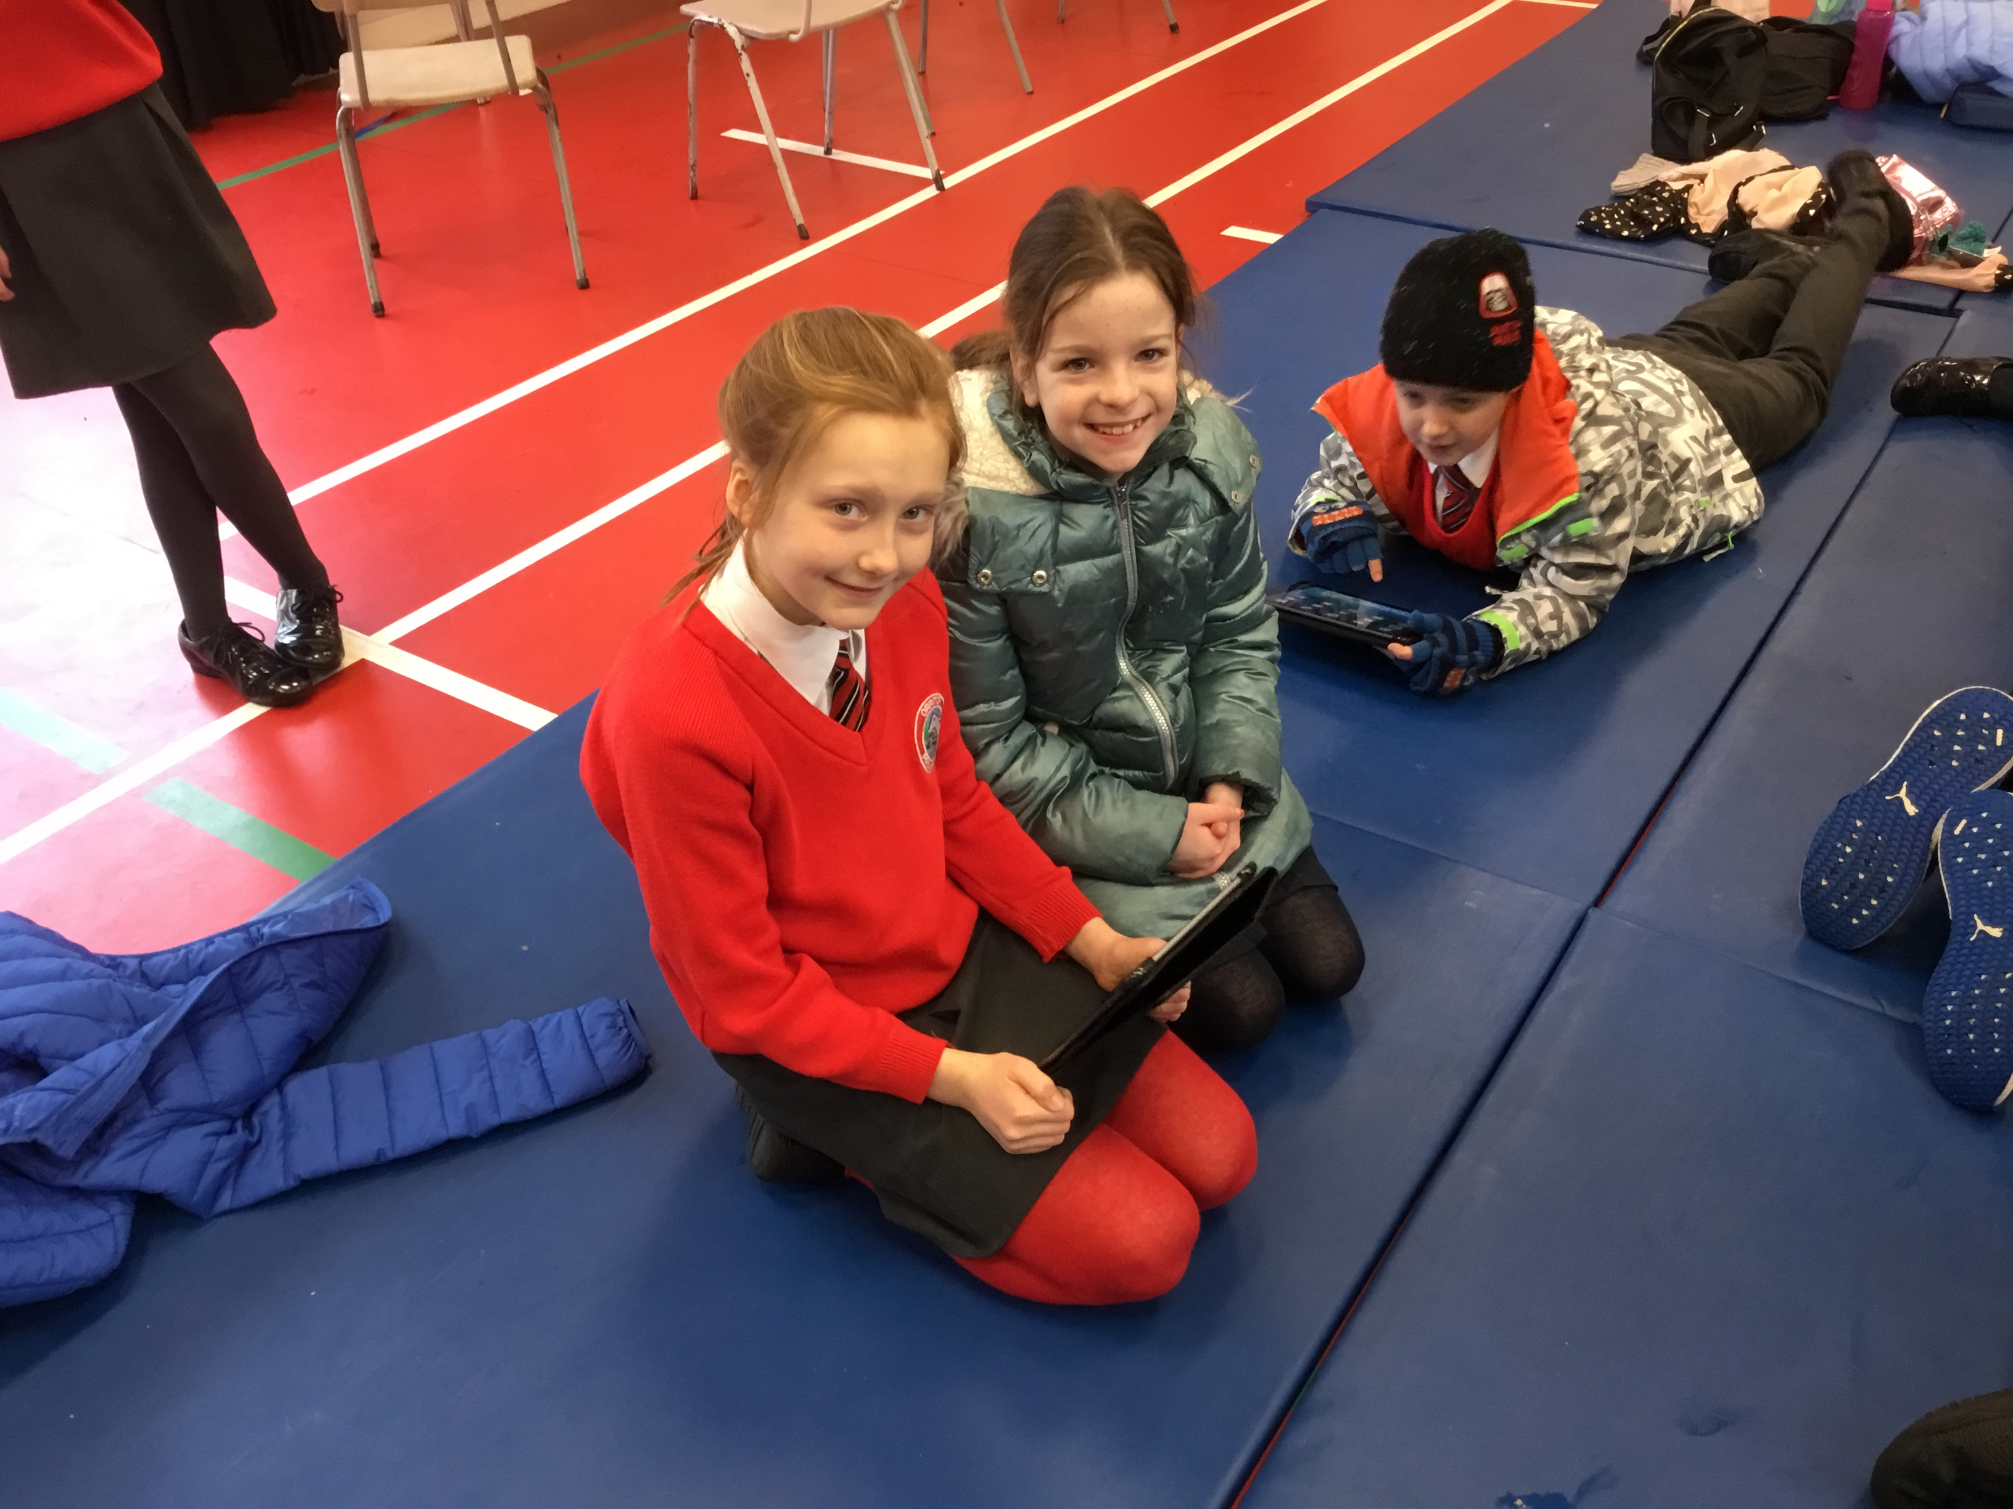

Slide 11
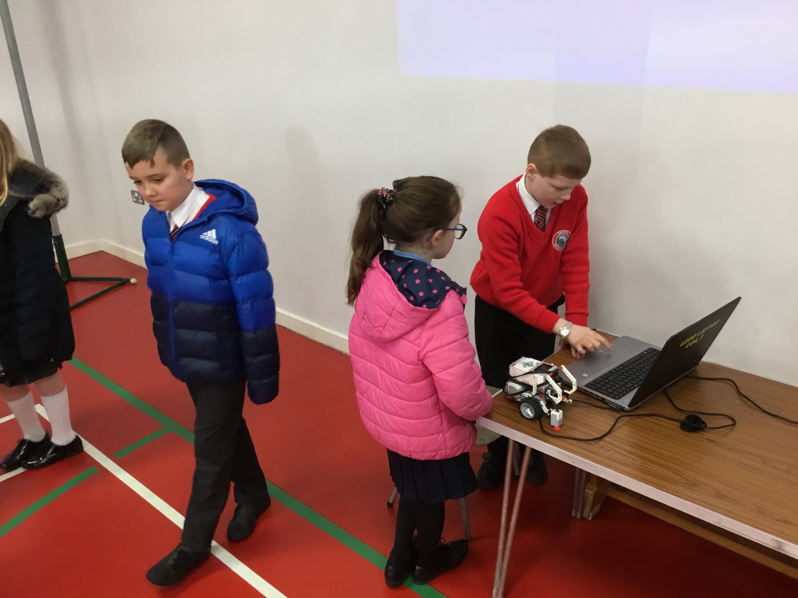

Slide 12
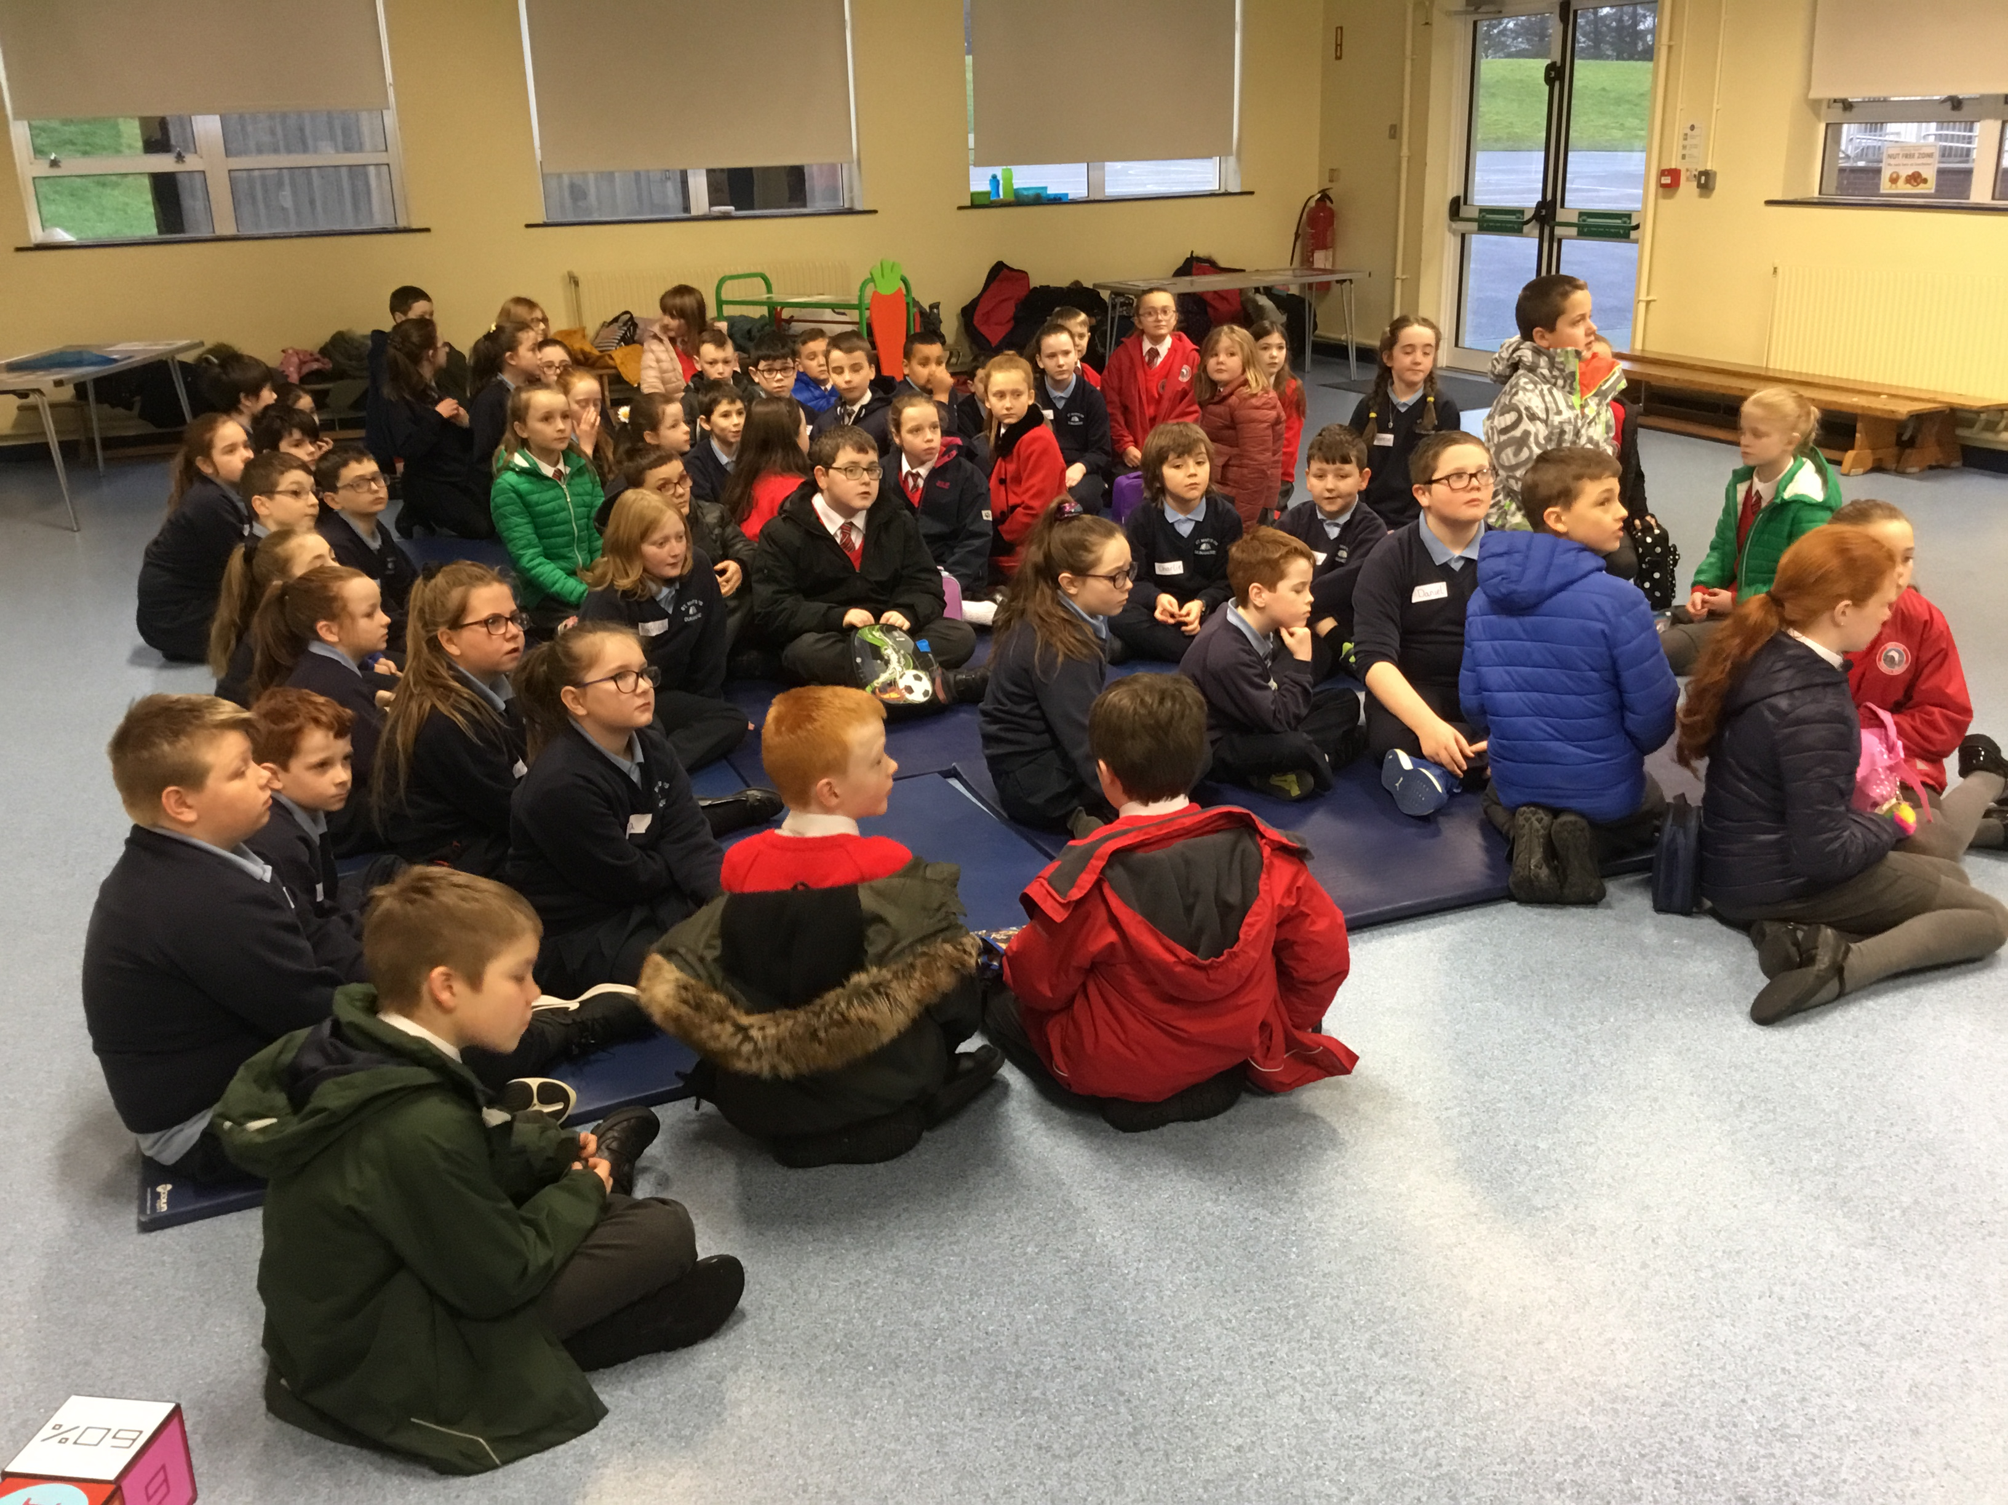
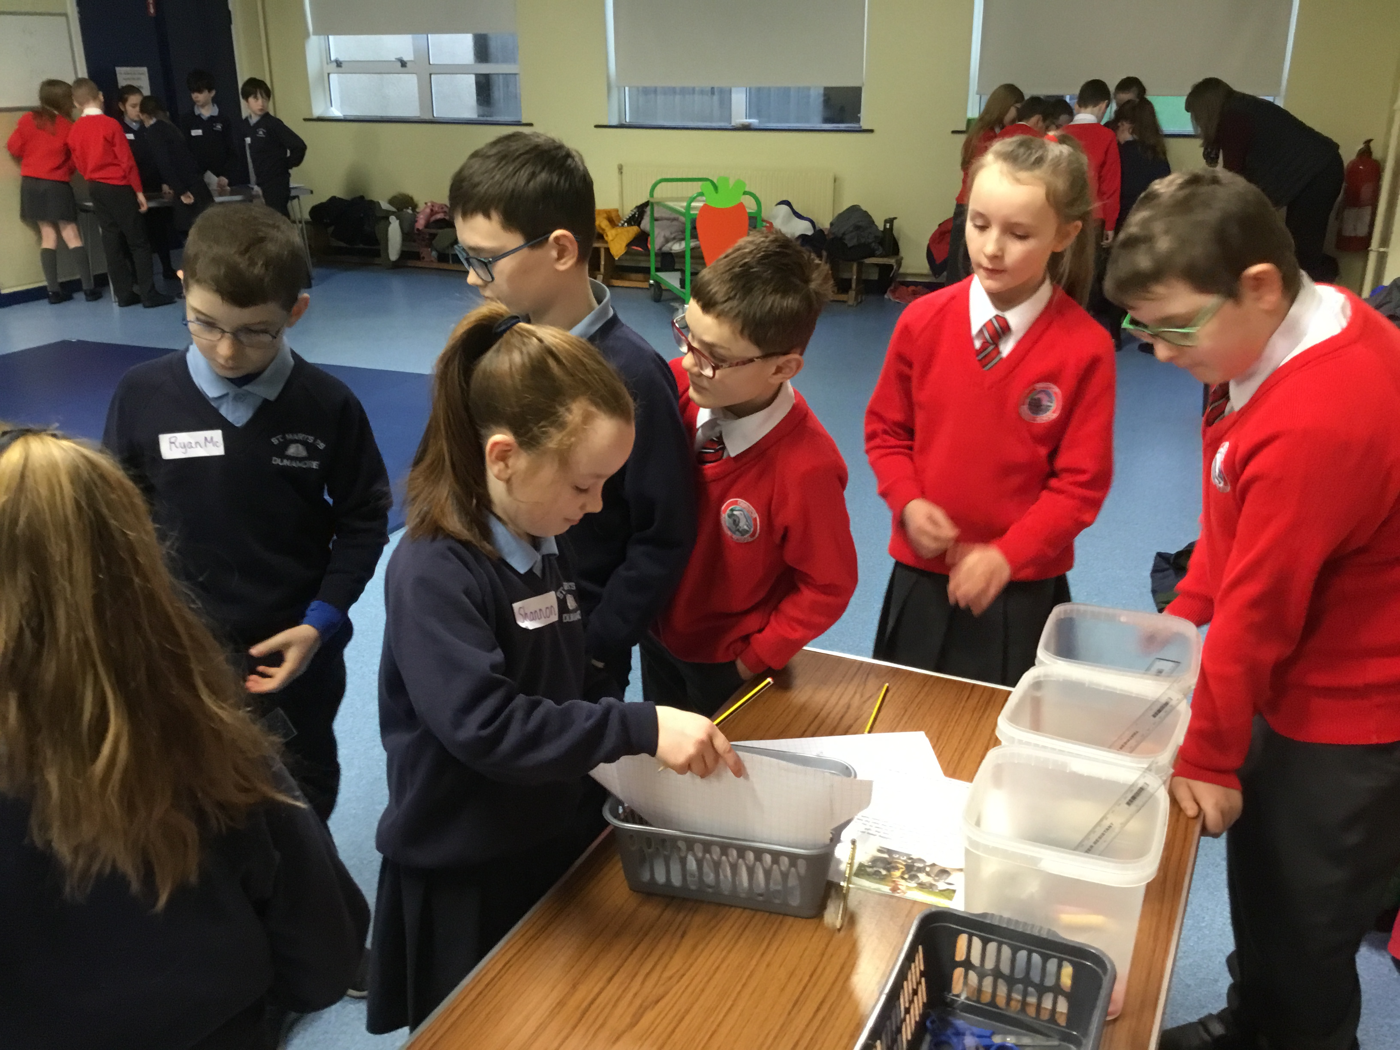
Maths Tasks at St. Mary’s Primary School

Slide 13
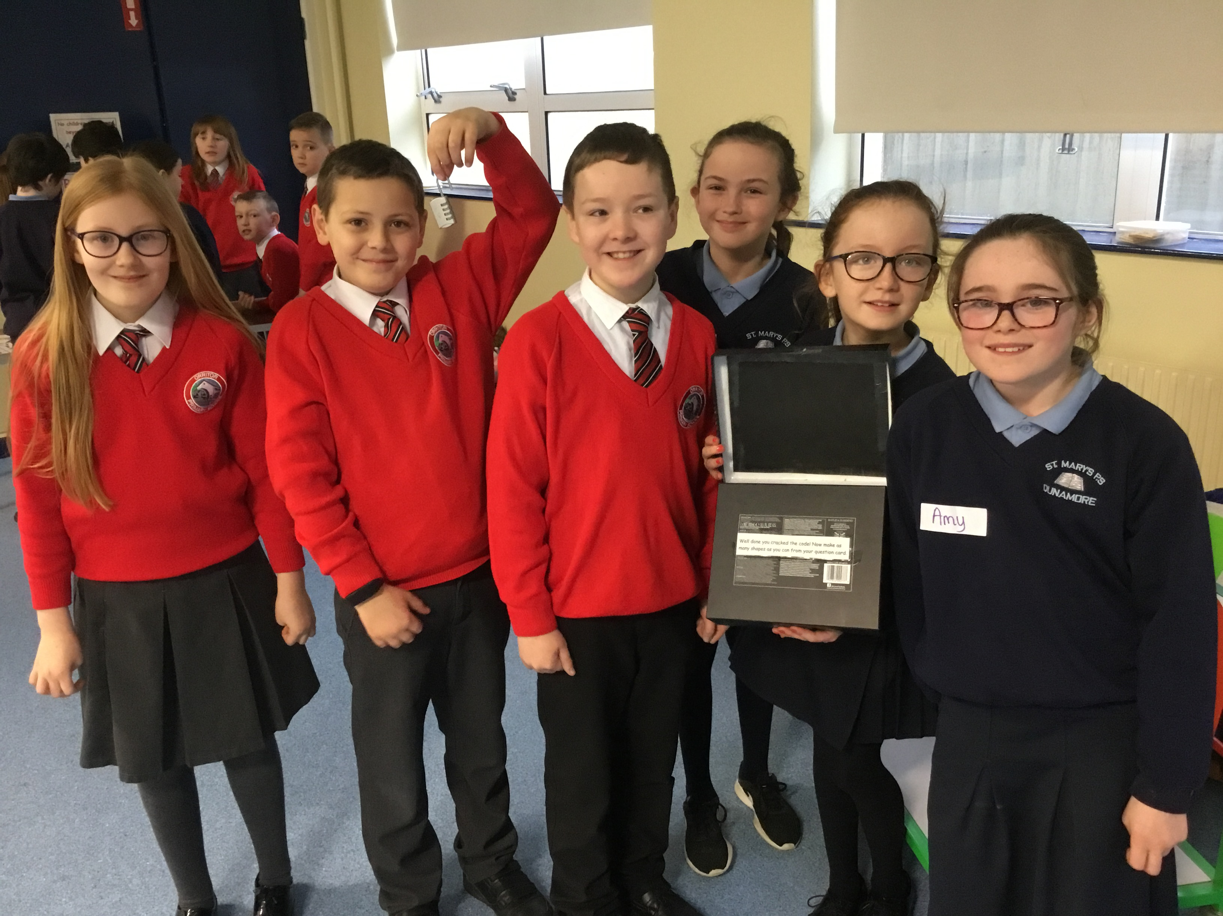

Slide 14
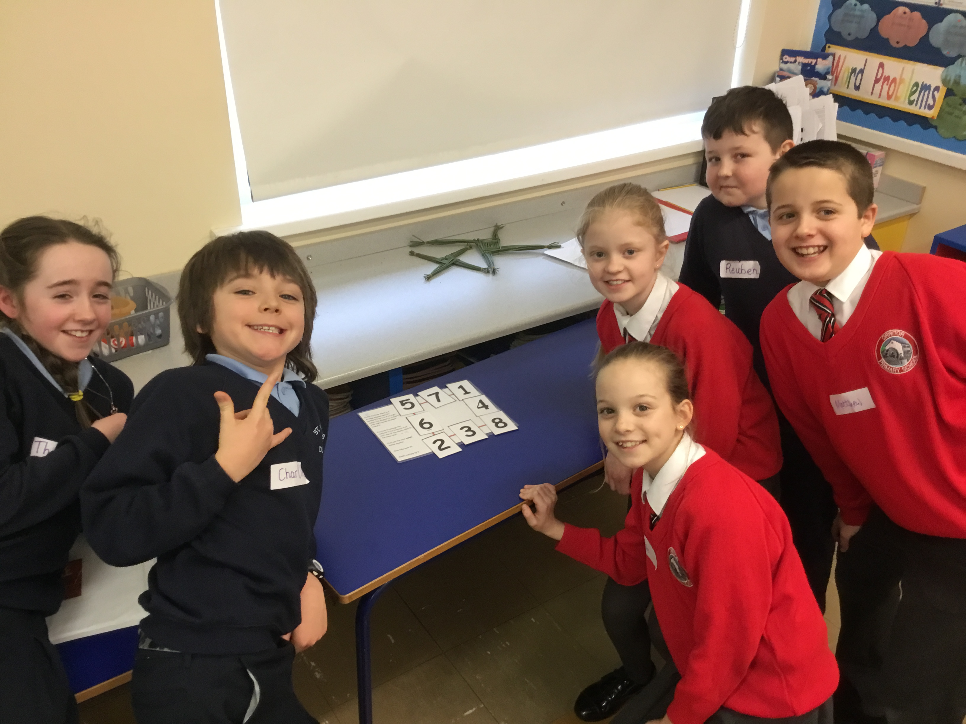
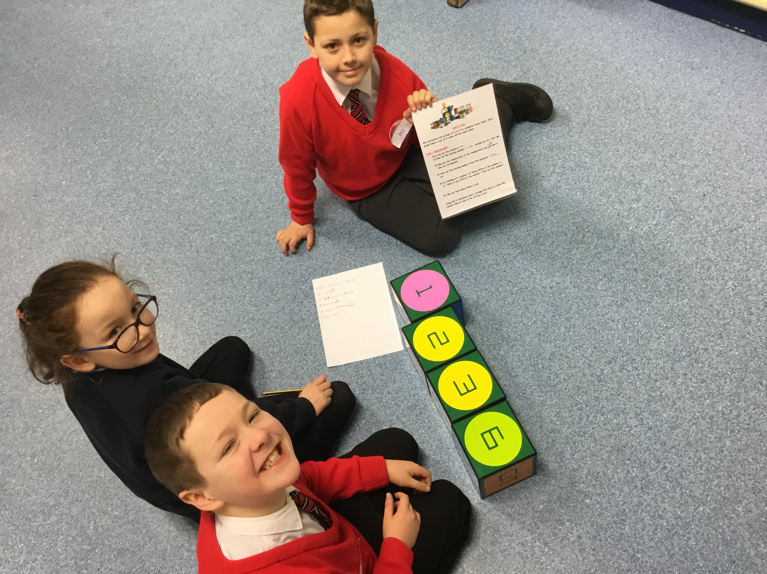

Slide 15
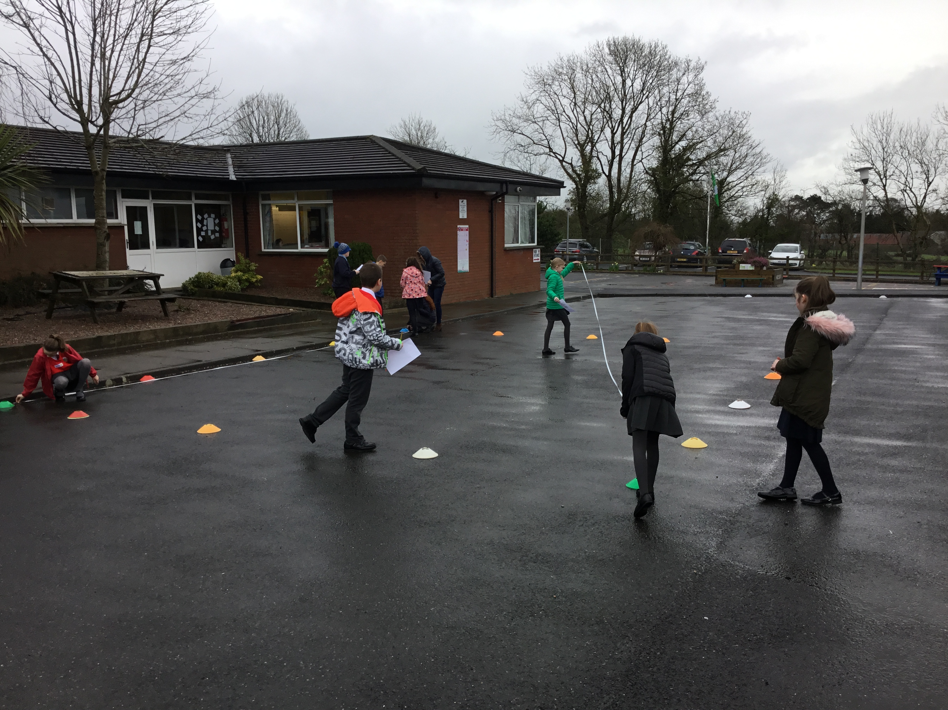
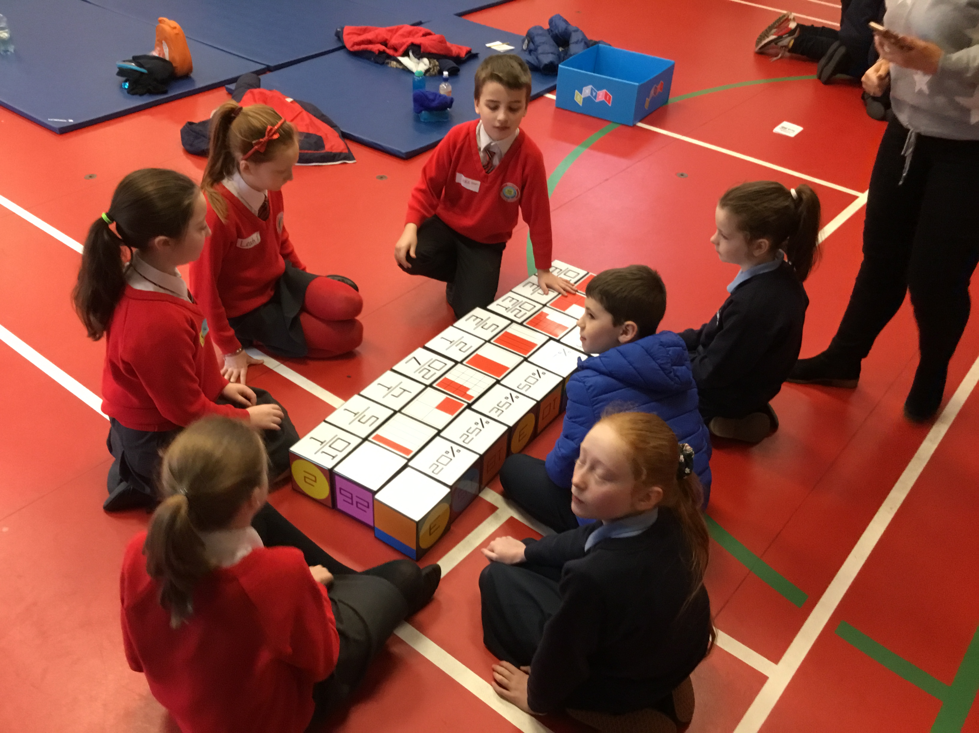
Day 2 at Orritor Primary School

Slide 16
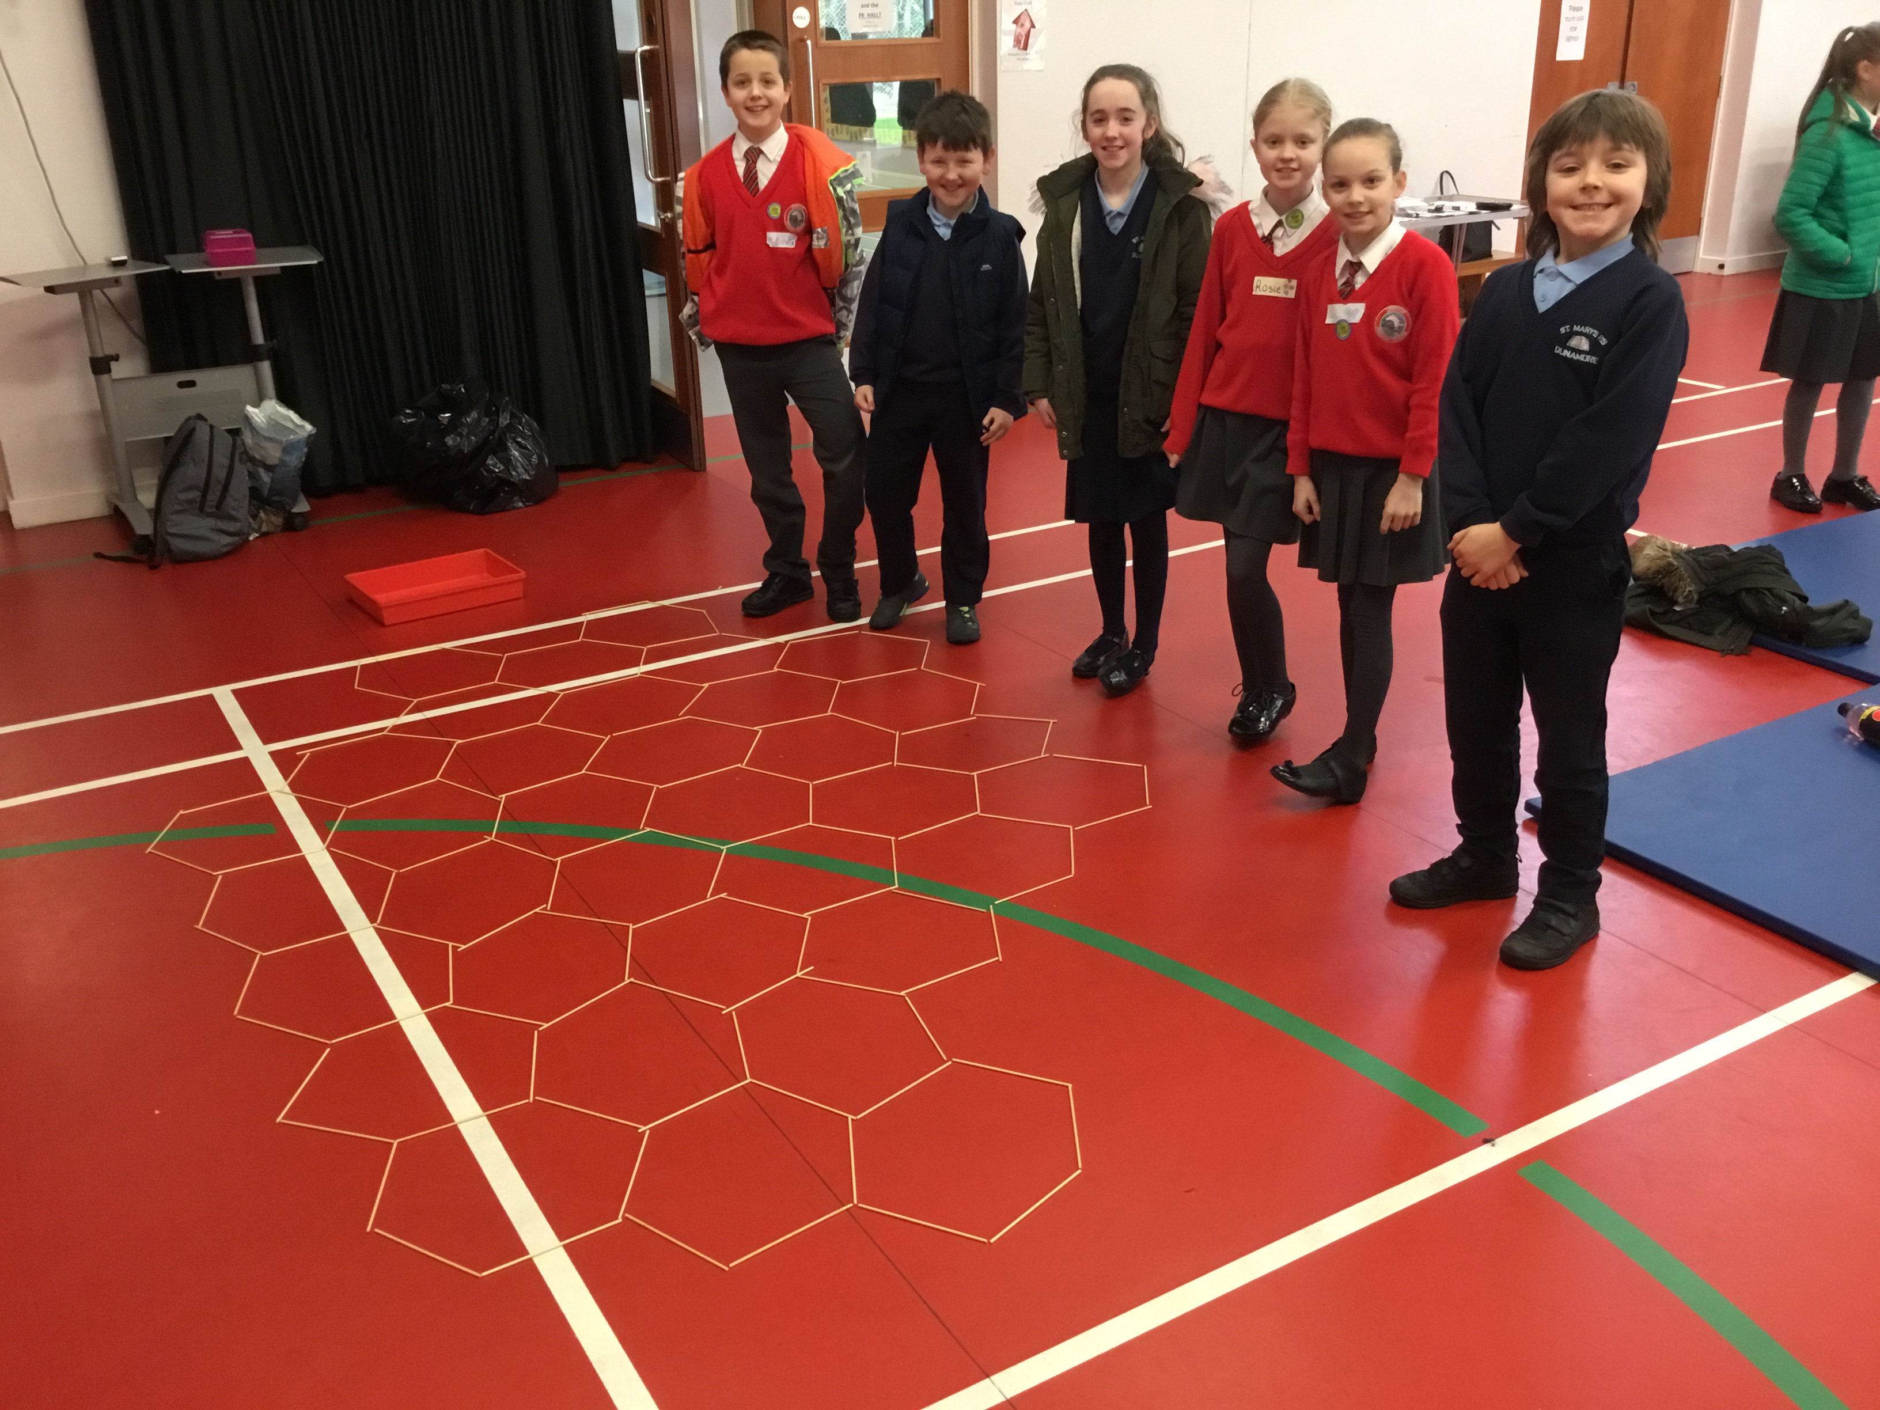
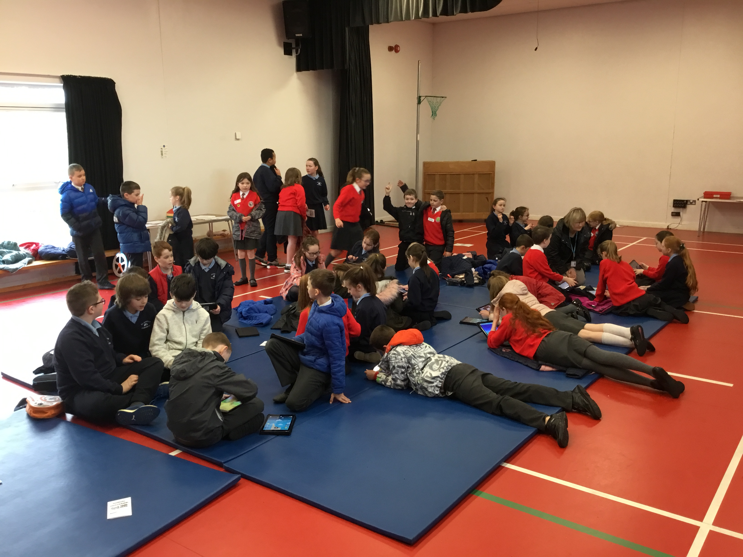

Slide 17
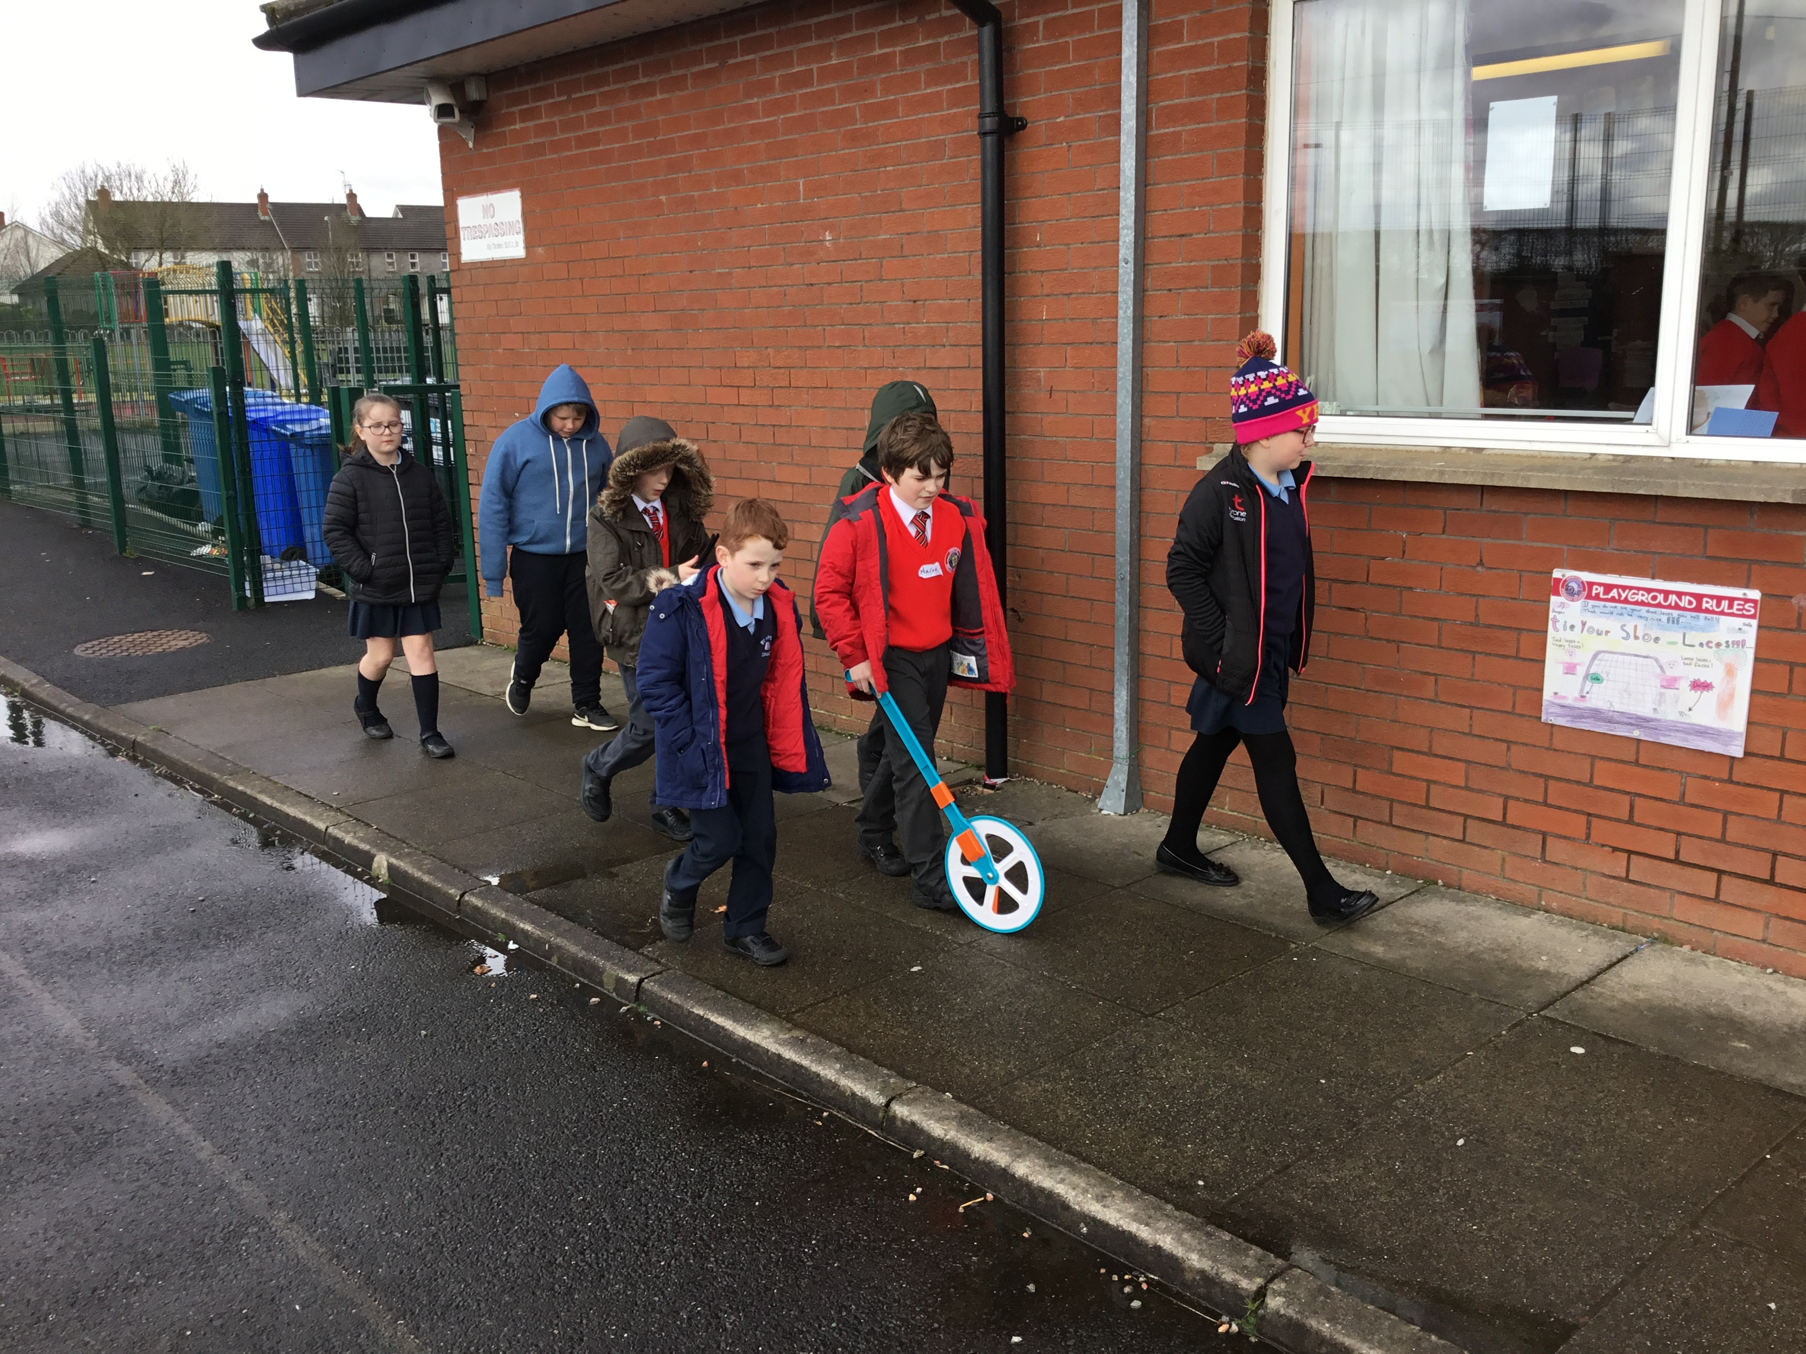

Slide 18
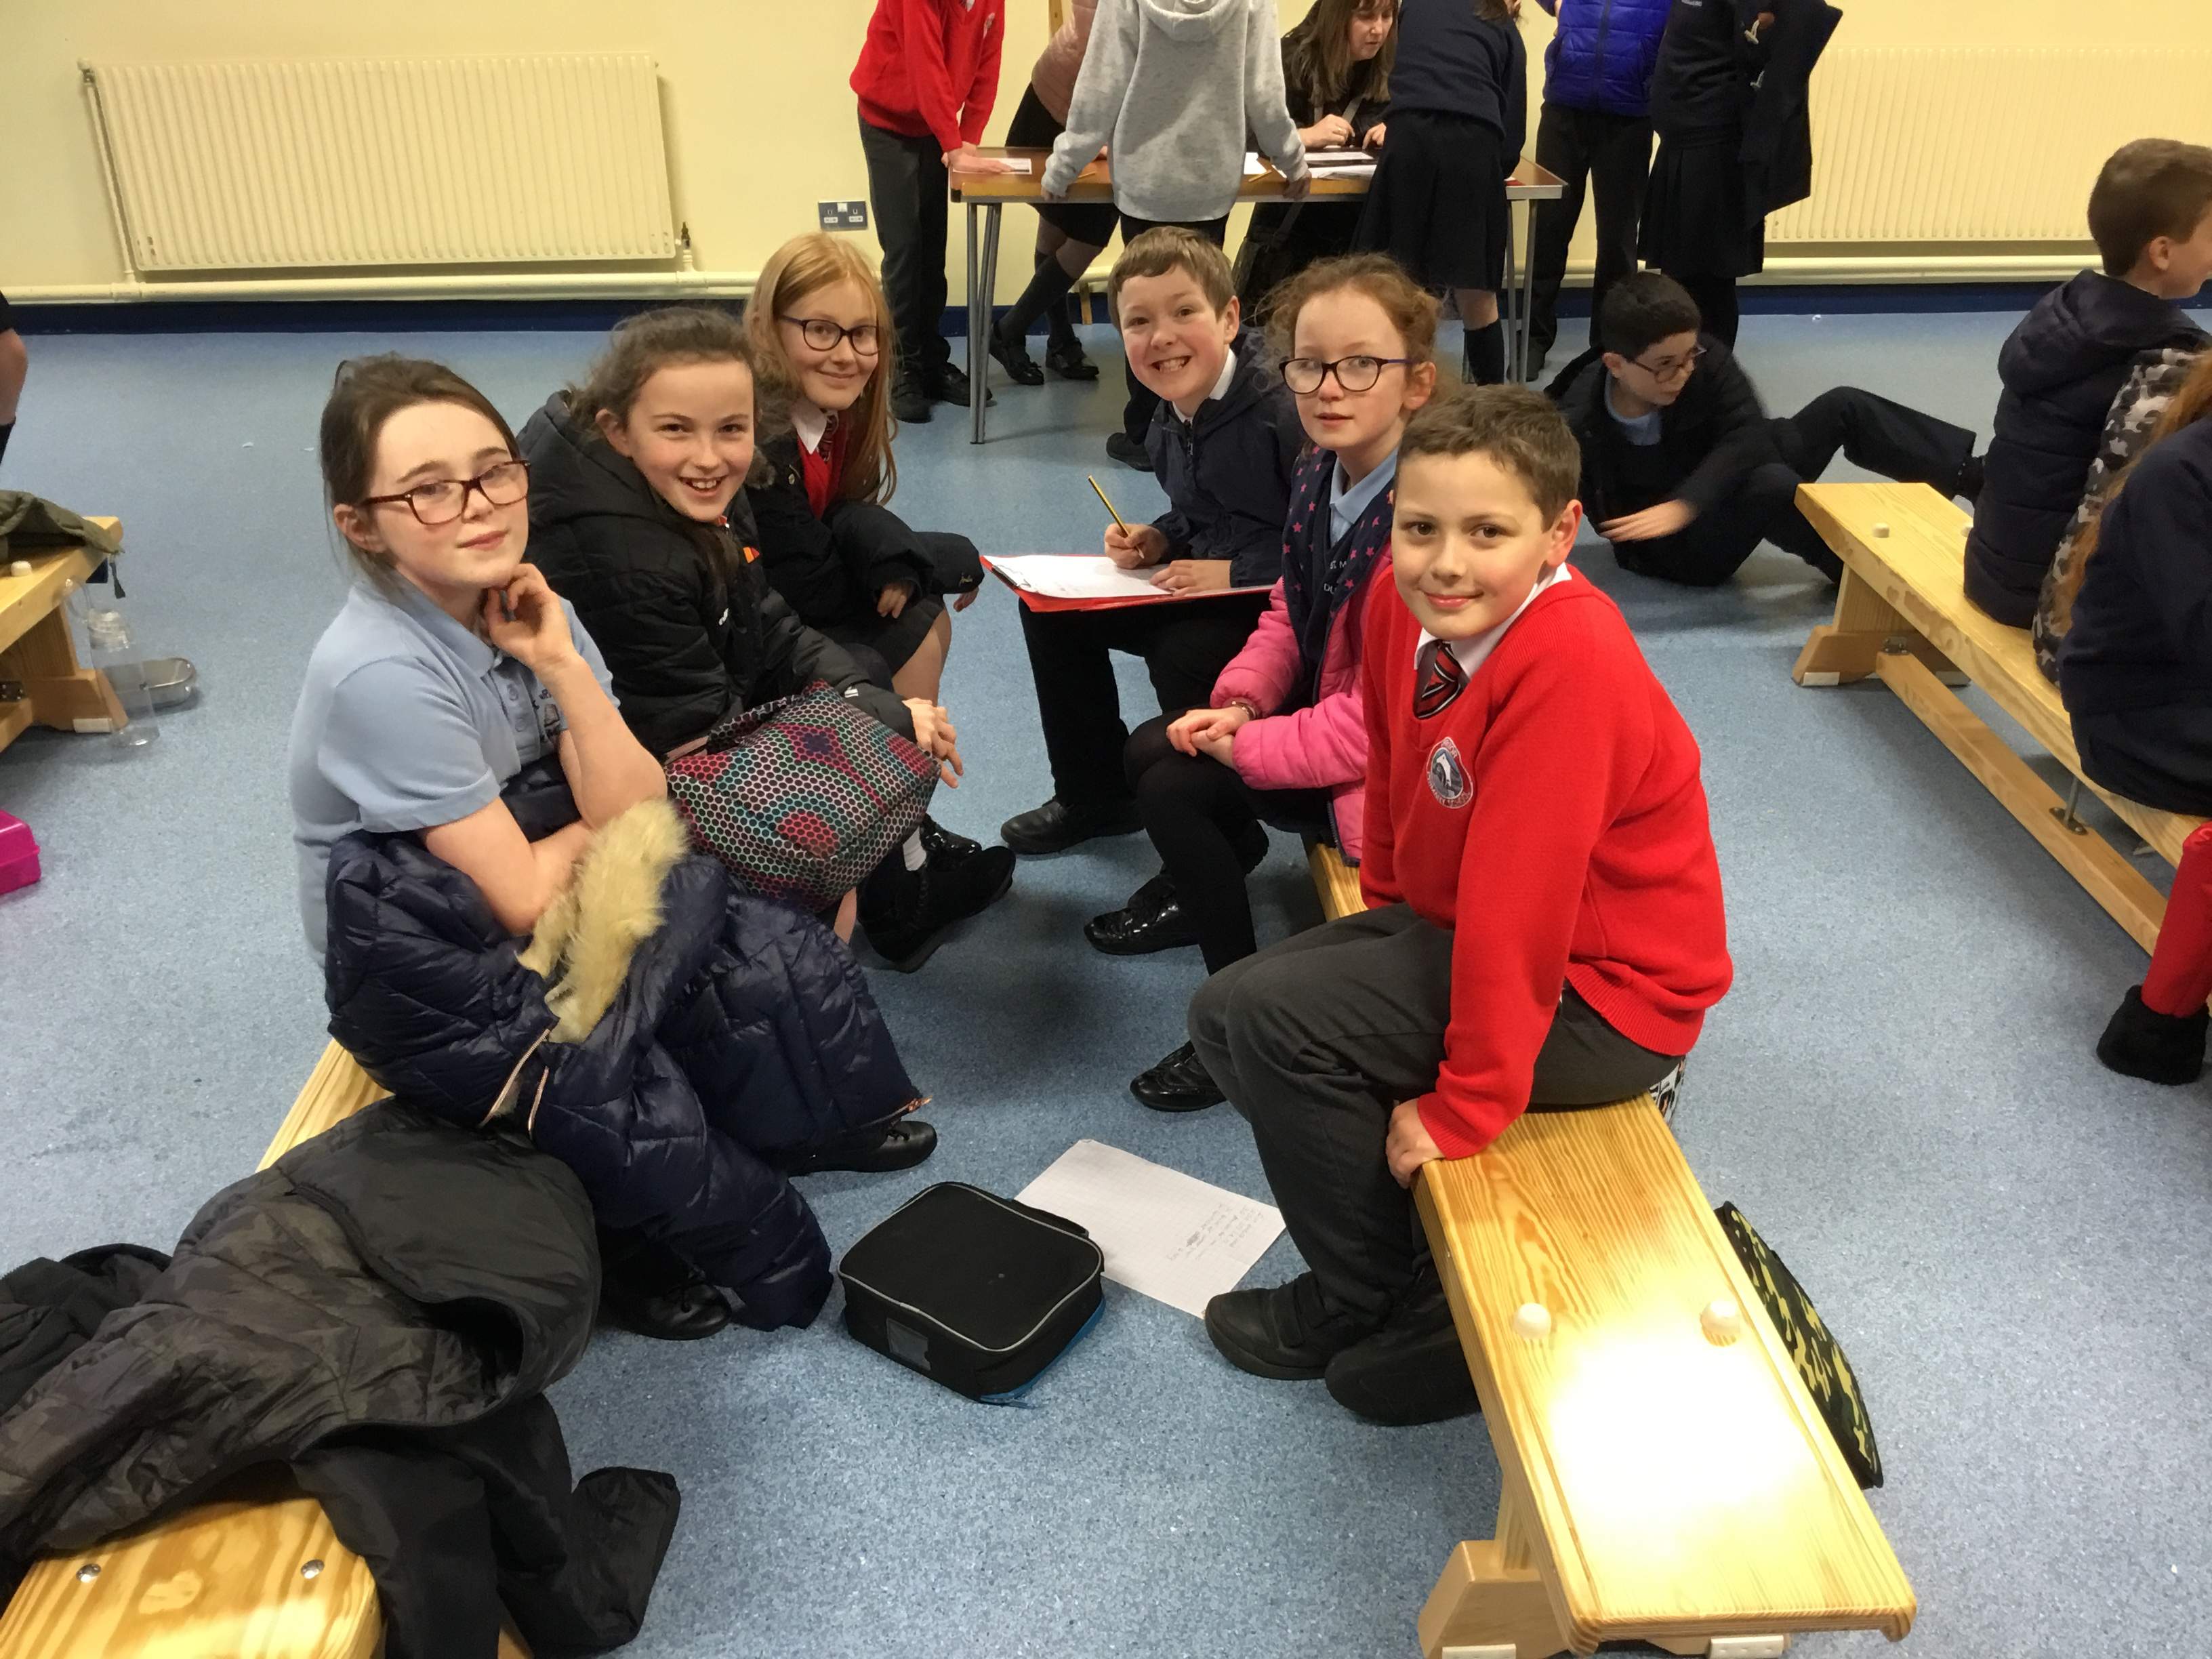
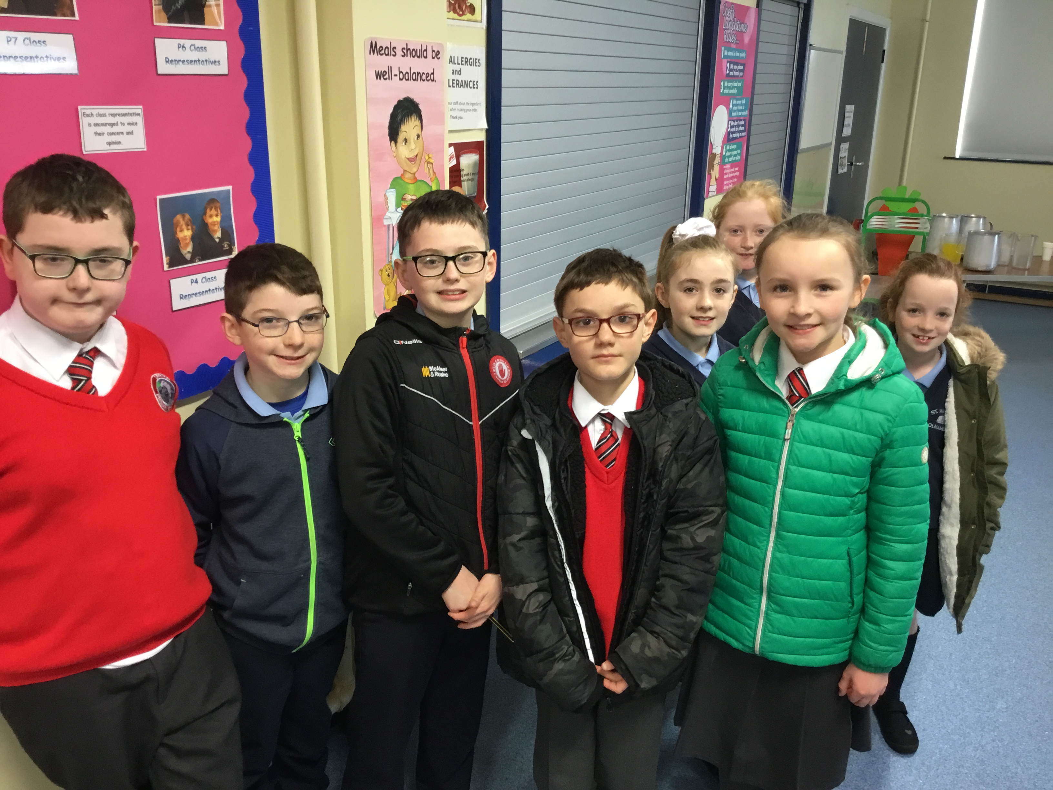
Day 2 at St. Mary’s Primary School

Slide 19
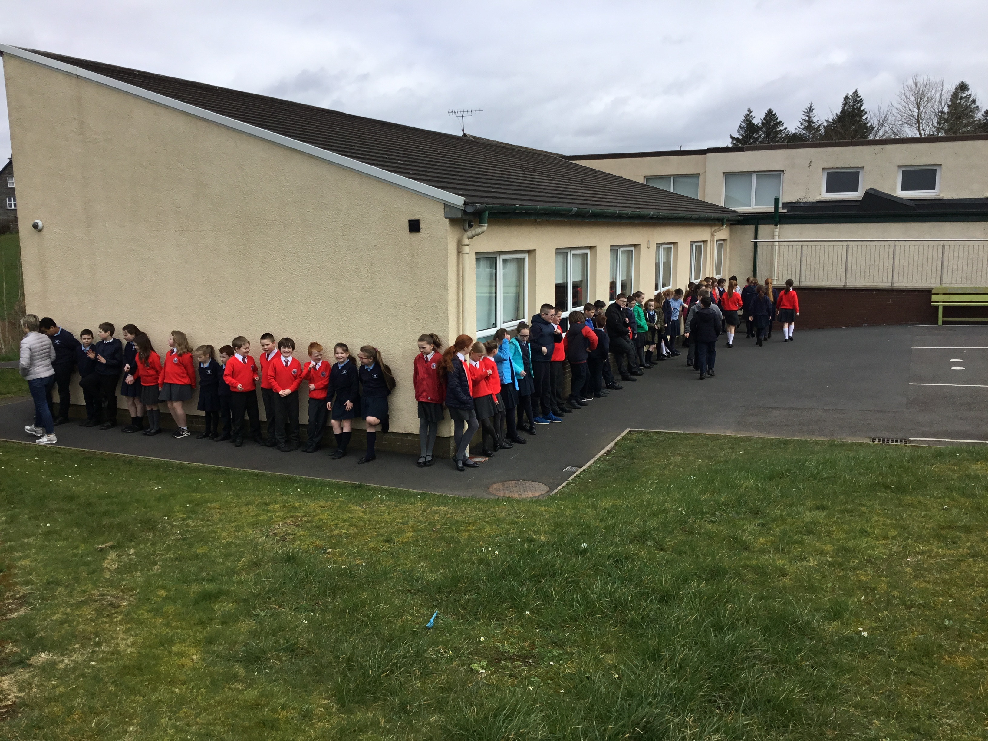

Slide 20
What is the Next Step?
The current Primary 6 will continue to work together next year and build upon the relationships they have formed.
The current Primary 5 will be introduced to the programme and will have the opportunity to access similar activities to the ones that Primary 6 have done this year.
The incoming Primary 1 and 2 children will be introduced to the Shared Education Programme through structured play activities.
The teachers will continue to participate in training for delivering and managing Shared Education.
The two schools will continue to work together, sharing resources and expertise.

