Slide 1


Beginning Nursery
Orritor Primary School
and Nursery Unit
Wednesday 17th June 2026

Slide 2
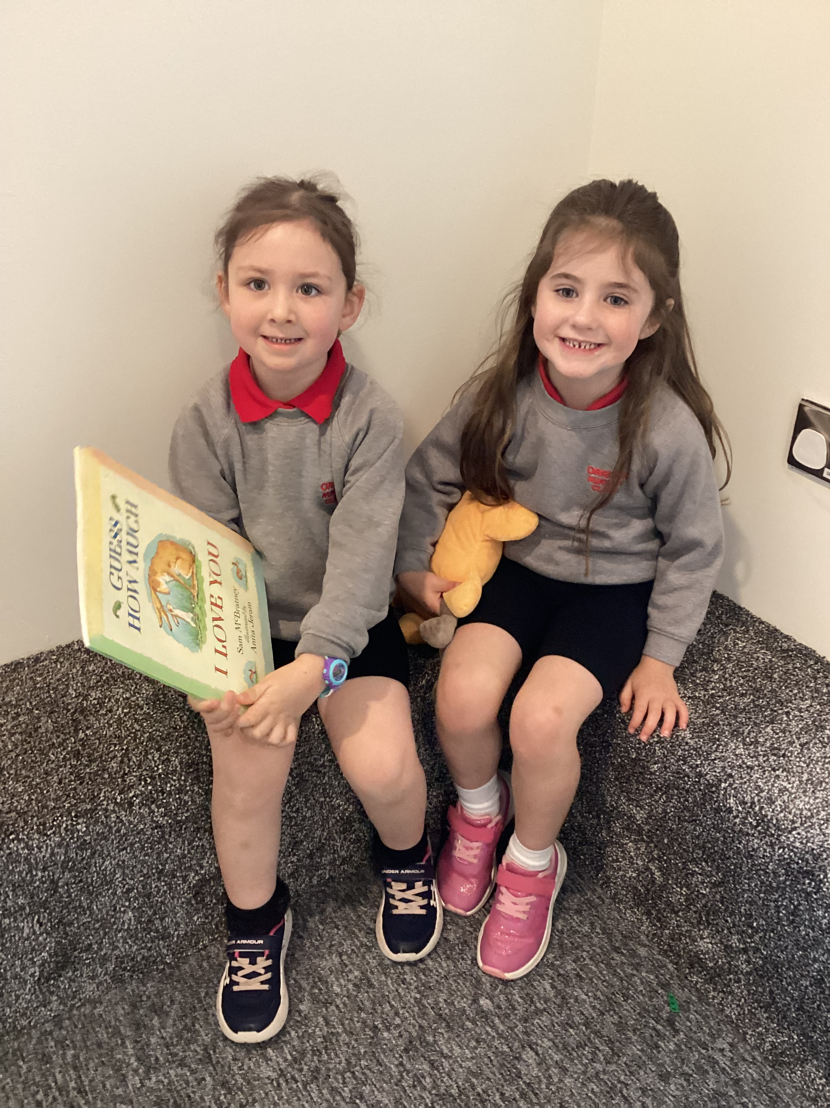

Nursery Enrolment – 2026/27
Nursery
2019/2020 - 27
2020/2021 - 26
2021/2022 - 26
2022-2023 - 27
2023-2024 - 26
2024-2025 - 26
2025-2026 - 28
2026-2027 - 31

Slide 3
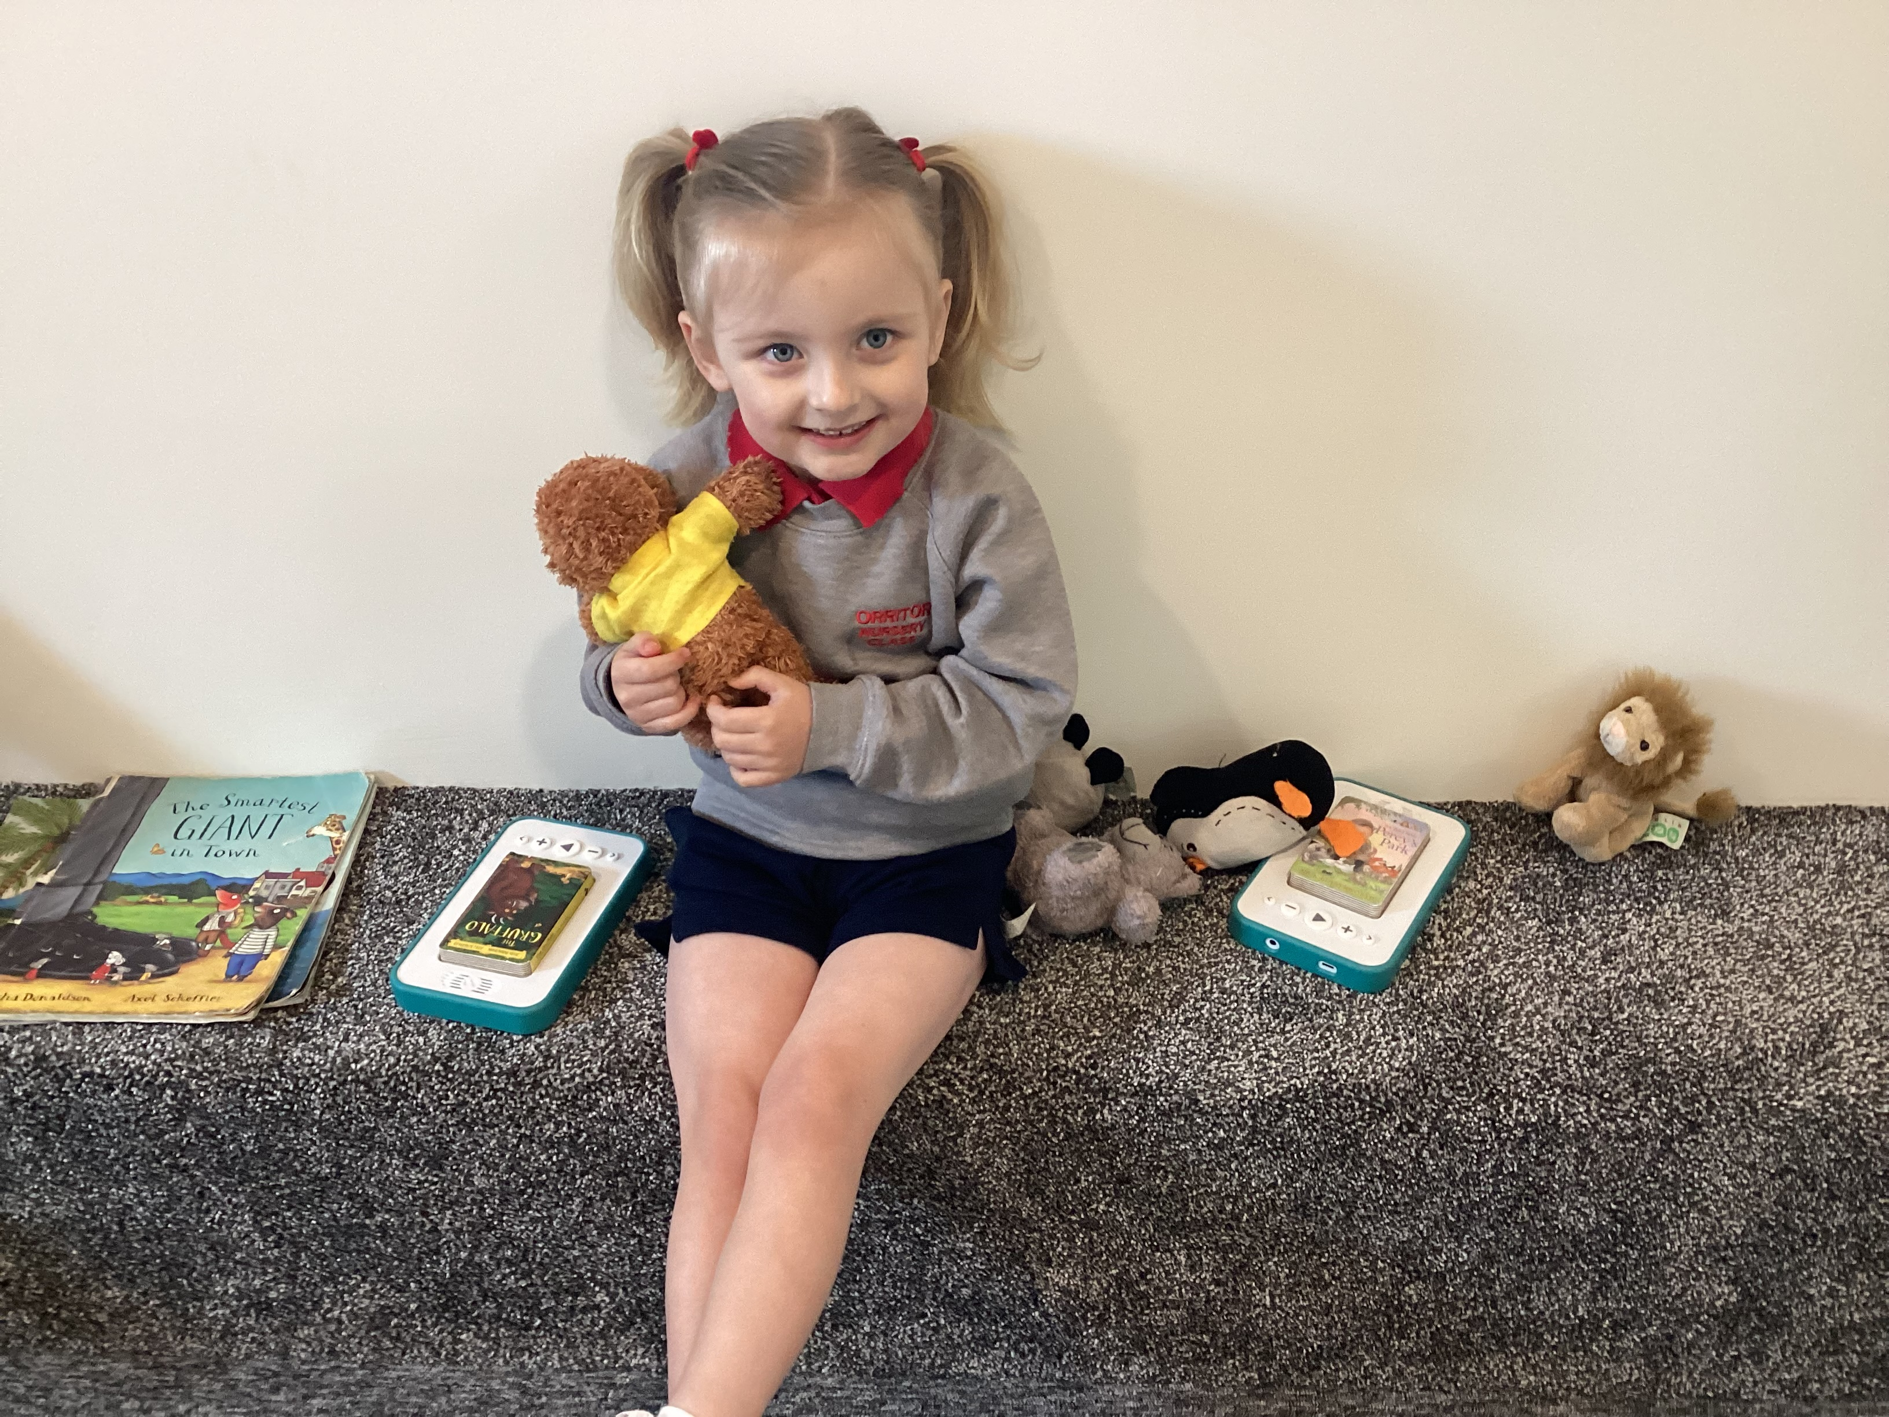
Staff List
Principal | Mr I. Cheevers
Vice-Principal | Mrs K. Black
Nursery Teacher | Miss S. Thompson
Nursery Assistant | Mrs D. Ferry
Nursery Assistant | Mrs L. Lawrence
Secretary | Mrs R. Dallas
Clerical Support | Mrs W. Thom

Slide 4


Slide 5


Slide 6
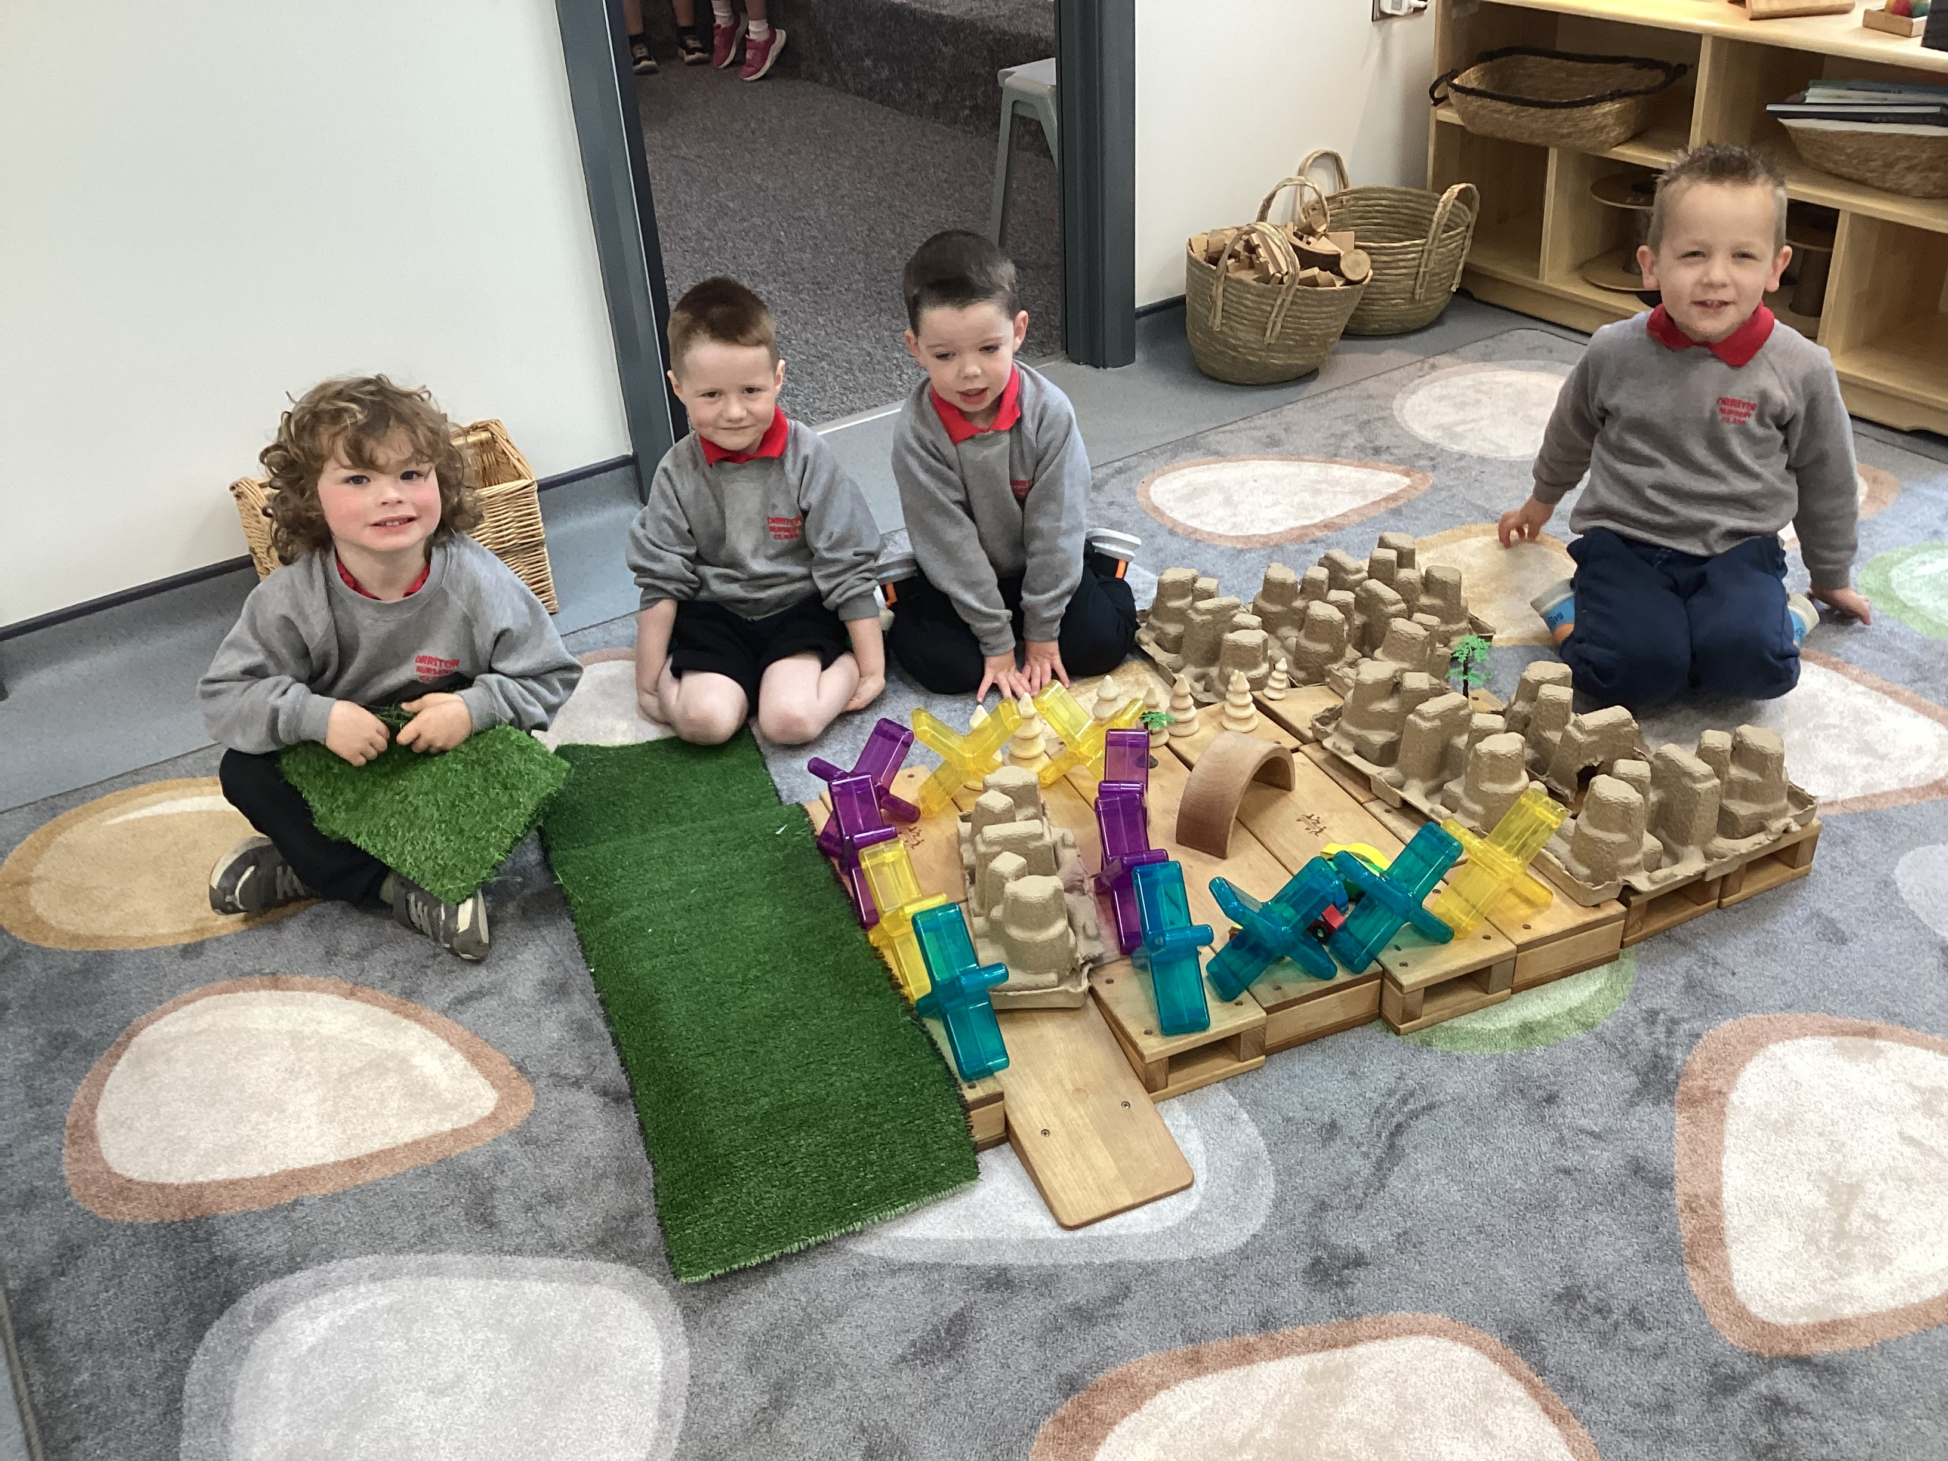
A Typical Day in Nursery
Learning through Play
Carpet time / topic time
Snack
Outdoor play
Rhymes and songs
Dinner
Story time / topic time
Learning through play

Slide 7
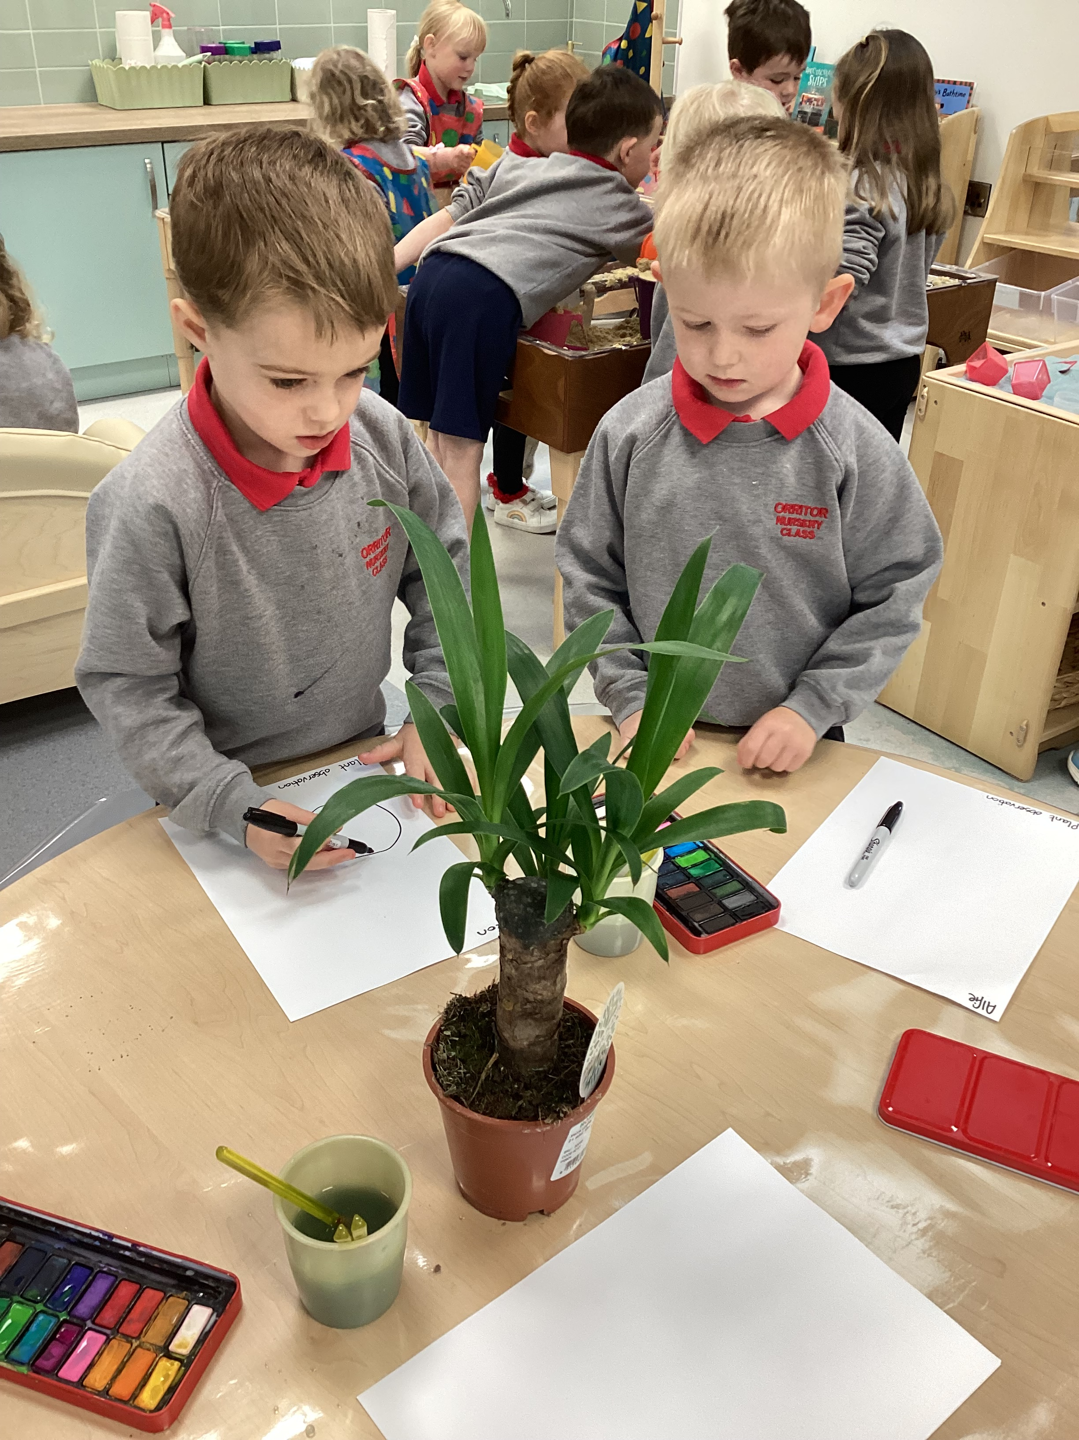
Nursery Curriculum
Personal, Social and Emotional Development
The Arts
Early Maths
Physical Development
Language Development
World Around Us

Slide 8
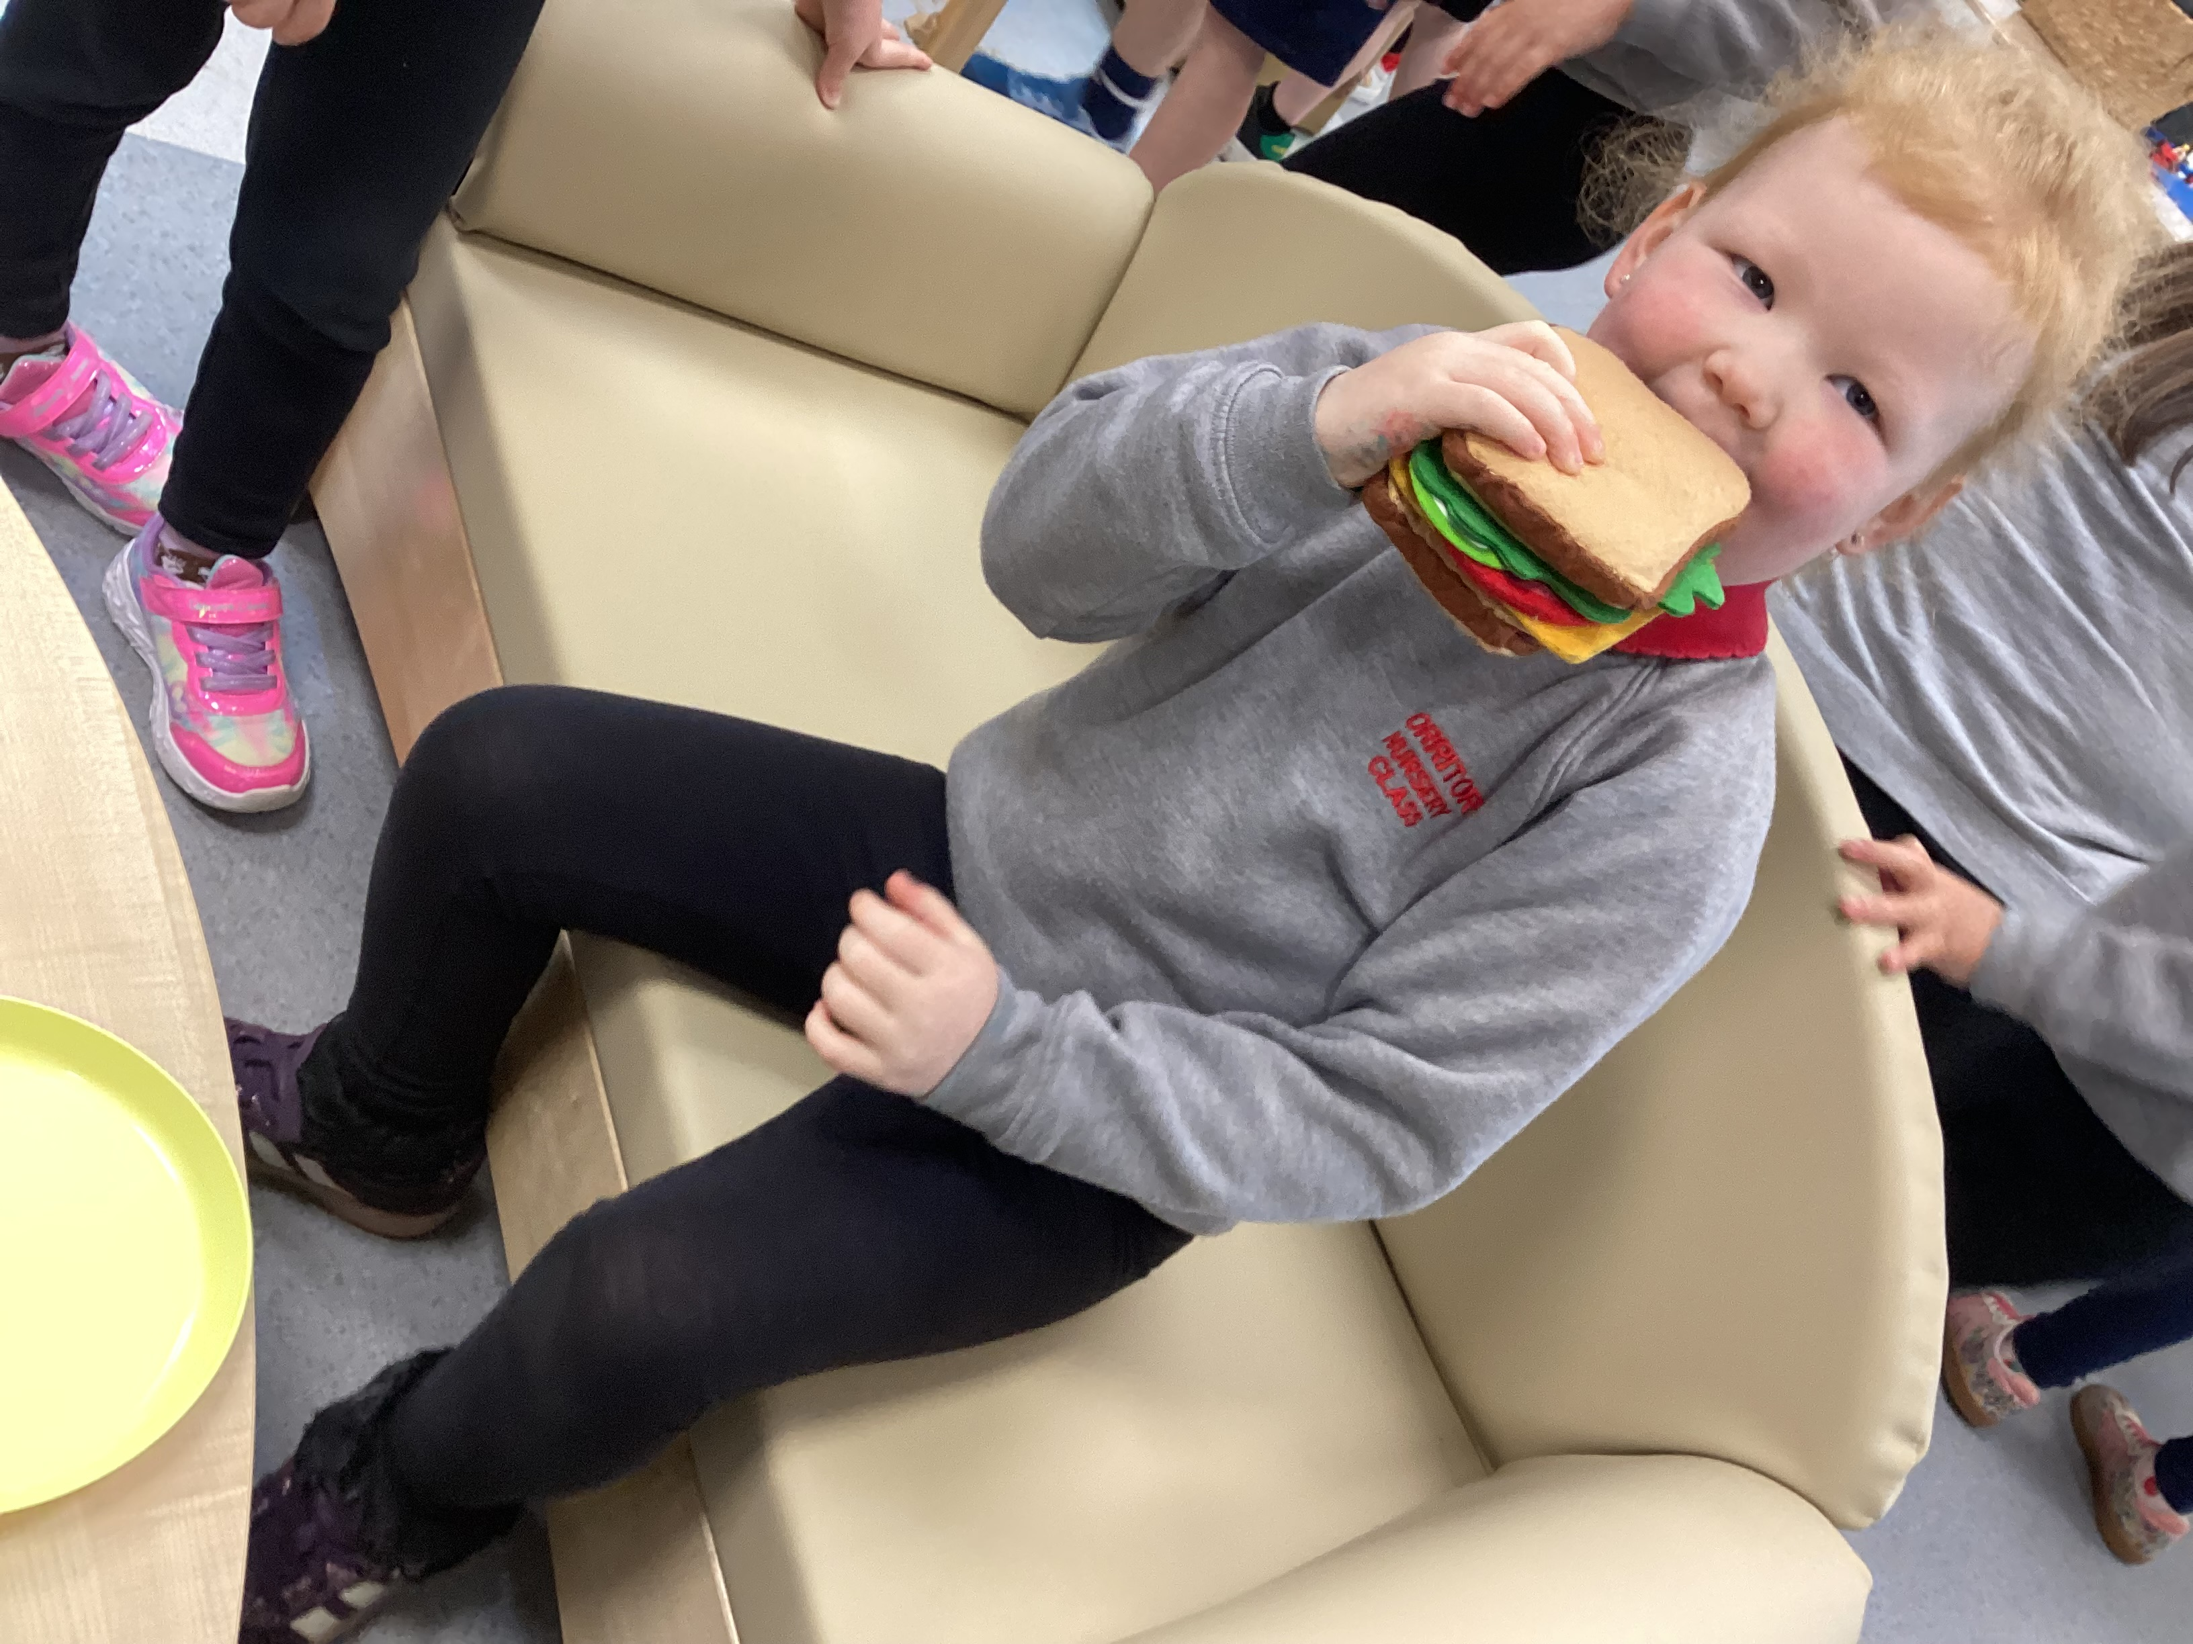
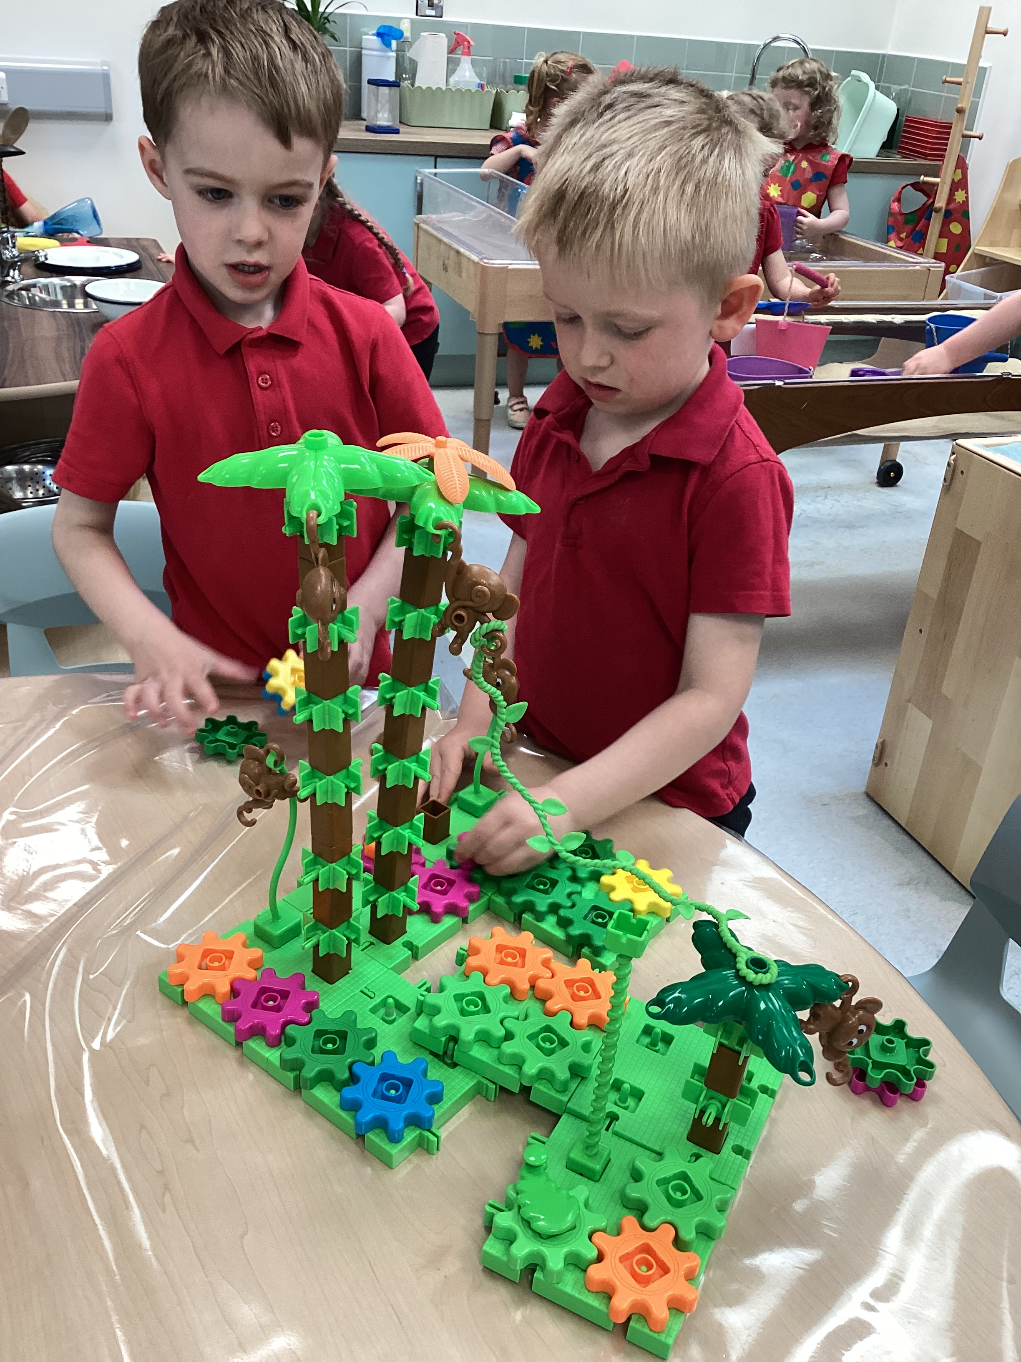
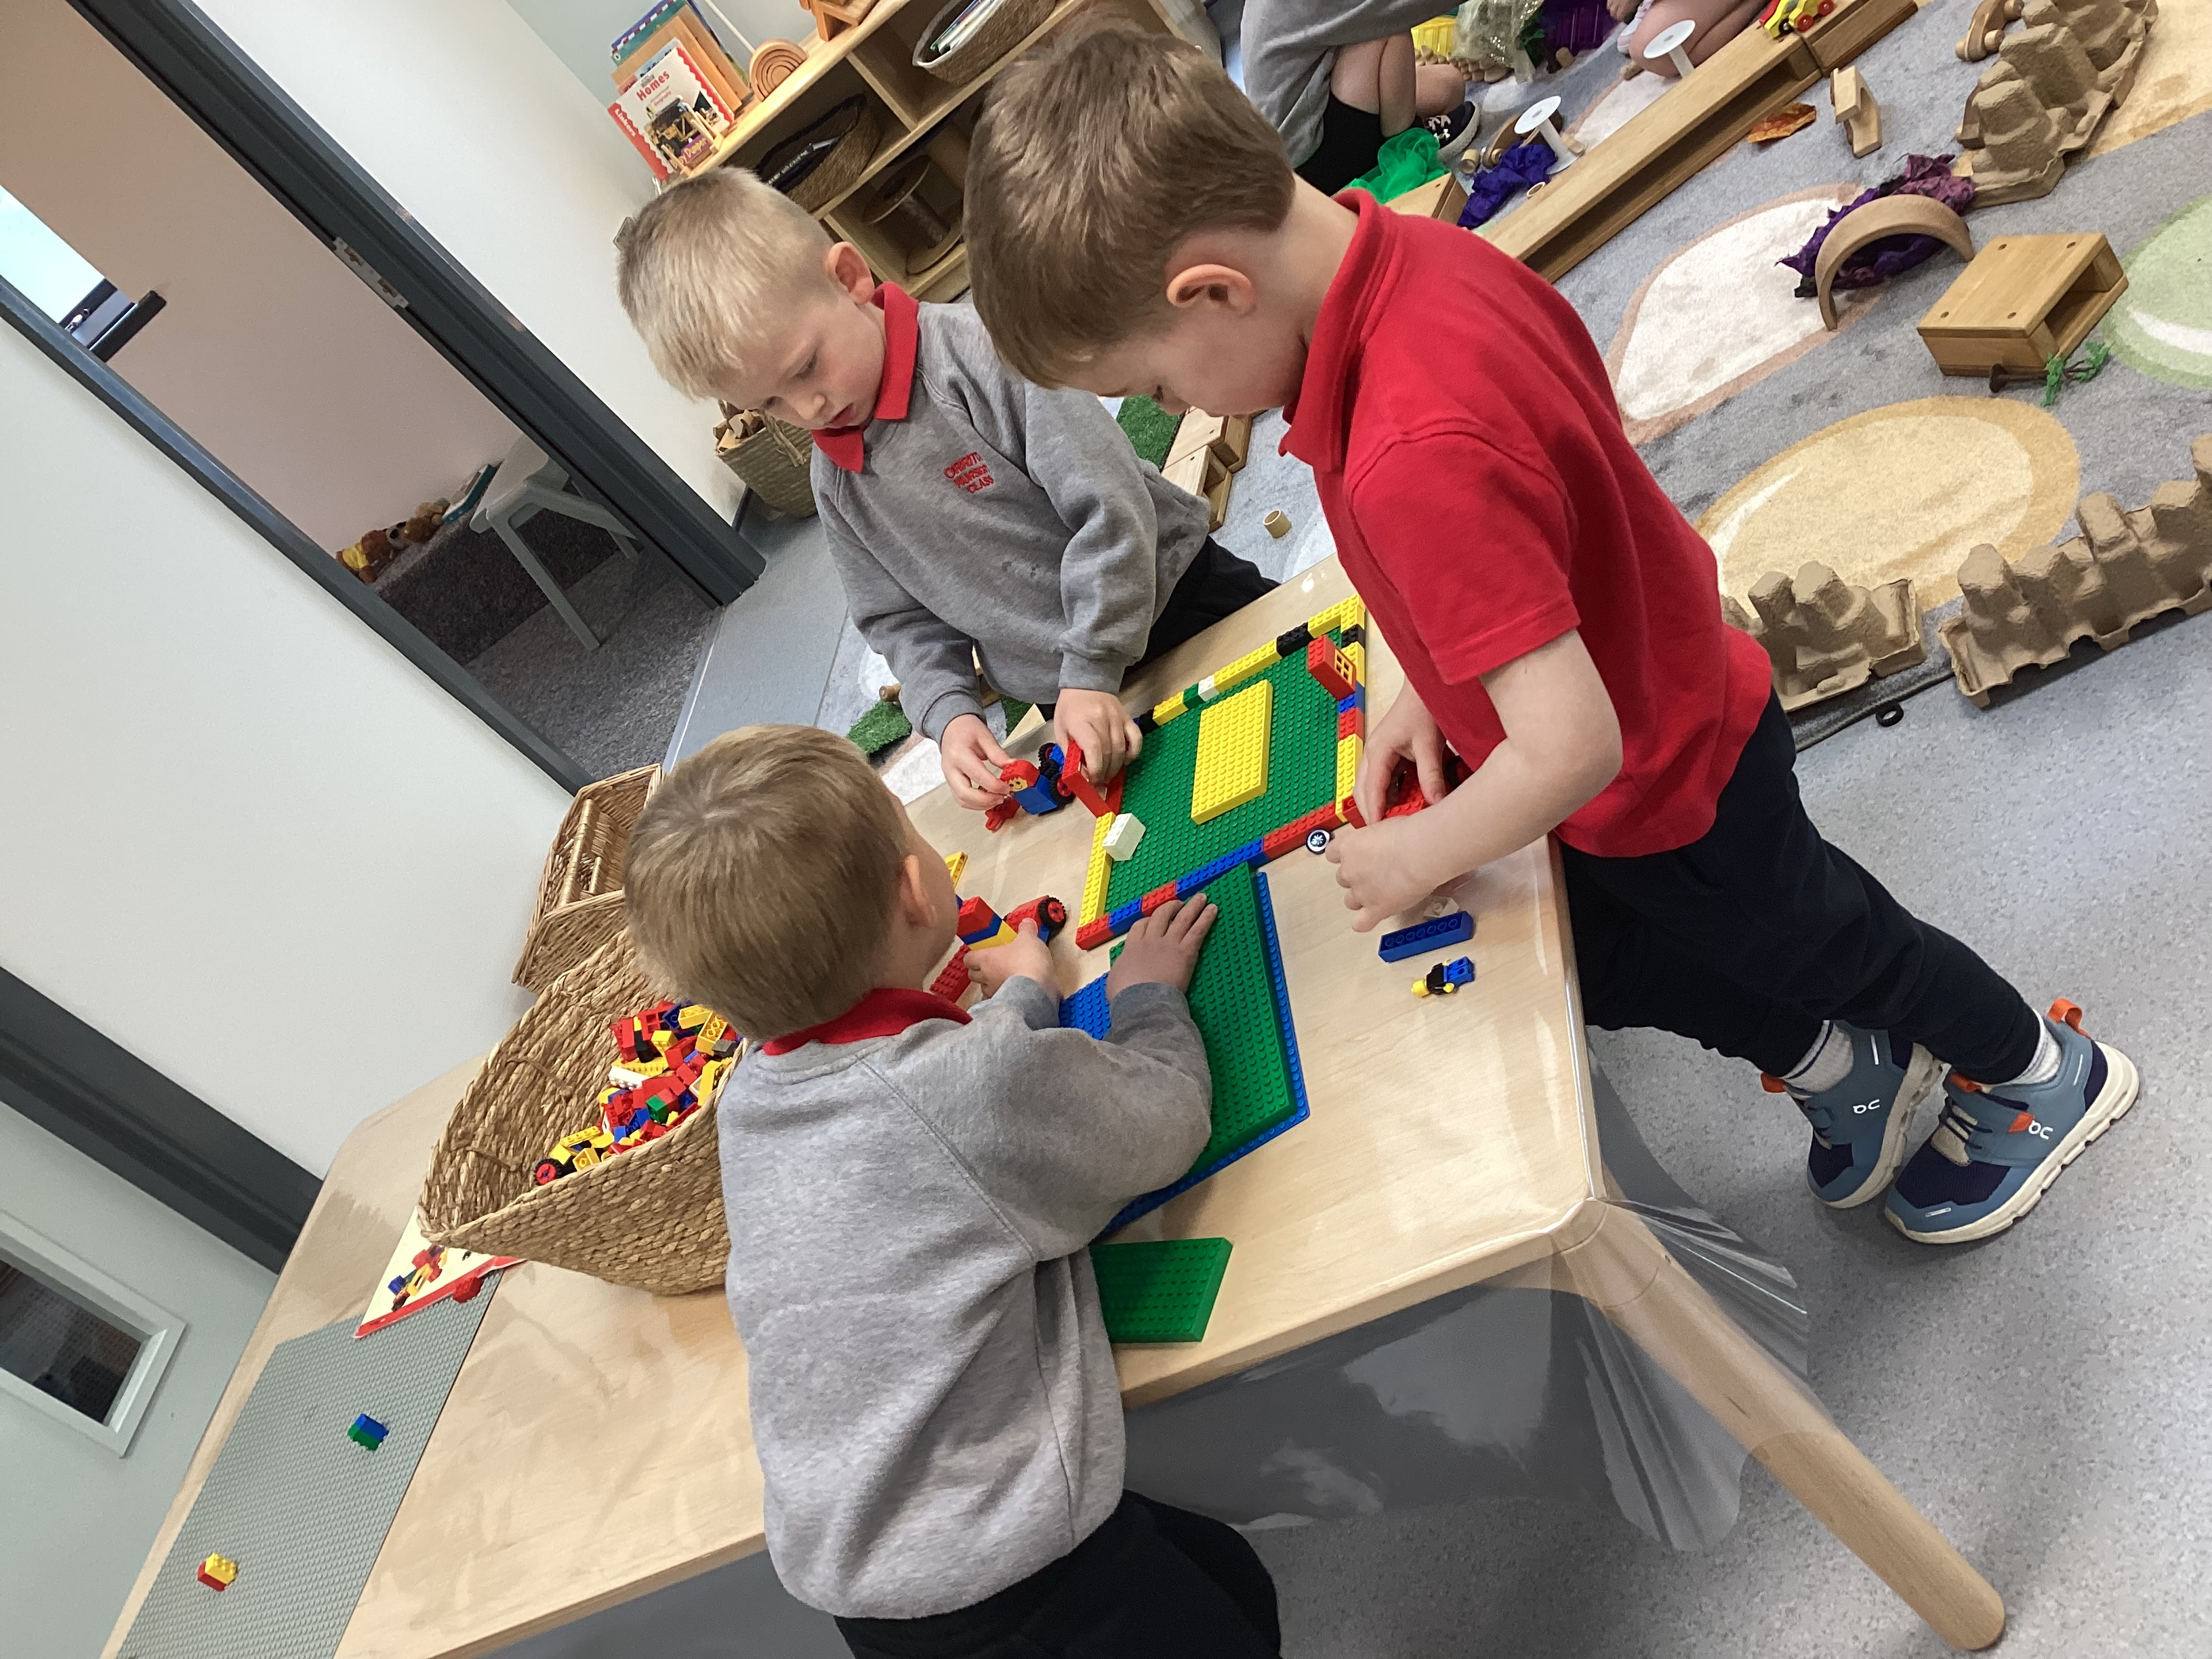

Slide 9
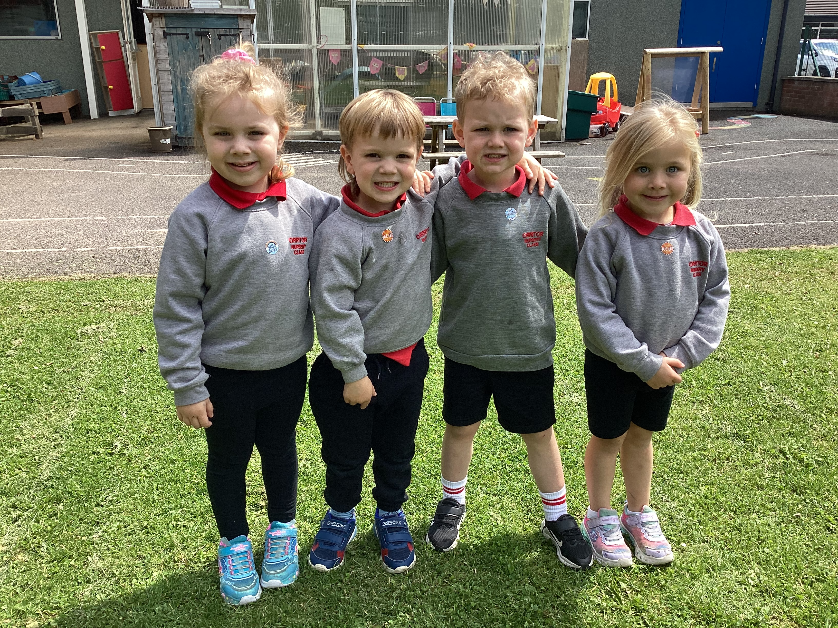
School Uniform – Nursery
Nursery
Dark jogging bottoms
Red school polo shirt
Grey school sweatshirt with logo​
Velcro / slip on shoes
Summer – dark shorts

Slide 10
Money and Payments
Dinner money – Daily; £3.00 (Nursery)
Breakfast Club – Daily; £2:00 currently (Nursery and Primary)
Snack and Fund (Nursery only) Monthly: £12

Slide 11
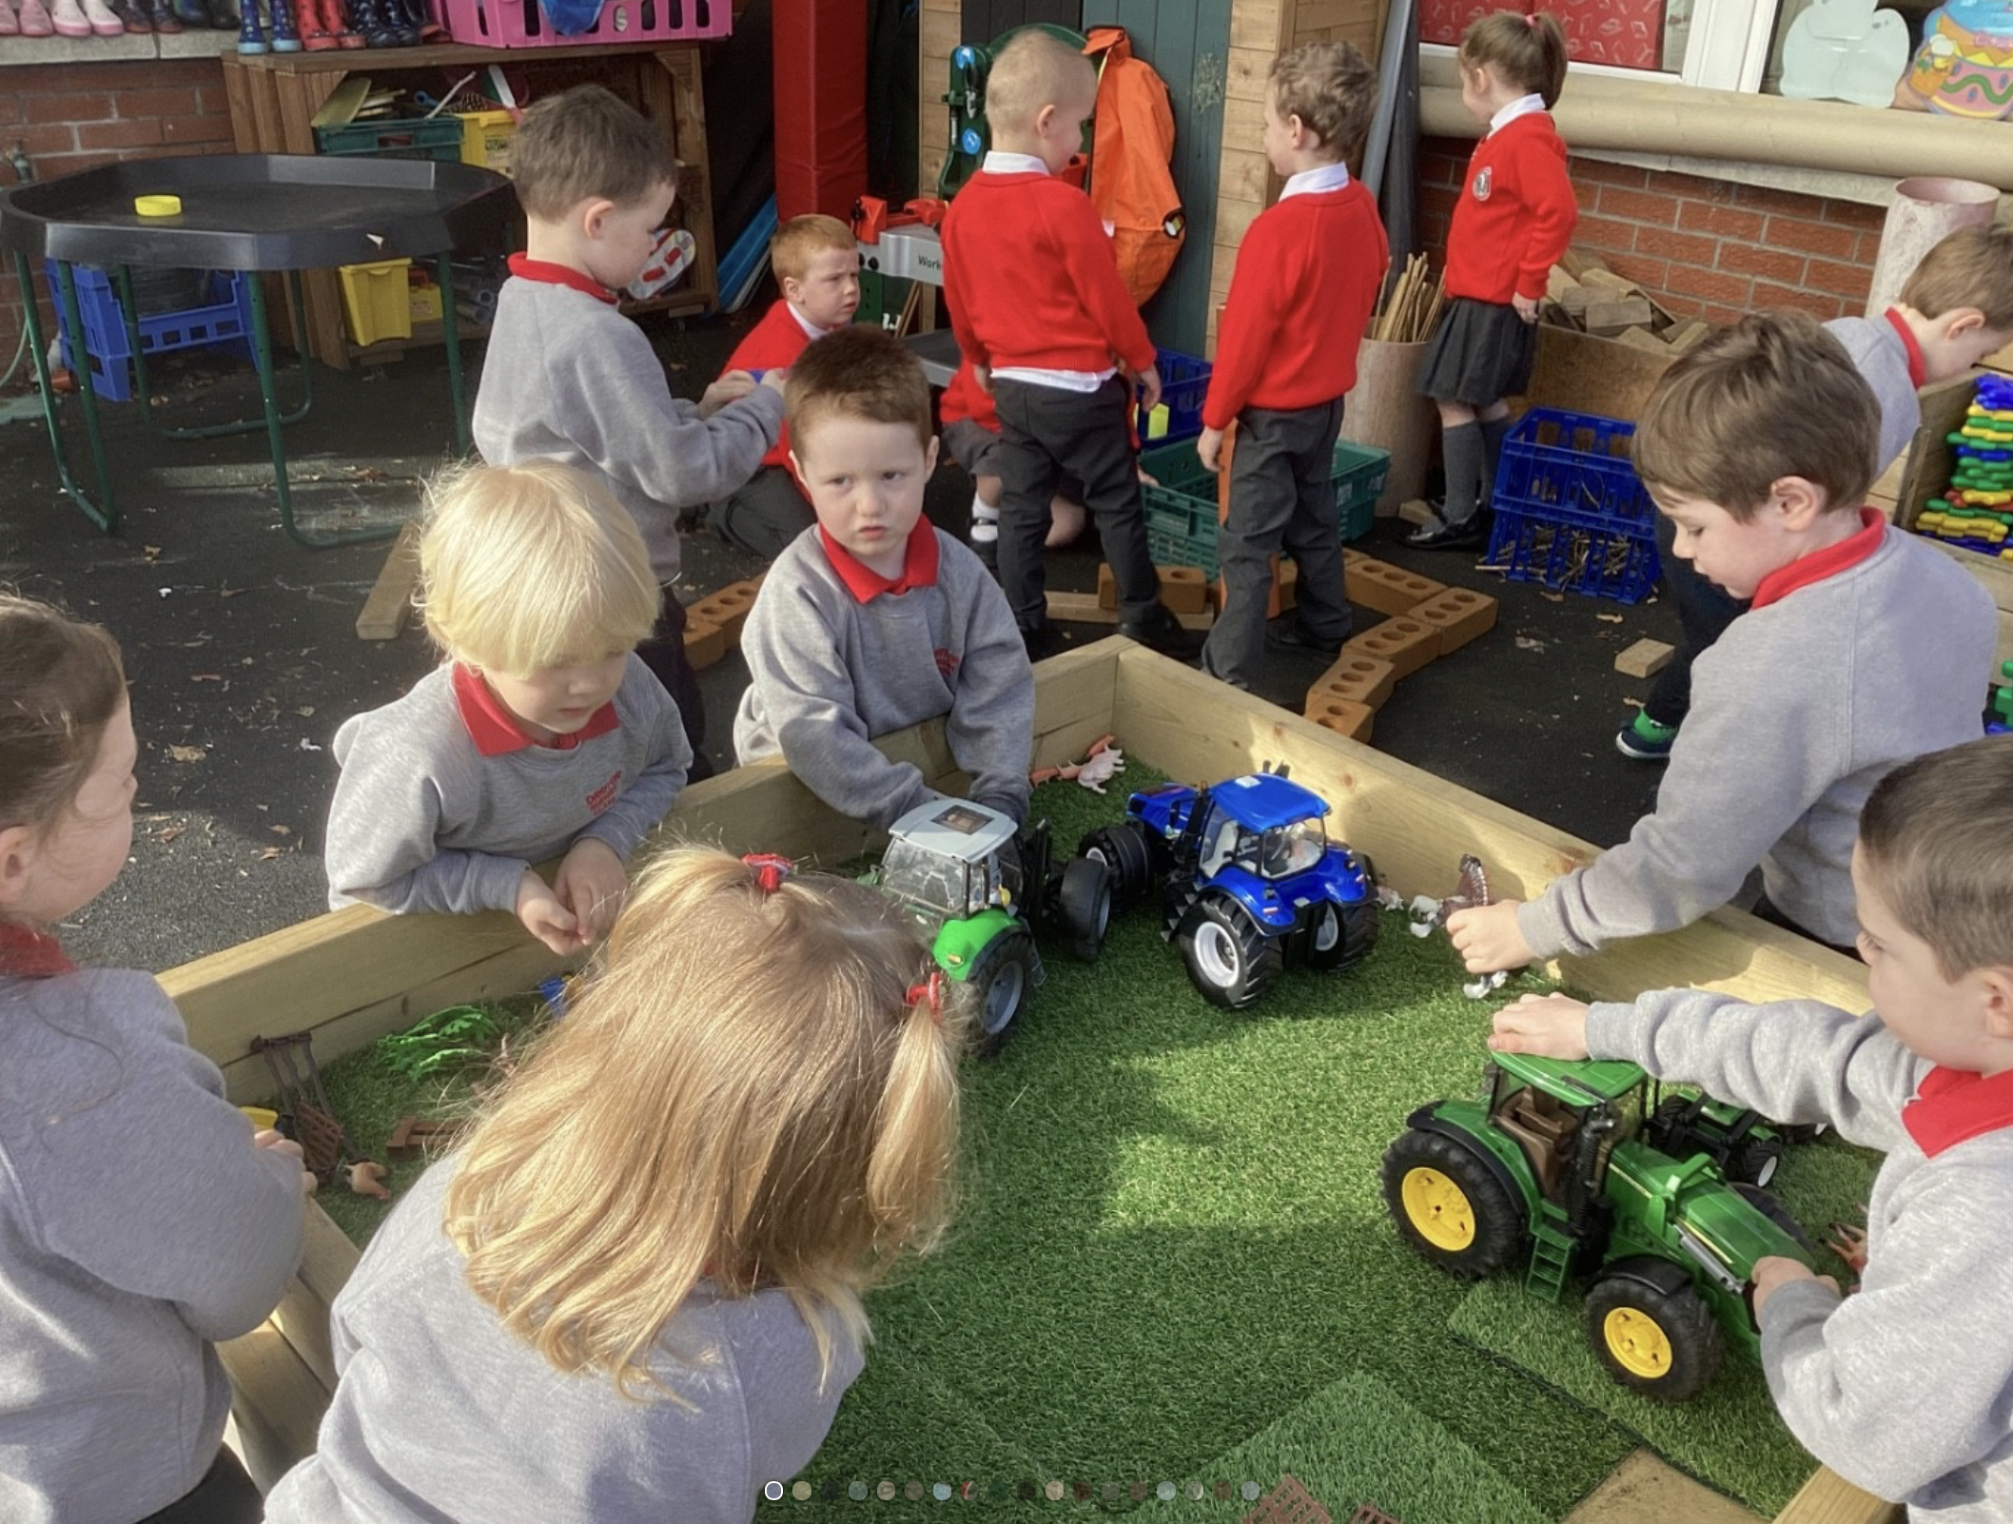
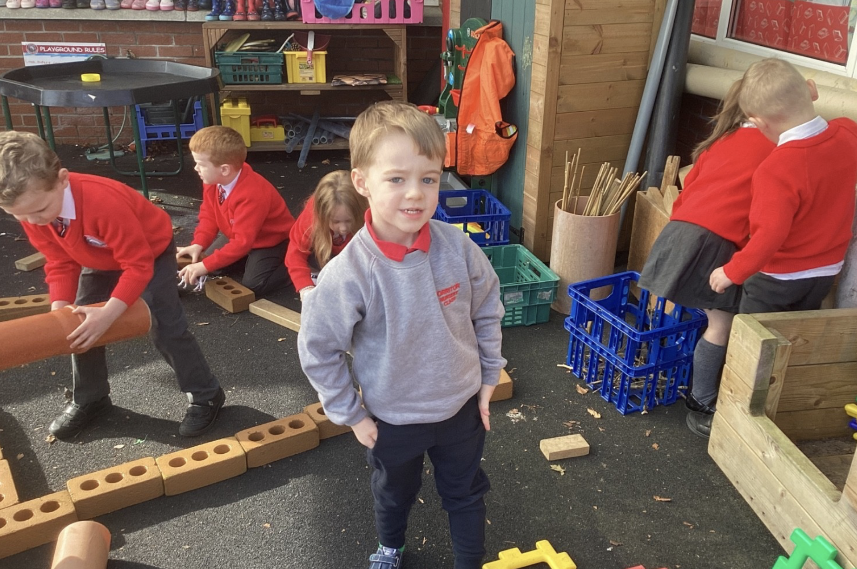
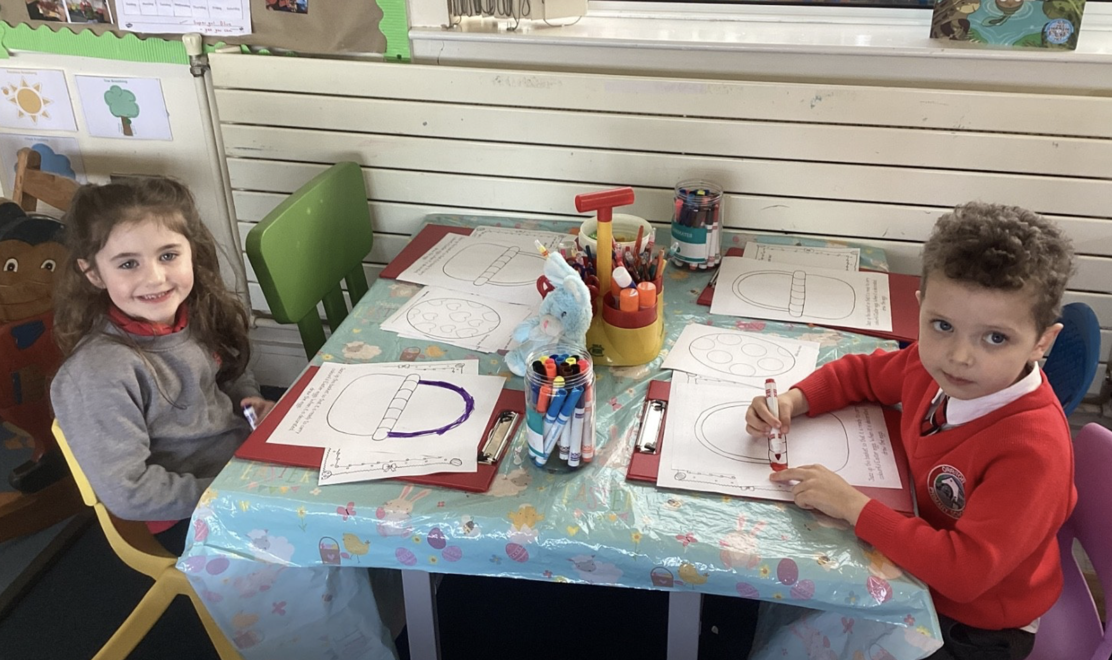
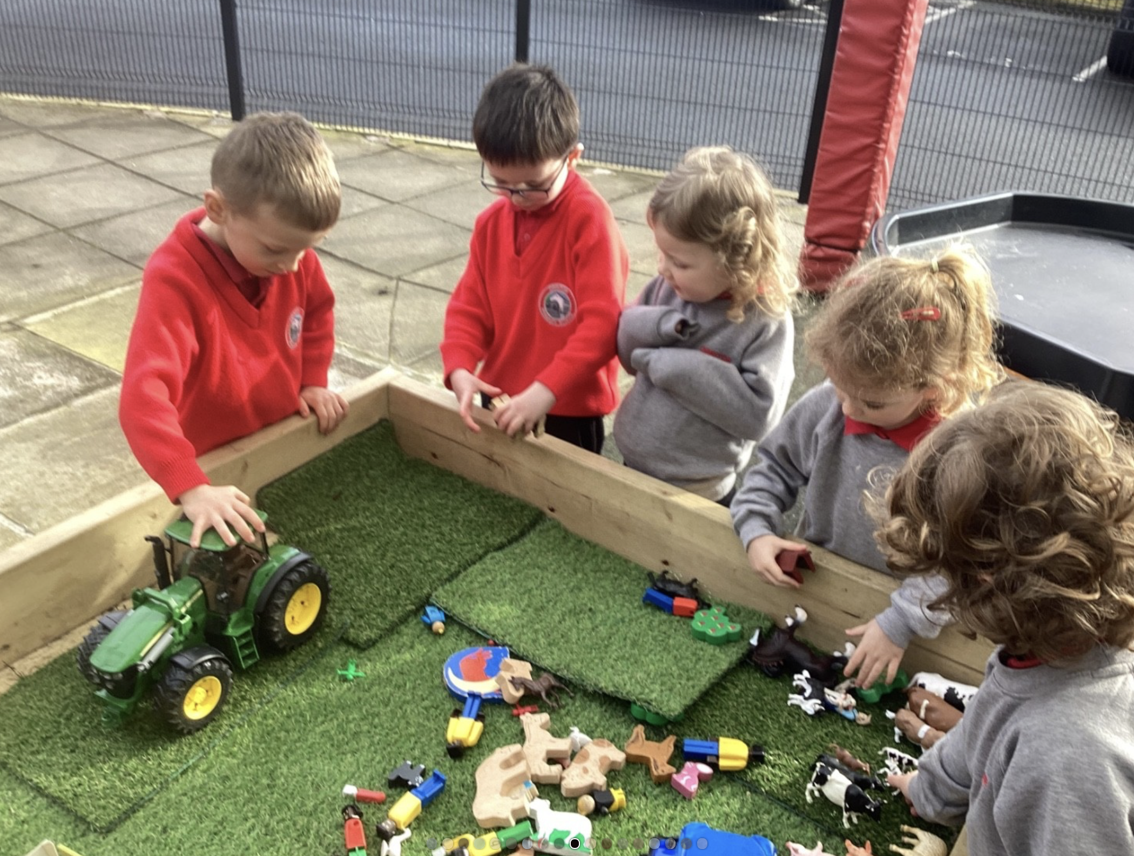
Links with Primary
1 and Nursery

Slide 12
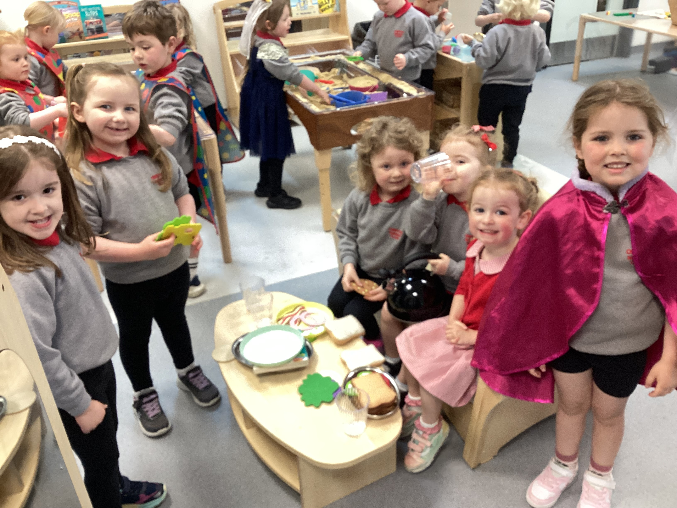
Contact with Parents
BOG Report and AGM
Notes/Letters
Policies
www.orritorps.co.uk
Seesaw
Parent Support Group
Absence – completed through the school app
Annual Report
Parent/Teacher Interviews
Facebook
Parent App (iOS or Google Store)

Slide 13
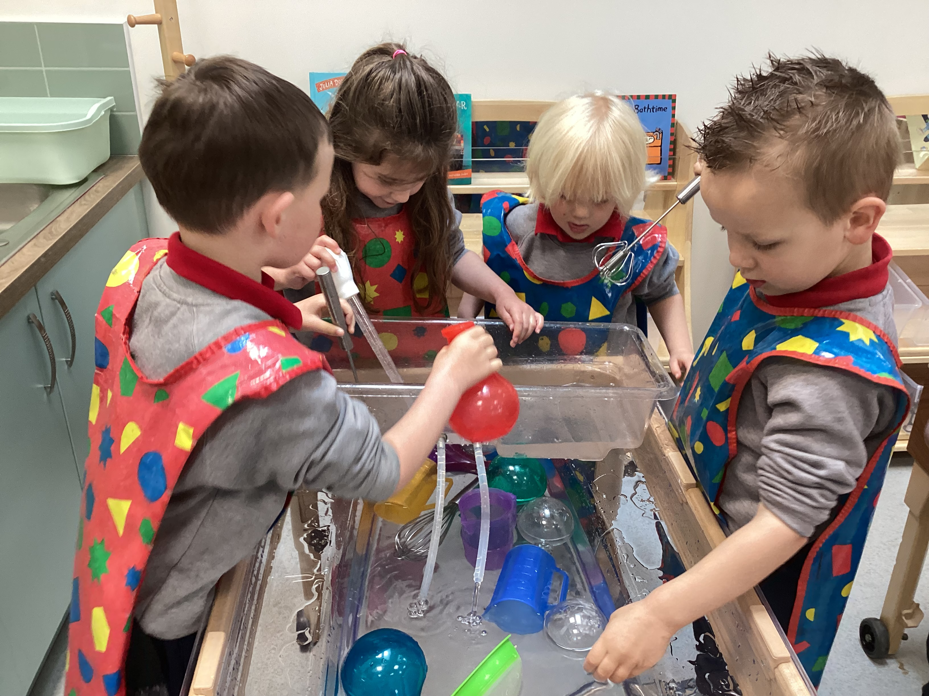
Encouraging Independence
Self-help skills
Toilet and hand washing
Undressing/dressing for outdoor play
Putting on shoes
Taking off/putting on coat
Packing, zipping school bags
Tidying up

Slide 14
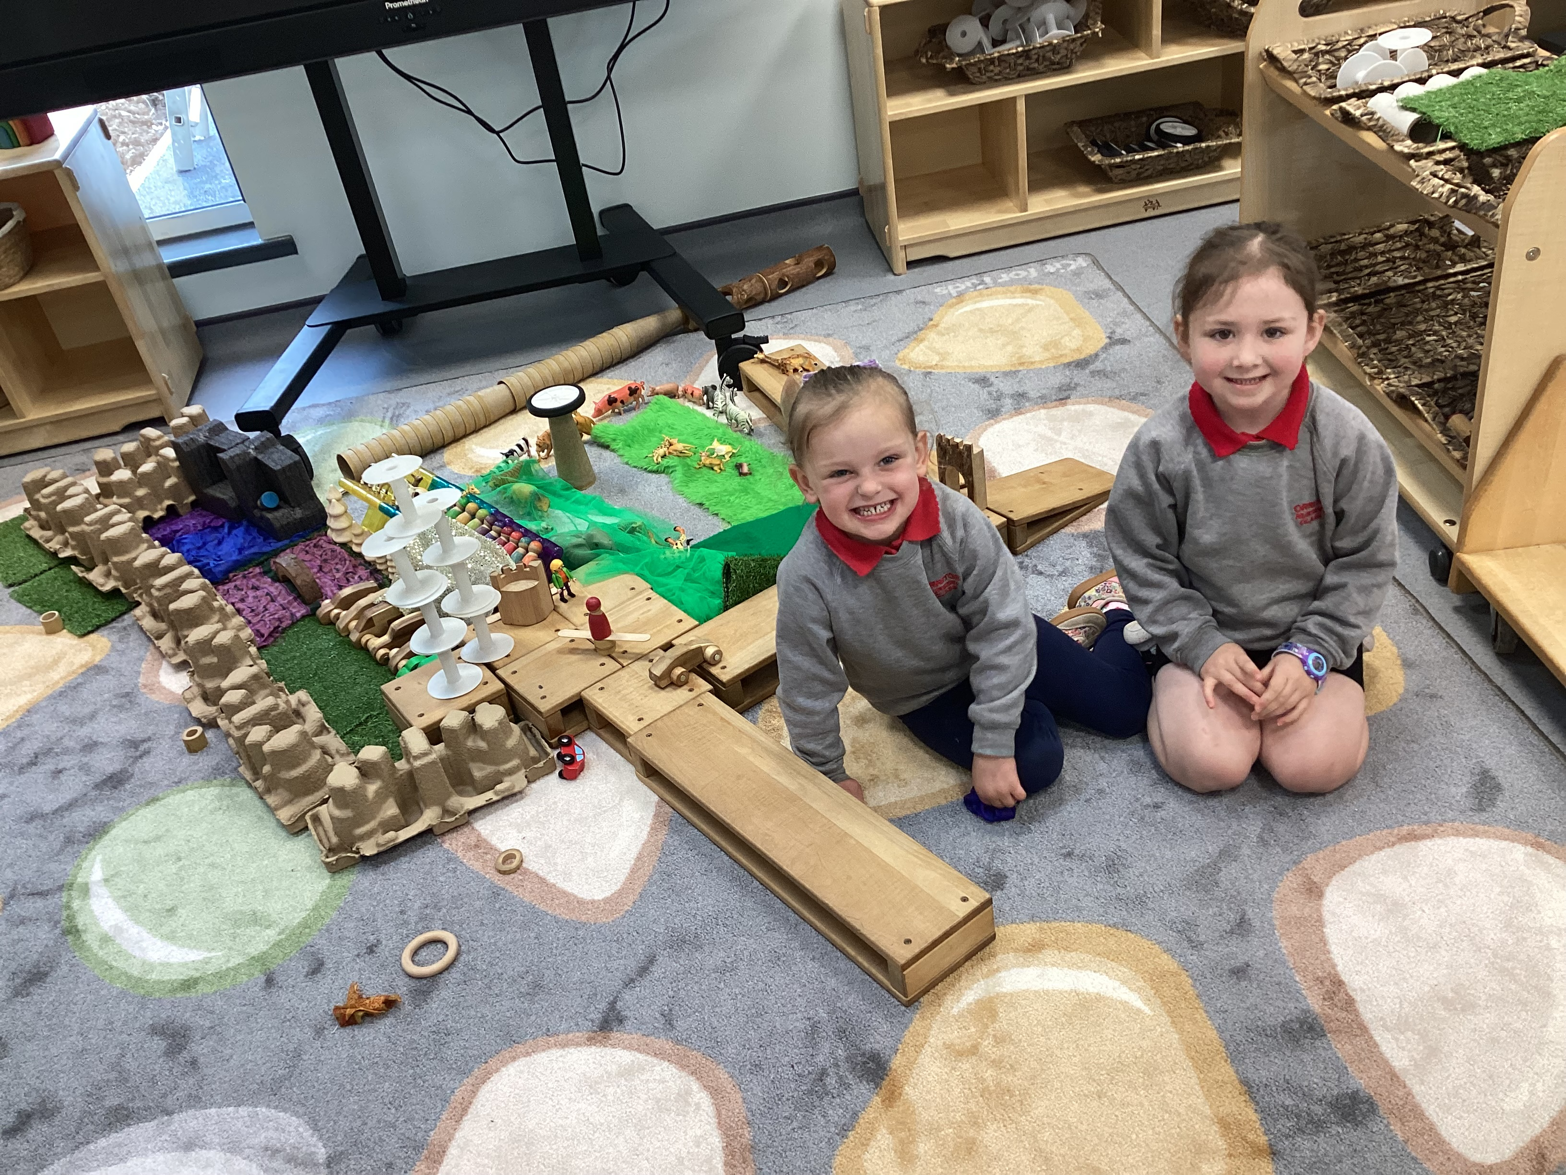
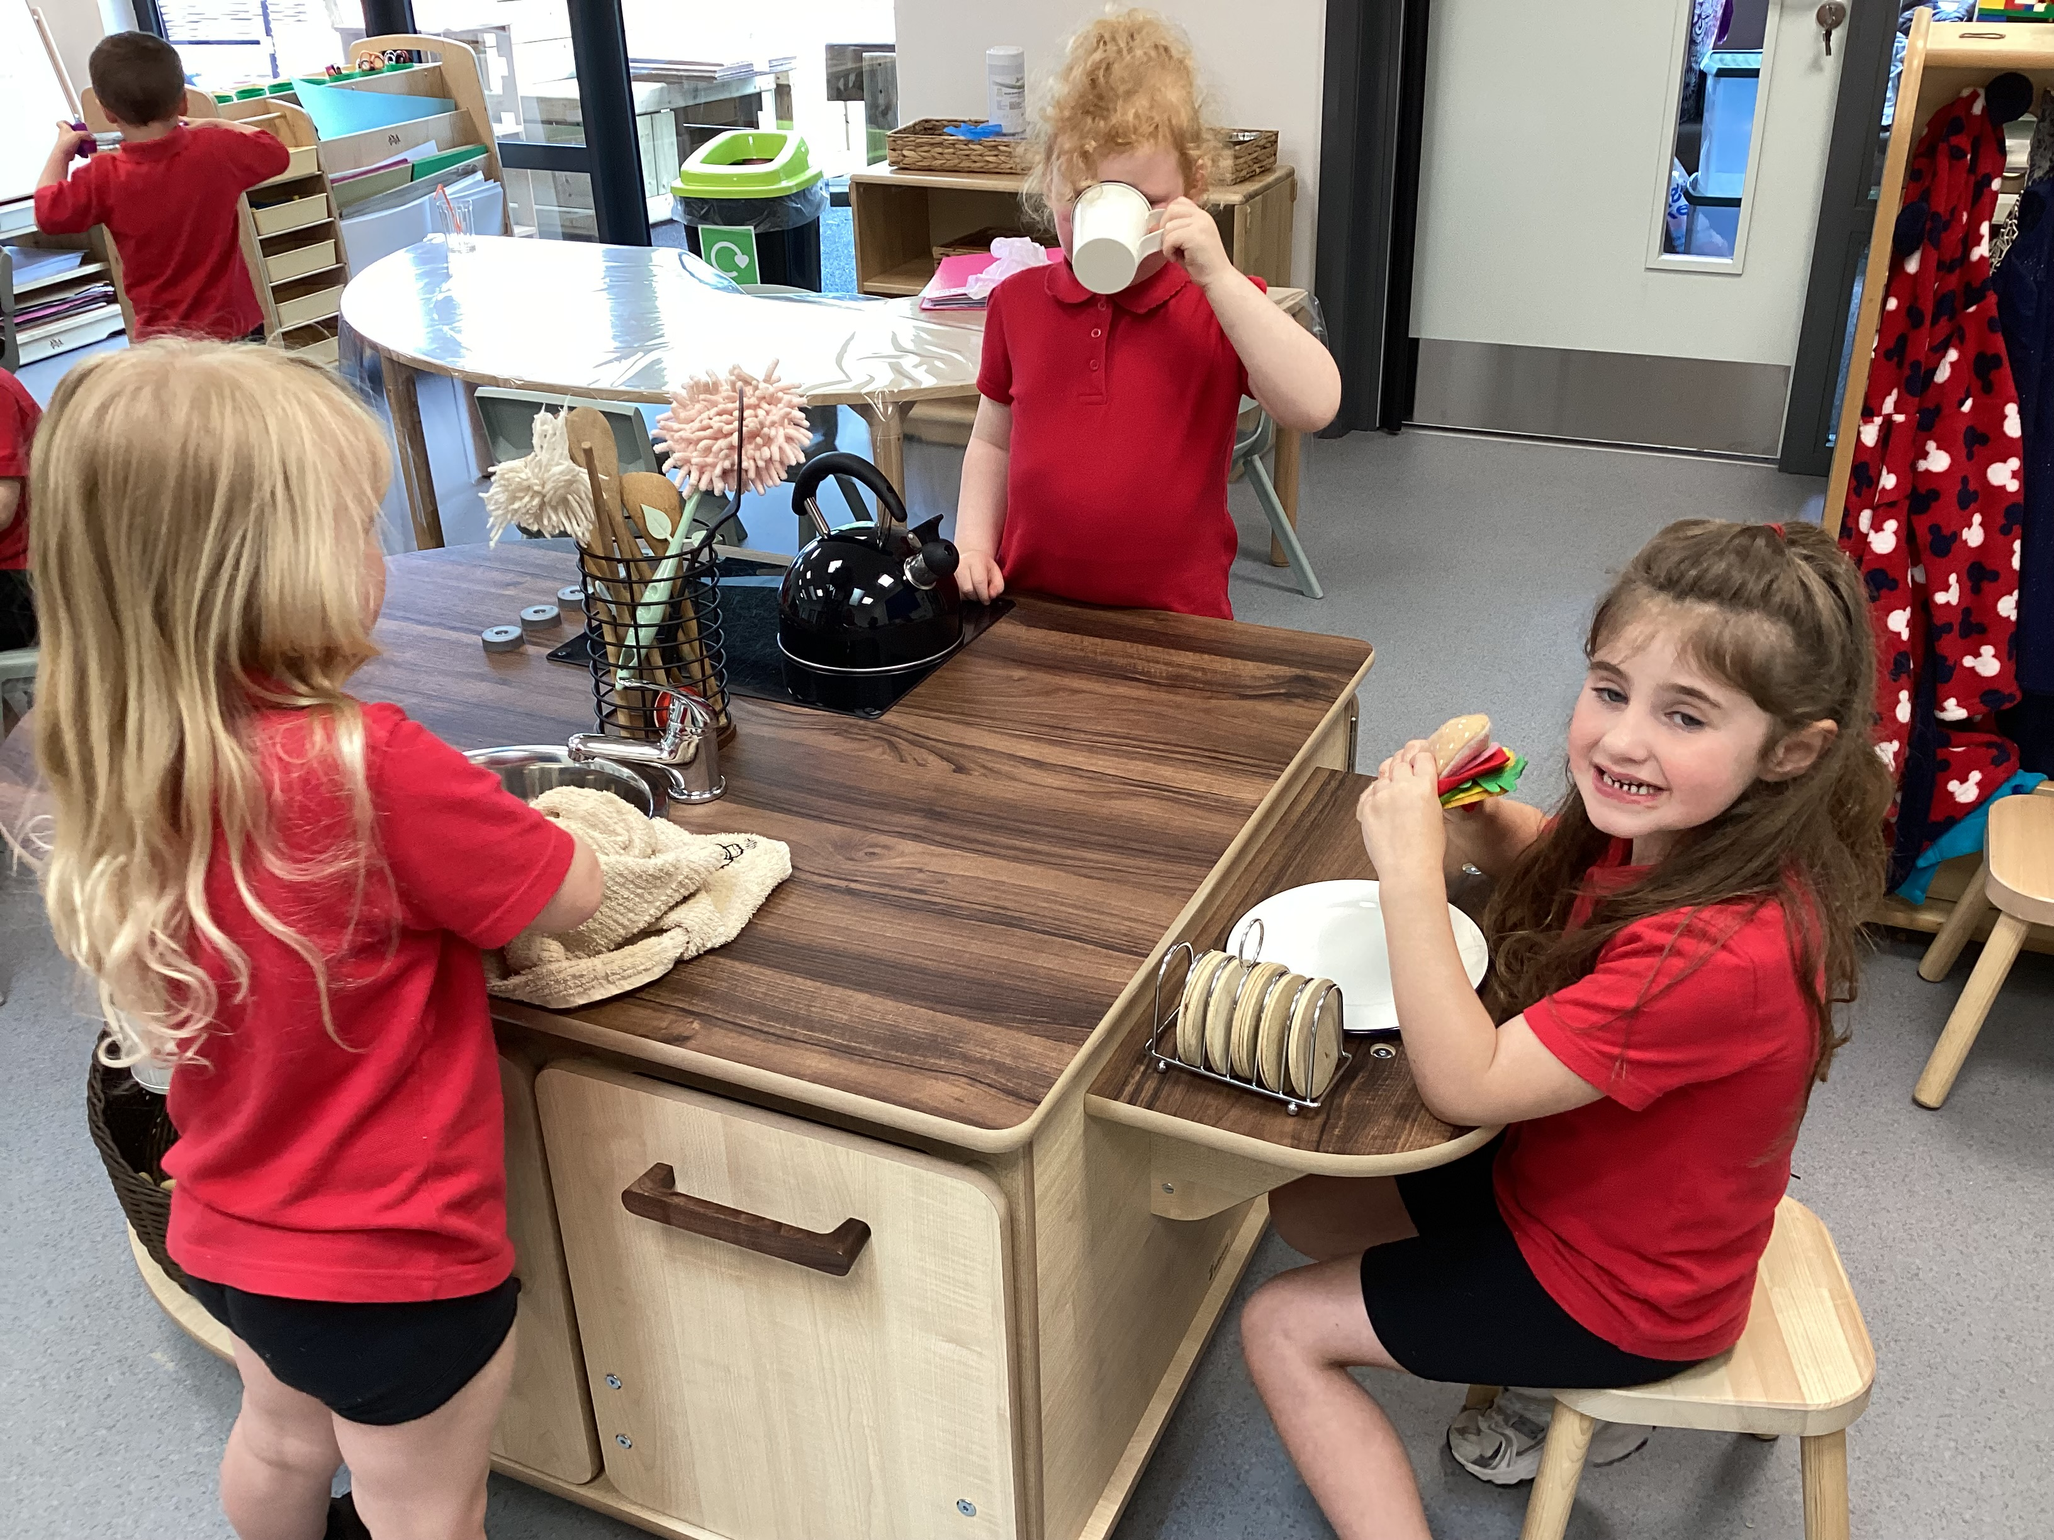
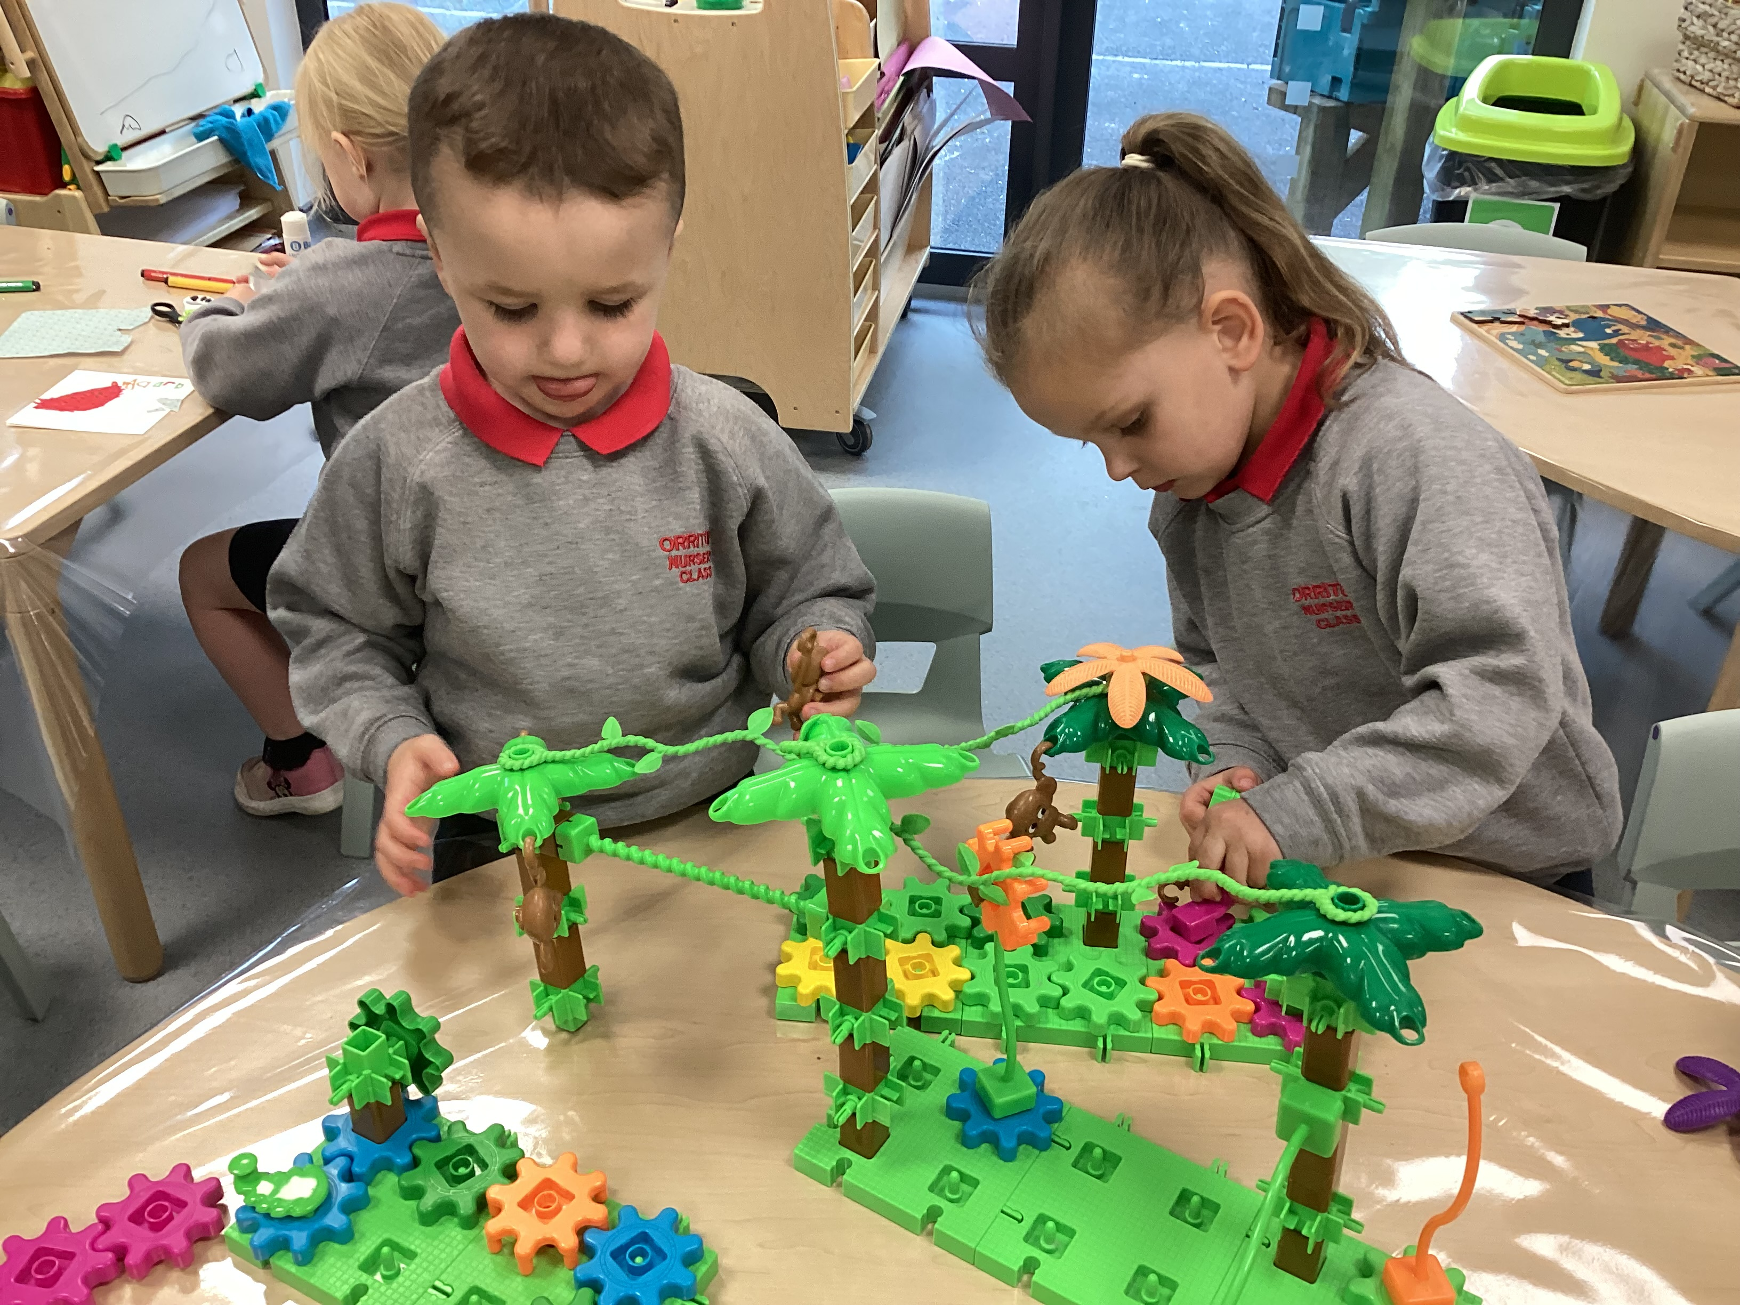

Slide 15
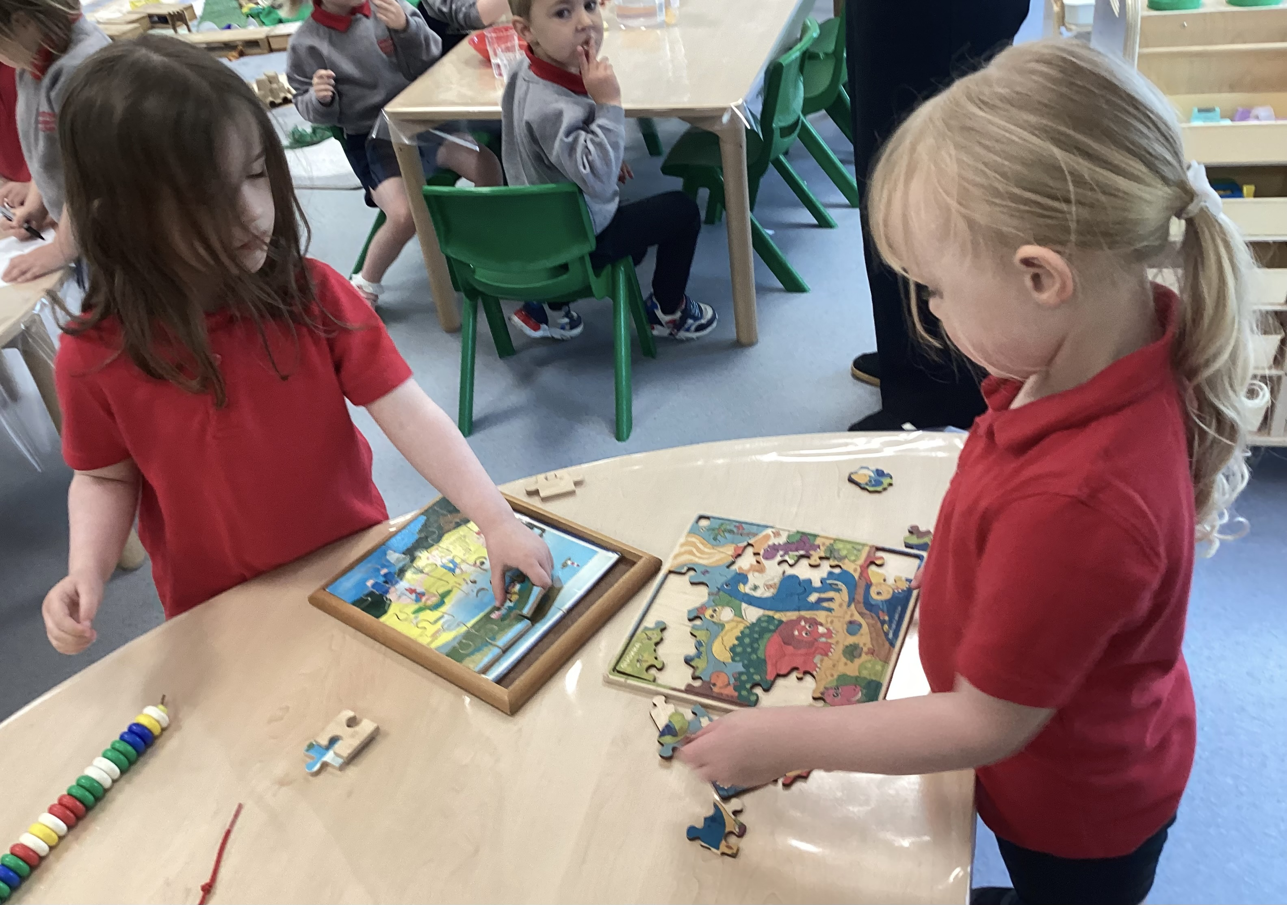
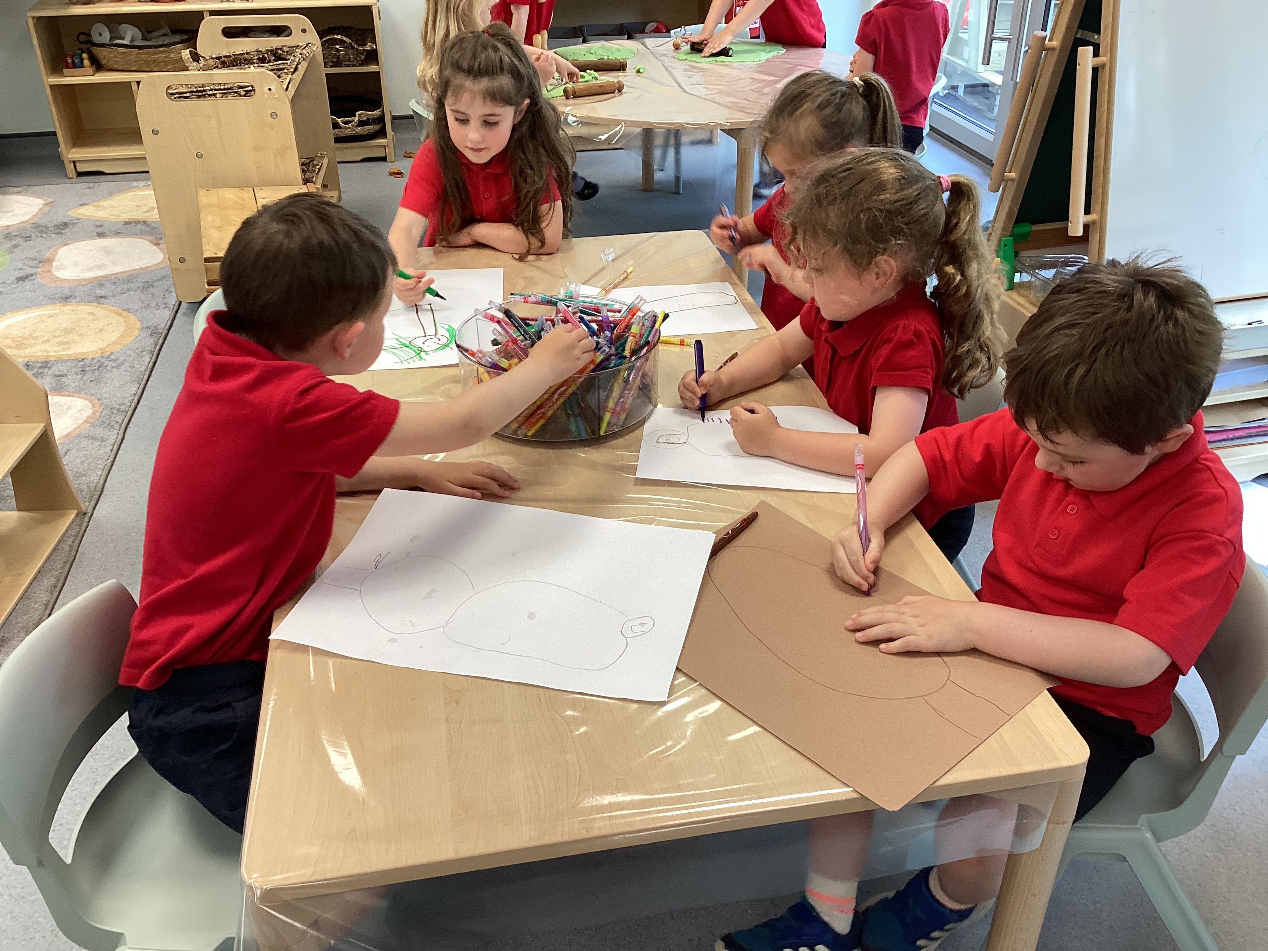
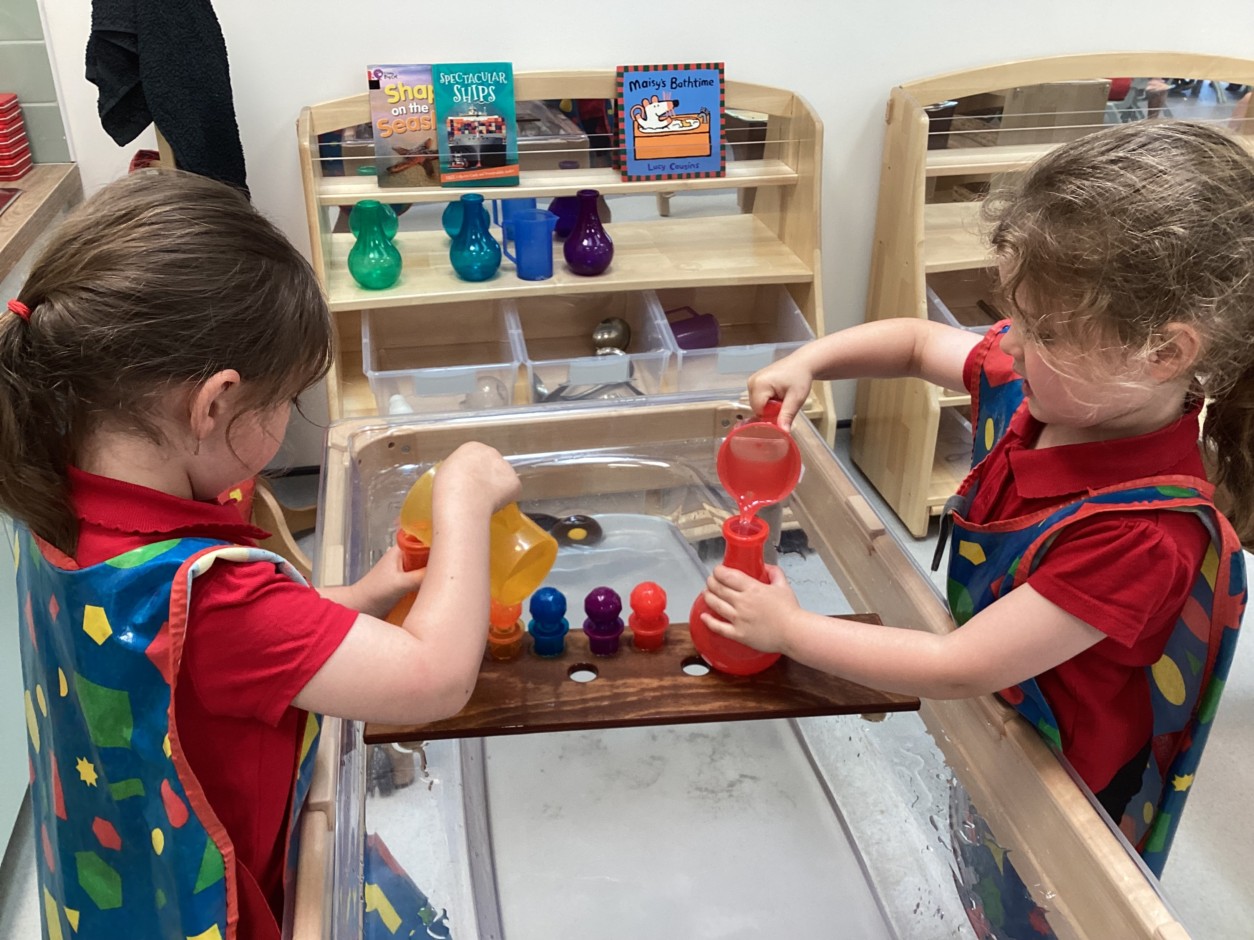

Slide 16
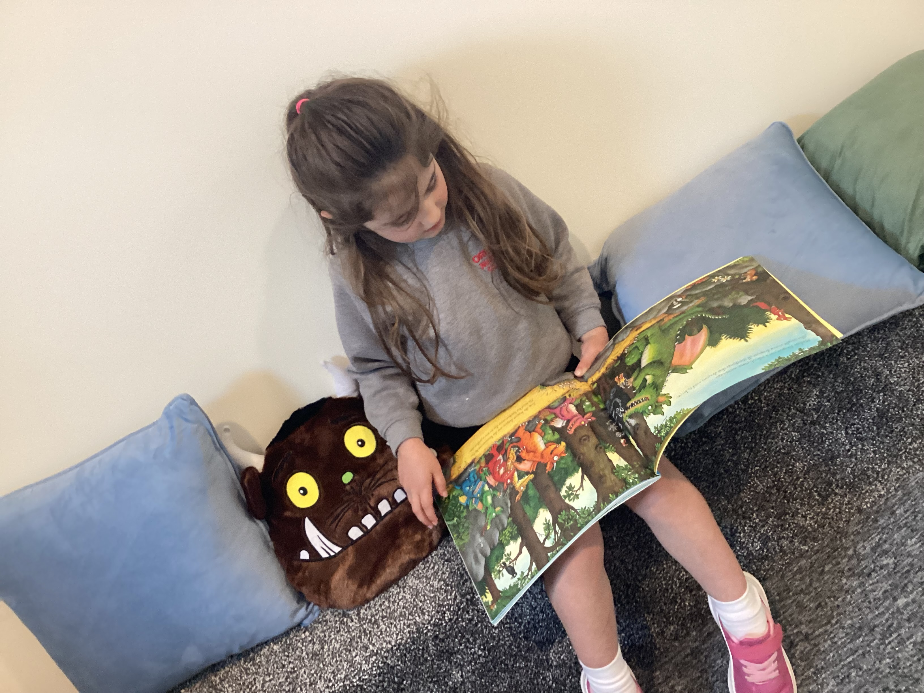
Housekeeping
Child absence
Main contacts and information
Changes at home which may impact pupils
Allergies or medical conditions
Naming all clothing and belongings
Money should be paid on time

Slide 17
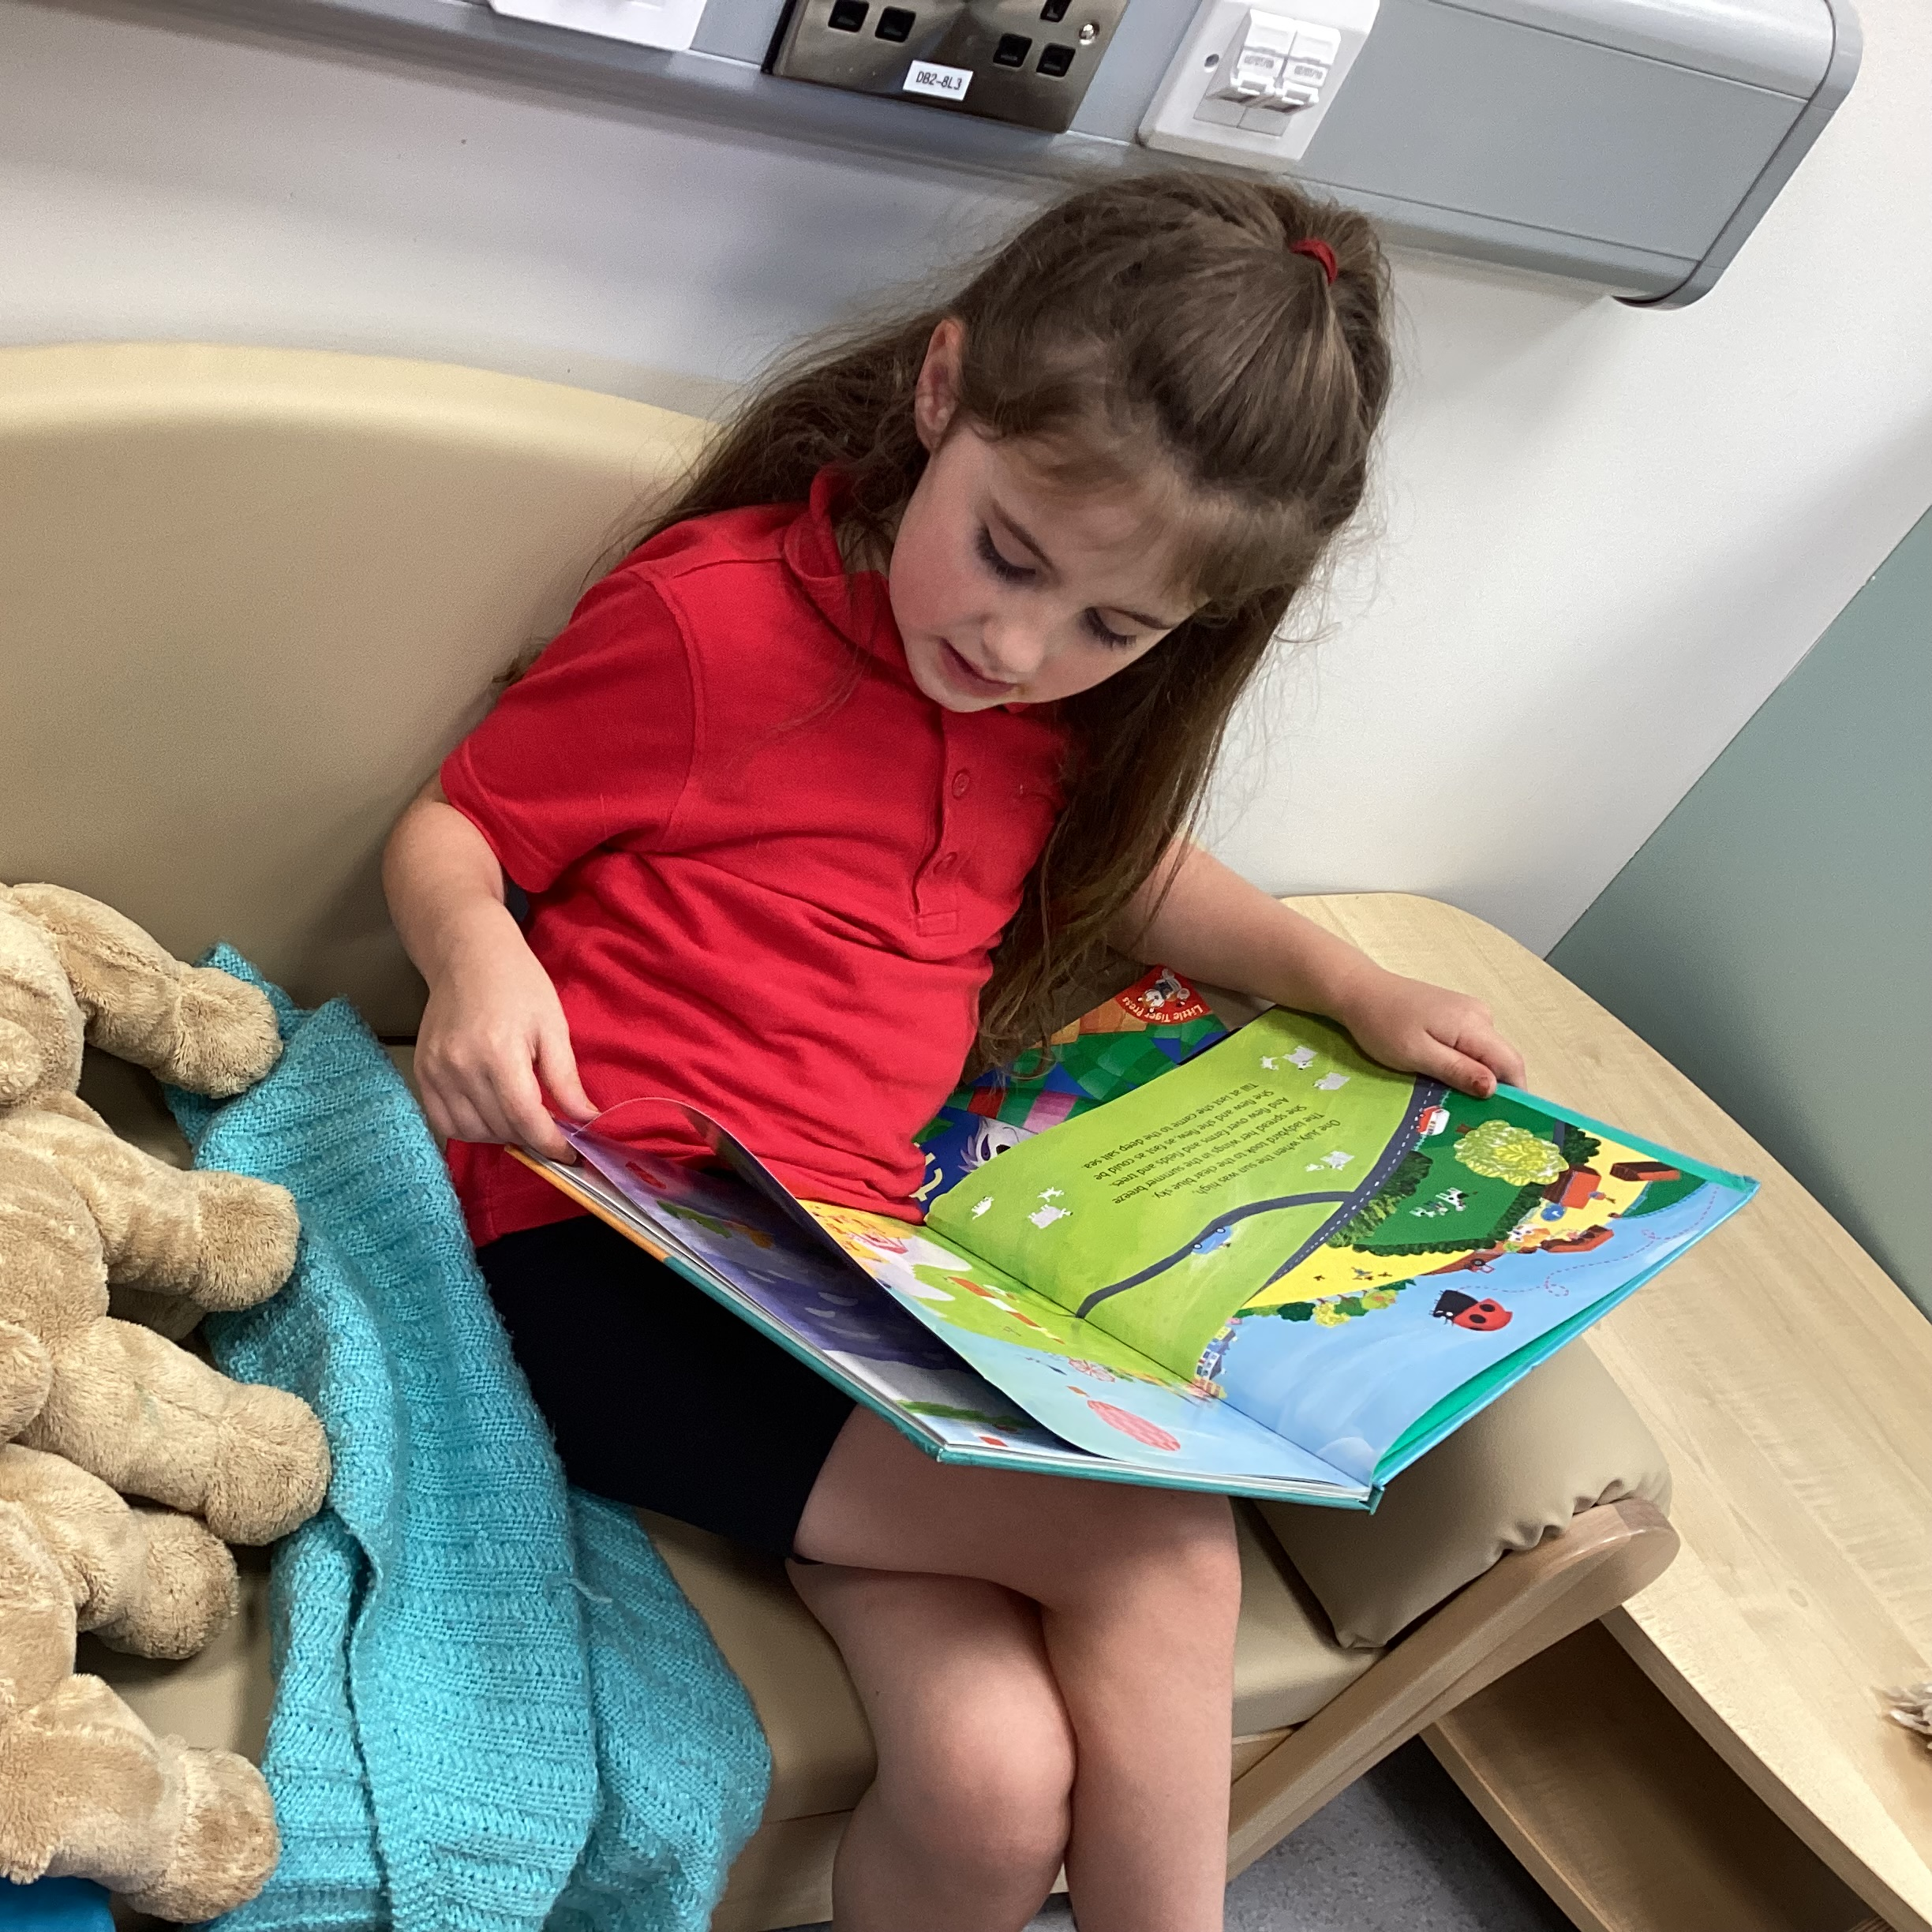
Nursery Information Pack
Data Collection Form
Policies
    Complaints Policy
    Safeguarding and Child Protection Policy
Holiday List
School App Information
SeeSaw Codes

Slide 18

Thank you for Listening!
icheevers766@c2ken.net

